Slide 1
Linked Open Data
Linked Data Web that can be processed by
machines

Slide 2
The Concept of Linked Data
Originally proposed by Tim Berners-Lee in 2006
Data published on the Web in such a way that it is machine-readable
The basic idea:
Use the RDF data model to publish structured data on the Web.
Use RDF links to interlink data from different data sources.

Slide 3
Linked Data Web vs. Traditional Web
Linked Data Web
Traditional Web
Anyone can publish anything at his/her will, at any time.
Publish RDF documents
Access with browsers that can navigate RDF links
Typed hyperlinks
Anyone can publish anything at his/her will, at any time.
Publish HTML documents
Access with web browsers
Untyped hyperlinks

Slide 4
The Basic Rules of Linked Data
Rule 1. Use URIs as names for things.
Rule 2. Use HTTP URIs so that a client (machine or human reader) can look up these names.
Rule 3. When someone looks up a URI, useful information should be provided.
Rule 4. Include links to other URIs, so that a client can discover more things.
For a given resource or concept we should use a unique and universal name to identify it.
Avoids:
The same name in different documents referring to completely different resources or concepts.
A given resource or concept being represented by different names in different documents.

Slide 5
The Basic Rules of Linked Data
Rule 1. Use URIs as names for things.
Rule 2. Use HTTP URIs so that a client (machine or human reader) can look up these names.
Rule 3. When someone looks up a URI, useful information should be provided.
Rule 4. Include links to other URIs, so that a client can discover more things.
Puts one more constraint on the first rule by specifying that not only should we use URIs to represent objects and concepts, we should also only use HTTP URIs.
Makes sure that data publishers can come up with identifiers that are globally unique without involving any centralized management.

Slide 6
The Basic Rules of Linked Data
Rule 1. Use URIs as names for things.
Rule 2. Use HTTP URIs so that a client (machine or human reader) can look up these names.
Rule 3. When someone looks up a URI, useful information should be provided.
Rule 4. Include links to other URIs, so that a client can discover more things.
At the early days of the Semantic Web, this was not always true: when a given URI was used in a browser, there might or might not be any information coming back at all.

Slide 7
The Basic Rules of Linked Data
Rule 1. Use URIs as names for things.
Rule 2. Use HTTP URIs so that a client (machine or human reader) can look up these names.
Rule 3. When someone looks up a URI, useful information should be provided.
Rule 4. Include links to other URIs, so that a client can discover more things.
Make sure the Linked Data world will grow into a real Web: without the links, it will not be a Web of data.

Slide 8
Publishing RDF Data on the Web
Step 1: Identifying things by using URIs
Information resources vs. non-information resources
Be unambiguous: There should be no confusion between identifiers for Web documents and identifiers for other resources.
A given URI should give both humans and machines a description about the resource identified. HTML for humans, RDF for machines.
303 and content negotiation. Accept: text/html or Accept: application/rdf+xml
Hash URI. http://www.liyangyu.com/foaf.rdf#liyang. Does not identify a Web document, identifies a non-information resource.

Slide 9
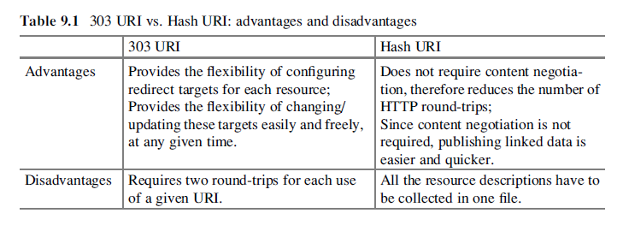
Publishing RDF Data on the Web
Step 1: Identifying things by using URIs

Slide 10
Publishing RDF Data on the Web
Step 1: Identifying things by using URIs
URI Aliases
<owl:sameAs rdf:resource¼"http://identi.ca/user/45563"/>

Slide 11
Publishing RDF Data on the Web
Step 2: Choosing vocabularies for RDF data
Always try to use terms defined in one or more ontologies.
Instead of inventing your own ontology, you should always use the terms from well-known existing ontologies:
  Friend-of-a-Friend (FOAF): terms for describing people
  Dublin Core (DC): terms for general metadata attributes
  Semantically-Interlinked Online Communities (SIOC): terms for describing online communities
  Description of a Project (DOAP): terms for describing projects
  Music Ontology: terms for describing artists, albums and tracks
  Review Vocabulary: terms for representing reviews

Slide 12
Publishing RDF Data on the Web
Step 3: Producing RDF statements to describe the things
Describe the things, I suppose. The text book skipped this one…

Slide 13
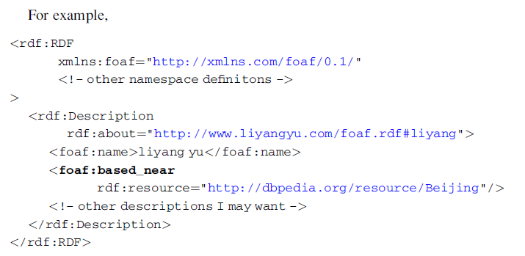
Publishing RDF Data on the Web
Step 4: Creating RDF links to other RDF data sets

Slide 14
Publishing RDF Data on the Web
Step 4: Creating RDF links to other RDF data sets
Creating links manually
  Understand the available linked datasets by studying available datasets. http://lod-cloud.net/
  Find the URIs as your linking targets
Creating links automatically
  At the time of this writing, there is still a lack of good and easy-to-use tools to automatically generate RDF links.
  Domain specific algorithms.

Slide 15
Publishing RDF Data on the Web
Step 5: Serving your RDF triples on the Web
Your Web server must be able to recognize the MIME-type application/rdf+xml.
Your Web server has to implement the 303 redirect, unless you choose hash URIs.
You should include links to other data sources, so a client can continue its navigation when it visits your data file.
You should also make sure there are external RDF links pointing at URIs contained in your data file.
http://vapour.sourceforge.net/ Validator.

Slide 16
Publishing RDF Data on the Web
Steps:
Identifying things by using URIs.
Choosing vocabularies for RDF data.
Producing RDF statements to described the things.
Creating RDF links to other RDF data sets.
Serving your RDF triples on the Web.

Slide 17
The Consumption of Linked Data
There are search engines
Browsers
Other applications
Semantic Web Search Engine for Human Eyes

Slide 18
