Slide 1

Rollen til fleksibel etterspørsel i avkarbonisering av det europeiske kraftsystemet
Christian Skar
Department of Industrial Economics and Technology Management
Norwegian University of Science and Technology (NTNU)

Slide 2
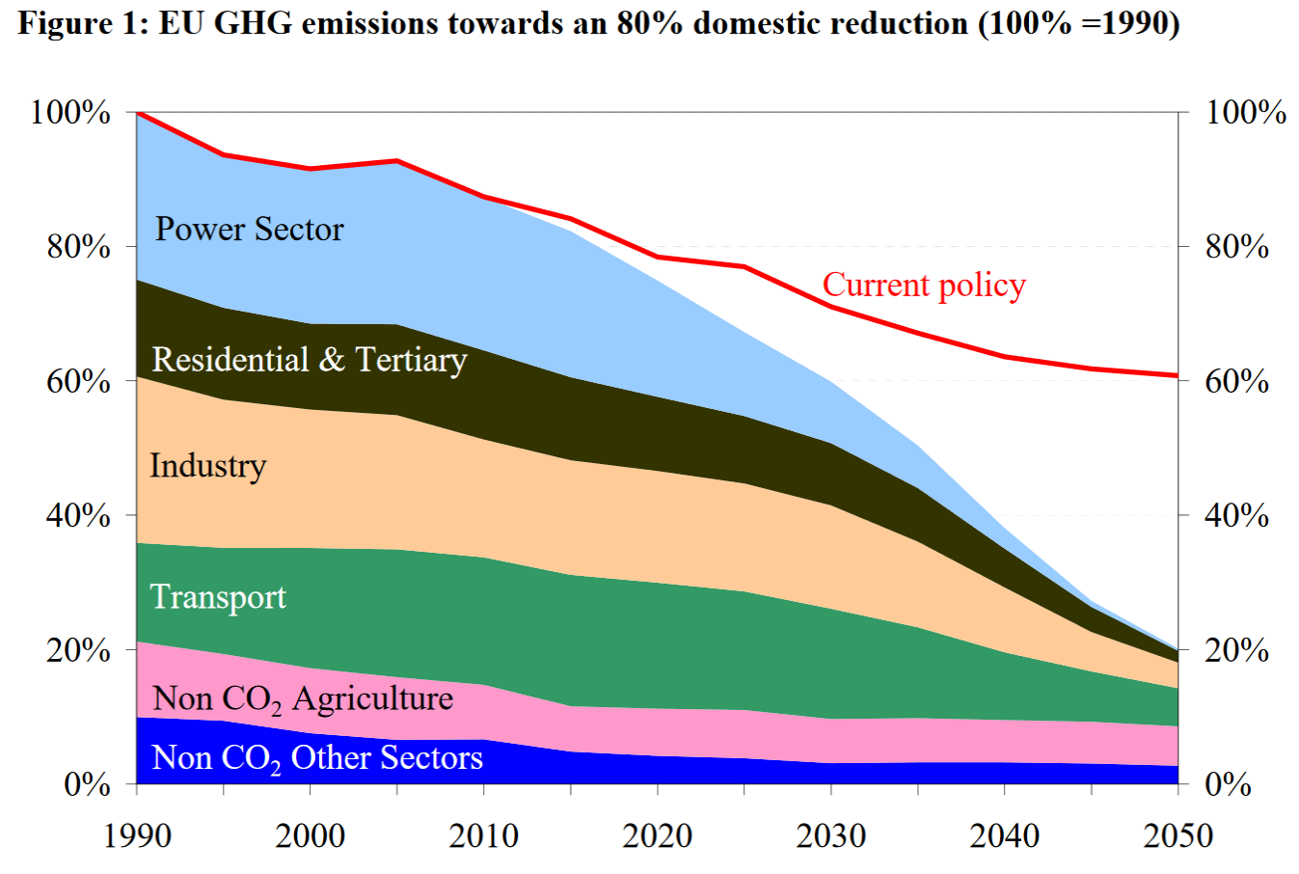
Backdrop: European Commission's view of a low-carbon Europe
By 2050: Near full decarbonization of power
Today: almost 25 % of total emissions from power generation
Source: European Commission. (2011). A Roadmap for moving to a competitive low carbon economy in 2050. Communication from The Commission to The European Parliament, The Council, The European Economic and Social Committee and The Committee of The Regions, COM(2011).

Slide 3
The challenge for Zero Emission Power Systems
- Intermittent generation and variable load

Slide 4
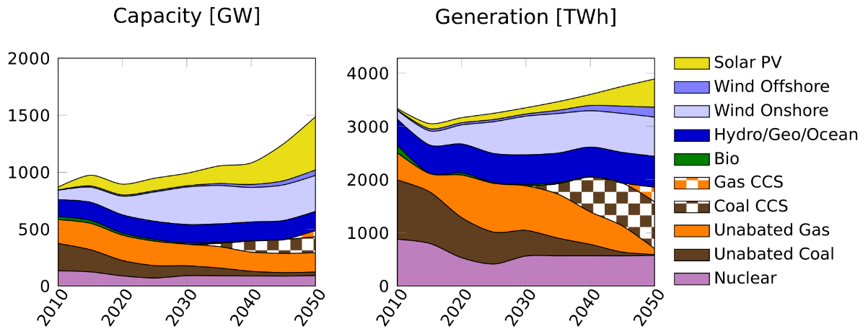
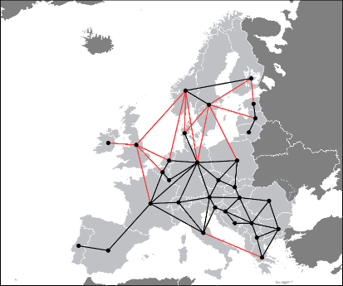
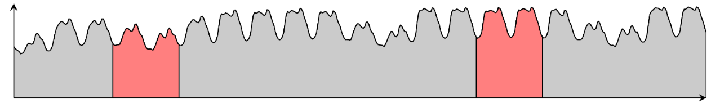
Co-optimization of strategic and operational decisions
Optimal investment strategy 2010-2015
Coupled optimization problem to minimize total system costs
Optimal dispatch for representative 48-hour blocks

Slide 5
Scenario assumptions
Baseline decarbonization: 90 % emission reduction from 2010 to 2050
  Nuclear capacities limited to the ENTSO-E vision 1&2 (medium nuclear) scenarios in the 2016 Ten Year Development Plan (TYDP) .
  Grid expansion towards 2020 fixed to ENTSO-E’s 2016 TYDP reference capacities. No more transmission investments beyond
  Development of Norwegian hydro power predefined
  Wind onshore capacity potential from IEA’s NETP 2016
Alternative scenario NoCCS: same as baseline but no carbon capture and storage available

Slide 6
Optimistic assumptions for “decentral” technologies
Source: Cole, W. J., Marcy, C., Krishnan, V. K., & Margolis, R. (2016). Utility-scale lithium-ion storage cost projections for use in capacity expansion models. DOI:doi.org/10.1109/NAPS.2016.7747866
Source: Gerbaulet, C., & Lorenz, C. (2017). dynELMOD: A dynamic investment and dispatch model for the future European electricity market. DIW Data Documentation (Vol. 88). Berlin.
Assumptions in line with optimistic scenarios in recent high-level studies
  PV: Fraunhofer ISE. (2015). Current and Future Cost of Photovoltaics. Long-term Scenarios for Market Development, System Prices and LCOE of Utility-Scale PV Systems. Agora Energiewende.
  Batteries: Schmidt, O., Hawkes, A., Gambhir, A., & Staffell, I. (2017). The future cost of electrical energy storage based on experience rates. Nature Energy, 6(July), 17110. DOI:10.1038/nenergy.2017.110

Slide 7
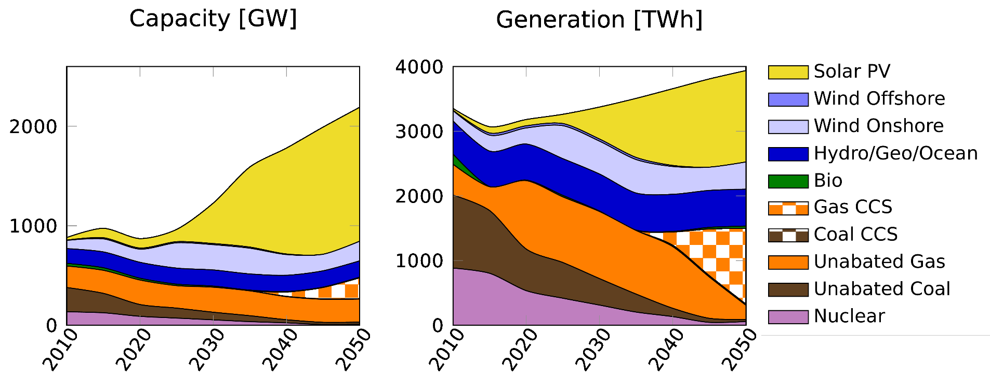
Baseline scenario: 90 % emission reduction
Technology/fuel (2050) | Capacity [GW] | Generation [TWh]
Solar | 1346 (61%) | 1413 (36%)
Wind | 198 (9%) | 421 (11%)
Gas CCS | 212 (10%) | 1172 (30%)
Coal CCS | 3 (0%) | 17 (0%)
Fossil unabated | 254 (12%) | 251 (7%)
Others | 179 (8%) | 663 (16%)
Battery energy storage by 2050:
1366 GWh

Slide 8
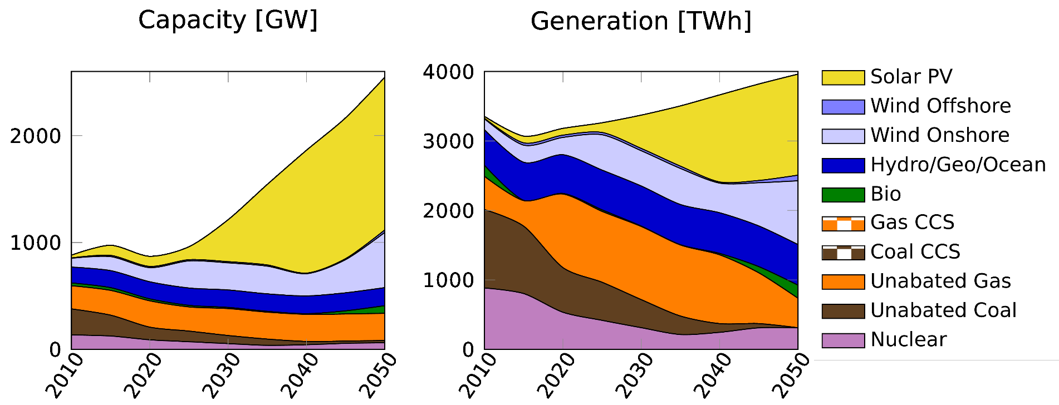
NoCCS scenario: 90 % emission reduction
Technology/fuel (2050) | Capacity [GW] | Generation [TWh]
Solar | 1429 (56%) | 1454 (37%)
Wind | 540 (21%) | 999 (25%)
Gas CCS
Coal CCS
Fossil unabated | 275 (11%) | 425 (11%)
Others | 303 (12%) | 1083 (28%)
Battery energy storage by 2050:
1963 GWh

Slide 9
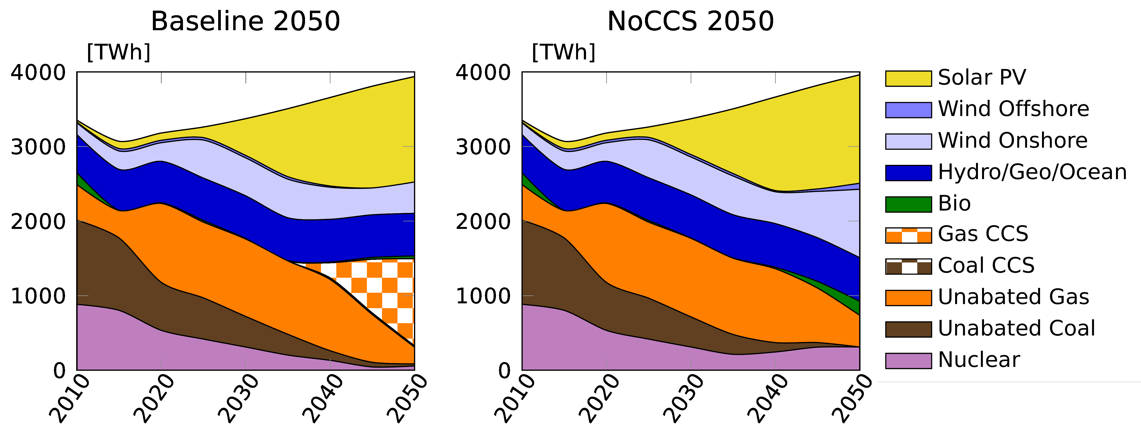
Transition to a low-carbon European power sector
Without CCS, decarbonization achieved through a diverse mix of
Wind
Bio
Unabated gas
Nuclear
Solar PV remains roughly at the same level as in the Baseline
Increased shared of unabated natural gas in the medium term. Due to
Retirement of nuclear and coal
Increasingly restrictive carbon constraints
Still high RES costs
Natural gas continues to be a significant fuel towards 2050, with CCS beyond 2040-2045.
Solar investments starts taking off by 2025-2030, Cost between 325-540 €/kW

Slide 10
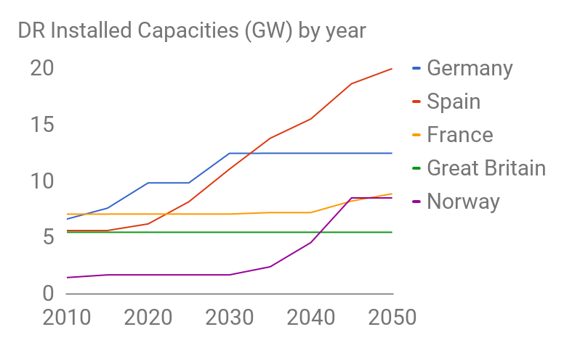
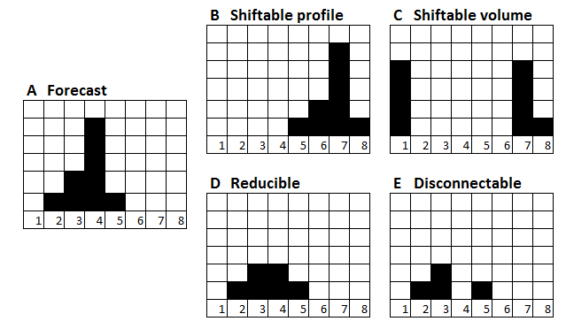
New drivers: Active consumers and distributed generation
Demand response module in testing
Notes:
Distributed generation
Generation (renewable) connected to the distribution system.
Rethinking system design: not just a question of moving electricity in bulk from large power plants to load centers
High shares of intermittent renewable generation.
Unpredictable generation
Needs to be balanced -> excess generation exported, deficit generation imported
Transmission and storage

Slide 11
Notes:
However, the capacity mixes of individual countries are more sensitive to the presence of DR. (That is something to be further investigated). The graph shows the DR capacities evolution of some of the largest European countries. The majority of the countries stays with DR capacities below 3GW.

Slide 12
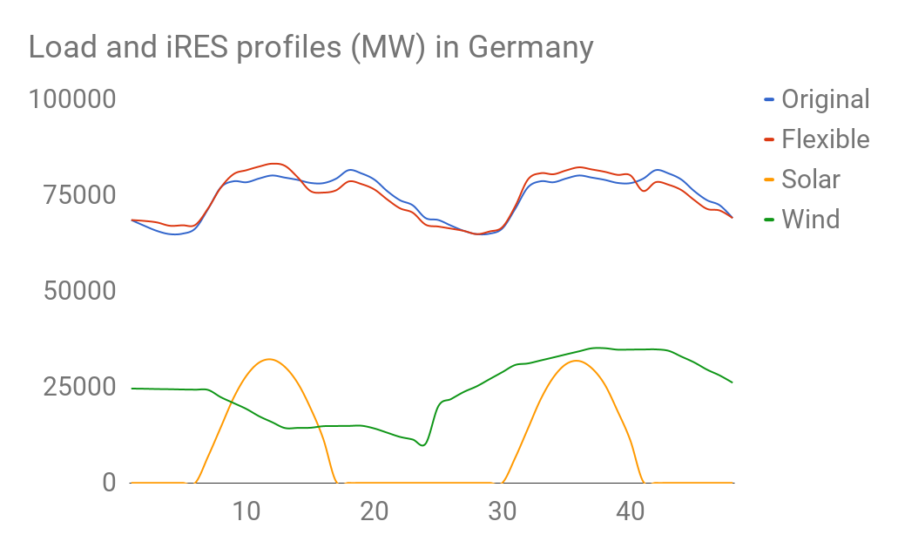
Notes:
The effects of DR loads on the load profiles are noticeable when high production of intermittent renewables (iRES) like wind and solar is available. The blue curve («Original») shows a 48-hours load profile in Germany (in summer) without DR. When DR is ON (Red Curve) some loads are shifted to the hours with solar and wind production.
The shifted load consists of all the DR groups. Identification of the DR groups that shift or curtail more load can be further investigated.

Slide 13
Capacities comparison between DR2 and DR0
The following bar graphs show the main differences in technology capacities in the case with DR (case DR2) and without (case DR0) between year 1 (2010) and year 9 (2050).
The positive y-axis indicate larger capacity in DR2 than in DR0 and viceversa
NOTE: this is for illustration only, the settings in this case study are not the same as for the European results shown previously

Slide 14
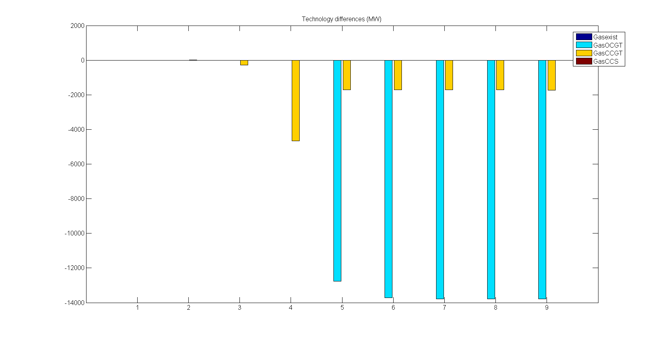
Gas plants
Notes:
More OCGT and CCGT in DR0

Slide 15
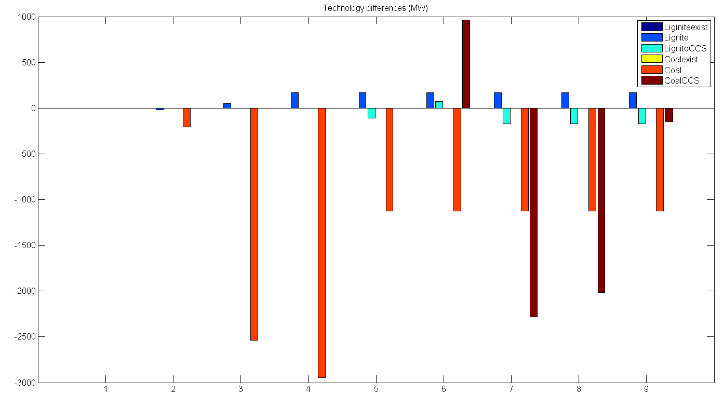
Coal plants
Notes:
More Lignite in DR2
More Coal and Lignite with CCS in DR0

Slide 16
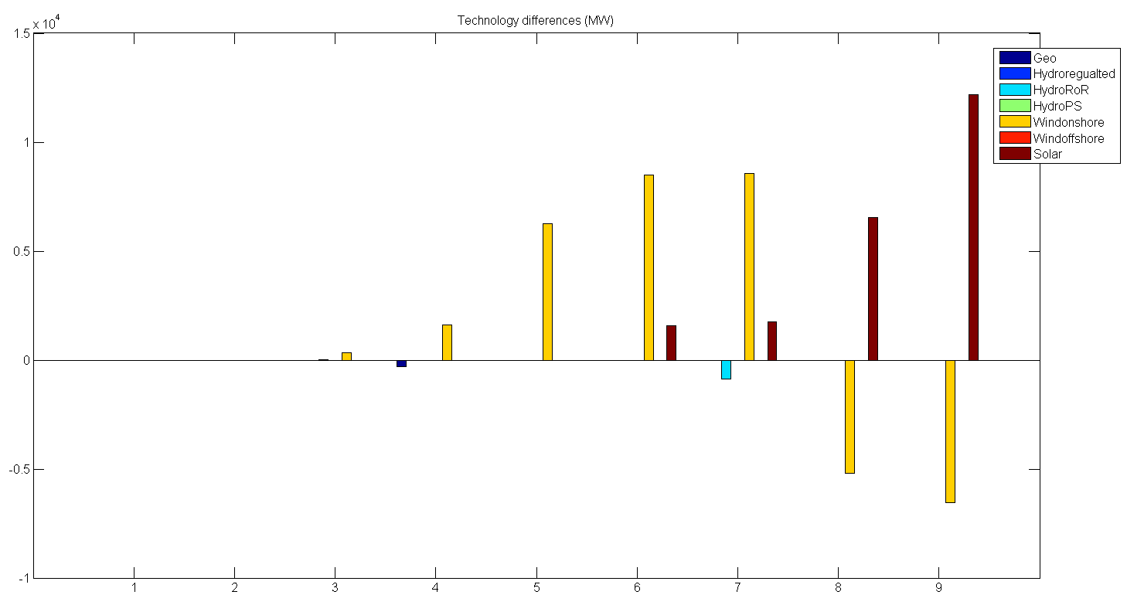
RES plants
Notes:
Solar plant investment prices decrease to the same levels as onshore wind in the last periods.
In case DR2 solar is effective for some countries: Bosnia, Spain, Greece, Italy, Macedonia and Portugal.
Probably in DR0 solar plants cannot be so effective

Slide 17
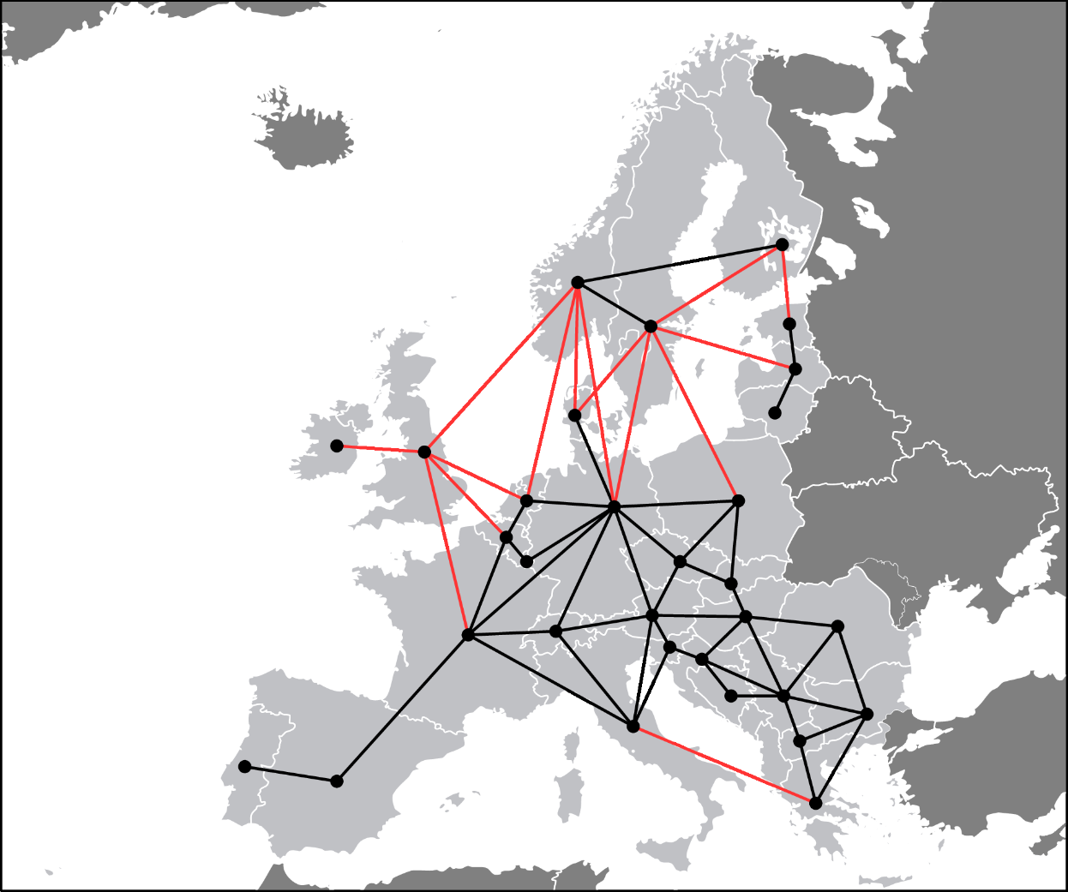
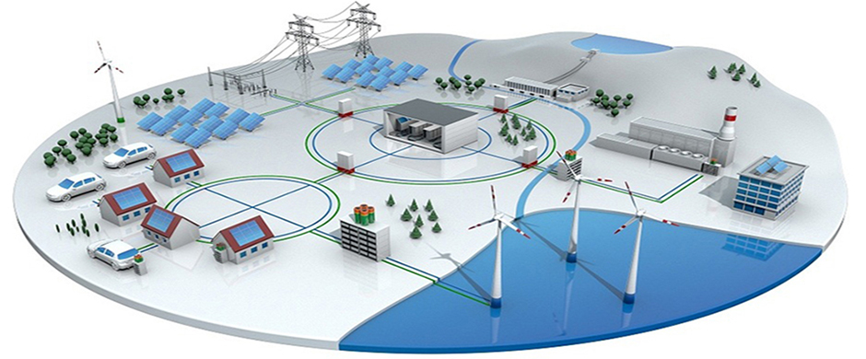
Next generation: Active consumers and distributed generation- local perspective
Demand Response module in EMPIRE : in testing now
Multiscale geographical representation
  Countries
  Regions
  Neigbourhoods
Kilde: 3M, Smart Grid: http://solutions.3m.com/wps/portal/3M/en_EU/SmartGrid/EU-Smart-Grid/
Notes:
Distributed generation
Generation (renewable) connected to the distribution system.
Rethinking system design: not just a question of moving electricity in bulk from large power plants to load centers
High shares of intermittent renewable generation.
Unpredictable generation
Needs to be balanced -> excess generation exported, deficit generation imported
Transmission and storage

Slide 18
References
EMPIRE
Skar, C., G. L. Doorman, G. A. PŽrez-ValdŽs, and A. Tomasgard. 2016. “A multi-horizon stochastic programming model for the European power system.” In review.
Skar, C., G. L. Doorman, G. Guidati, C. Soothill, and A. Tomasgard. 2016. “Modeling transitional measures to drive CCS deployment in the European power sector.”, In review.
Skar, C., Doorman, G. L. & Tomasgard, A. (2014, May). The future European power system under a climate policy regime. In EnergyCon 2014, IEEE International Energy Conference (pp. 337–344). Dubrovnik, Croatia. ISSN: 978-1-4799-2448-6.
Skar, C., Doorman, G. L. & Tomasgard, A. (2014, August). Large-scale power system planning using enhanced Benders decomposition. In Proceedings of the 18th Power Systems Computation Conference (PSCC). Krakow, Poland.

Slide 19
References
MULTI-HORIZON & SCENARIOS
Hellemo, L., Midthun, K., Tomasgard, A. and Werner, A., Multistage stochastic programming for natural gas infrastructure design with a production perspective, World Scientific Series in Finance, in Gassman, H.I. and Ziemba, W.T. (editors), Stochastic programming- Applications in finance, energy, planning and logistics, World Scientific Series in Finance, 2012.
Kaut, Michal; Midthun, Kjetil Trovik; Werner, Adrian; Tomasgard, Asgeir; Hellemo, Lars; Fodstad, Marte. (2014) Multi-horizon stochastic programming. Computational Management Science. volum 11 (1-2).
Werner, A.S., Pichler, A., Midthun, K.T., Hellemo, L., Tomasgard, A. , Risk measures in multi-horizon scenario trees, In Raimund Kovacevic, Georg Ch. Pflug, and Maria Th. Vespucci (editors) Handbook of Risk Management in Energy Production and Trading , Springer, 2013.
Seljom, Pernille Merethe; Tomasgard, Asgeir. (2015) Short-term uncertainty in long-term energy system models - A case study of wind power in Denmark. Energy Economics. vol. 49.

