Slide 1

Long term power system design using EMPIRE
- effects of demand response
Asgeir Tomasgard
Prof. Dept of industrial economics nd technology managment, NTNU,
Director, FME CenSES - Centre for Sustainable Energy Studies
WP leader FME ZEN: WP2 policy measuers, innovation and business models
Christian Skar
Post doc, Dept. of industrial economics

Slide 2
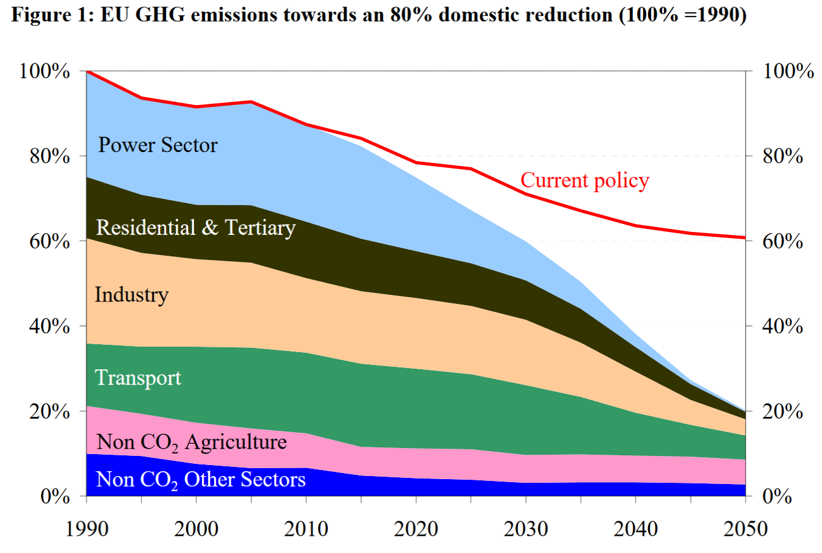

Backdrop: European Decarbonization
Near full decarbonization of power
?
CCS??
???
Source: European Commission. (2011). A Roadmap for moving to a competitive low carbon economy in 2050. Communication from The Commission to The European Parliament, The Council, The European Economic and Social Committee and The Committee of The Regions, COM(2011).

Slide 3
The challenge for Zero Emission Power Systems
- Intermittent generation and variable load

Slide 4
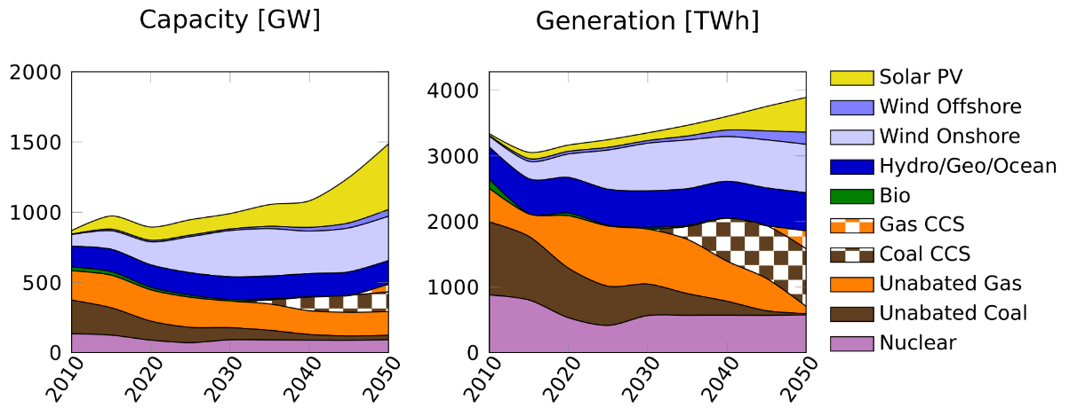
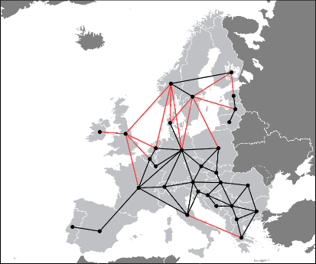
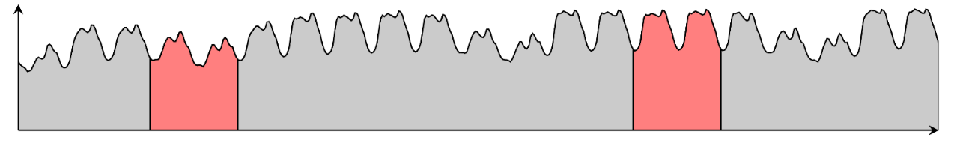
Co-optimization of strategic and operational decisions
Optimal investment strategy 2010-2015
Coupled optimization problem to minimize total system costs
Optimal dispatch for representative 48-hour blocks

Slide 5
Scenario assumptions
Baseline decarbonization: 90 % emission reduction from 2010 to 2050
  Nuclear phase-out in Germany, no new nuclear in Belgium and the Netherlands
  Grid expansion towards 2030 limited to ENTSO-E’s 2016 Ten Year Development Plan reference capacities. Beyond 2030, cumulative limits:
    500 MW additional per 5 year limit on overhead line expansion
    1400 MW additional per 10 year on sub-sea cable expansion
  Development of Norwegian hydro power predefined (according to input from CEDREN)
Alternative scenario NoCCS: same as baseline but no carbon capture and storage available
Notes:
We do not impose national policies on CCS, RES, emission reduction. May run optional cases with this in the future

Slide 6
Baseline scenario: 90 % emission reduction
Technology/Fuel | Capacity [GW] | Generation [TWh]
CCS | 193 (15%) | 1178 (15%)
Wind | 241 (19%) | 654 (17%)
Solar PV | 347 (27%) | 403 (10%)
Coal (unabated) | 26 (2%) | 23 (1%)
Natural Gas (unabated) | 160 (13%) | 106 (3%)
Notes:
Total natural gas w/o CCS in generation mix: 450 TWh

Slide 7
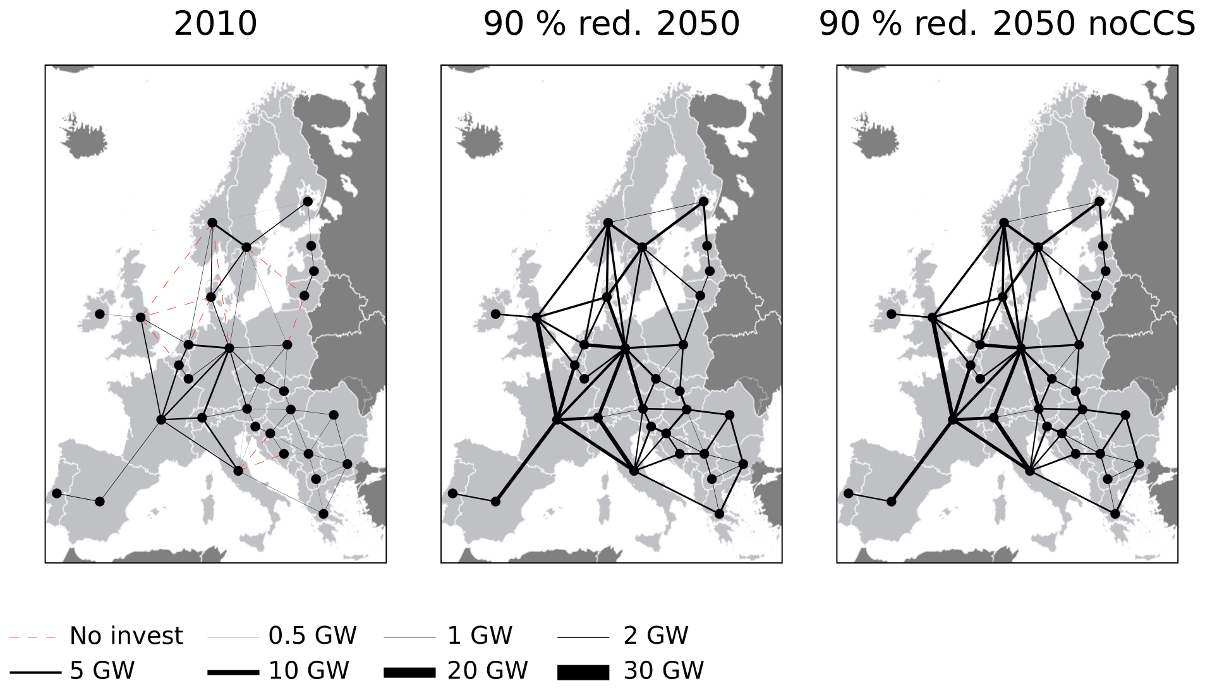
Transmission
Baseline
Total cable capacity from Norway in 2050: 16.3 GW
Total European interconnector capacity increase: 250 % from 2010 to 2050
NoCCS
Interconnector capacity increase: 360 % from 2010 to 2050
Notes:
Cable capacity does not include interconnector to Sweden!
Norway interconnector expansion to neighbors at the limit in both Baseline and NoCCS
In the NoCCS case 54 out of 64 hit the max installed capacity limit by 2050
In the Baseline only 27 interconnectors reach this limit

Slide 8
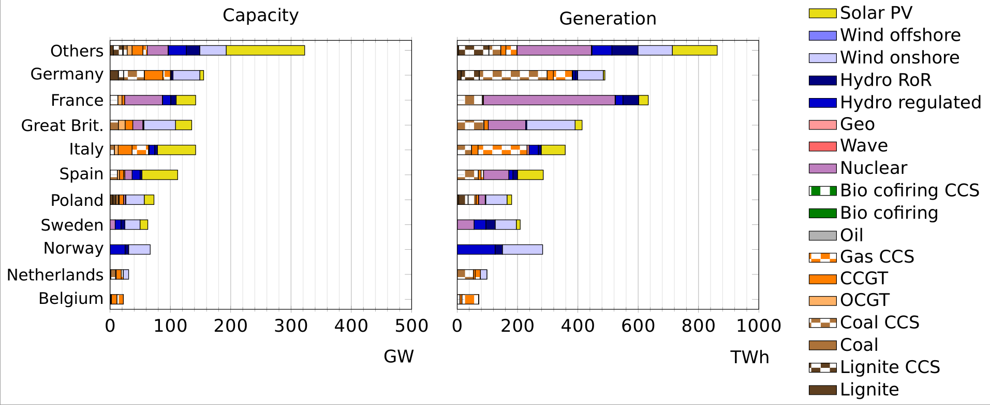
Baseline country results 2050
Source: CenSES position paper Norway as a flexibility provider to Europe, in preparation.

Slide 9
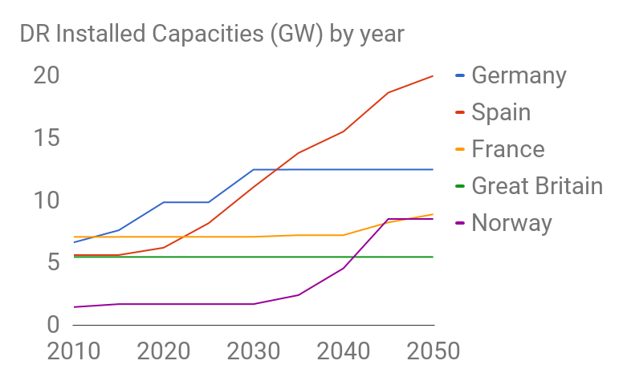
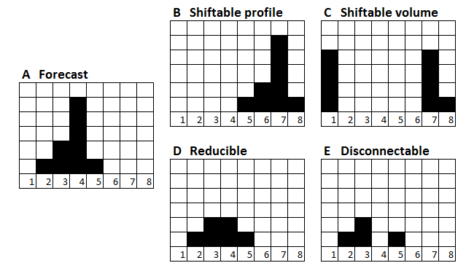
New drivers: Active consumers and distributed generation
Demand response module in testing
Notes:
Distributed generation
Generation (renewable) connected to the distribution system.
Rethinking system design: not just a question of moving electricity in bulk from large power plants to load centers
High shares of intermittent renewable generation.
Unpredictable generation
Needs to be balanced -> excess generation exported, deficit generation imported
Transmission and storage

Slide 10
Notes:
However, the capacity mixes of individual countries are more sensitive to the presence of DR. (That is something to be further investigated). The graph shows the DR capacities evolution of some of the largest European countries. The majority of the countries stays with DR capacities below 3GW.

Slide 11
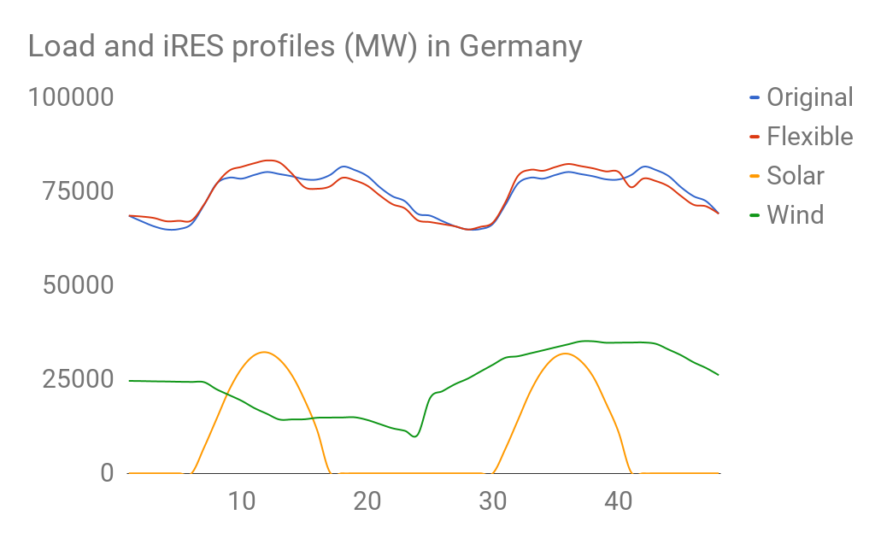
Notes:
The effects of DR loads on the load profiles are noticeable when high production of intermittent renewables (iRES) like wind and solar is available. The blue curve («Original») shows a 48-hours load profile in Germany (in summer) without DR. When DR is ON (Red Curve) some loads are shifted to the hours with solar and wind production.
The shifted load consists of all the DR groups. Identification of the DR groups that shift or curtail more load can be further investigated.

Slide 12
Capacities comparison between DR2 and DR0
The following bar graphs show the main differences in technology capacities in the case with DR (case DR2) and without (case DR0) between year 1 (2010) and year 9 (2050).
The positive y-axis indicate larger capacity in DR2 than in DR0 and viceversa

Slide 13
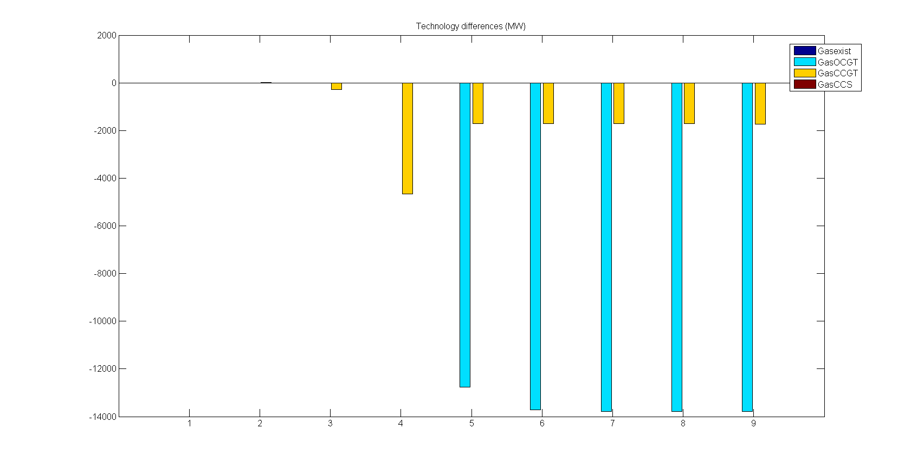
Gas plants
Notes:
More OCGT and CCGT in DR0

Slide 14
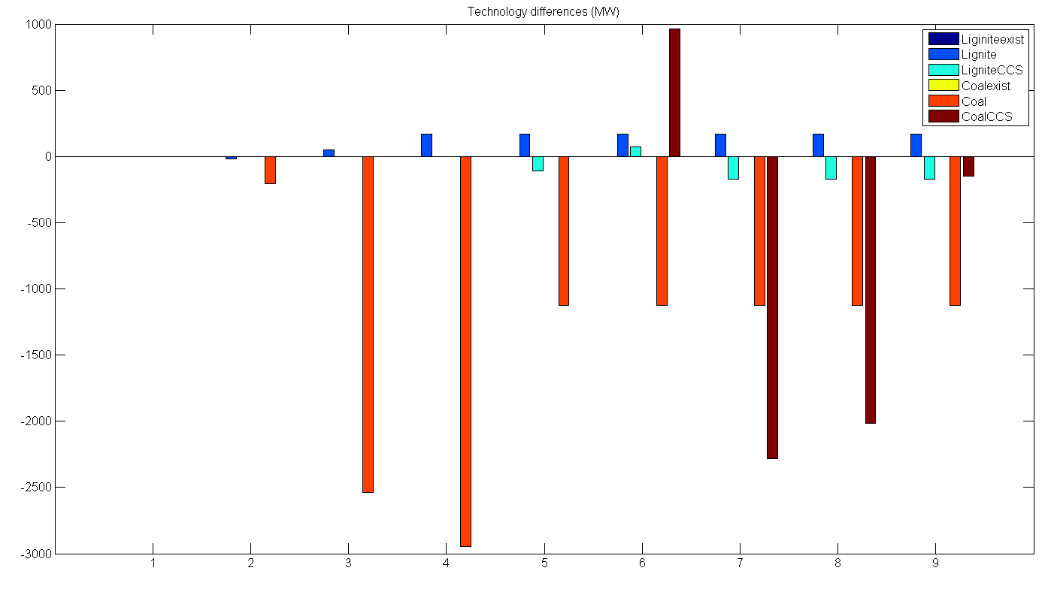
Coal plants
Notes:
More Lignite in DR2
More Coal and Lignite with CCS in DR0

Slide 15
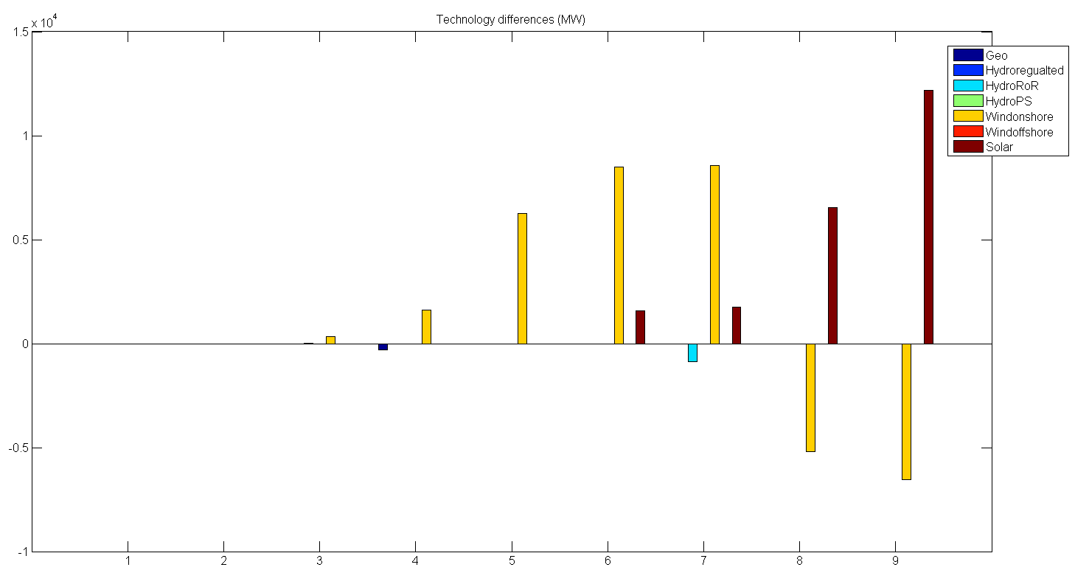
RES plants
Notes:
Solar plant investment prices decrease to the same levels as onshore wind in the last periods.
In case DR2 solar is effective for some countries: Bosnia, Spain, Greece, Italy, Macedonia and Portugal.
Probably in DR0 solar plants cannot be so effective

Slide 16
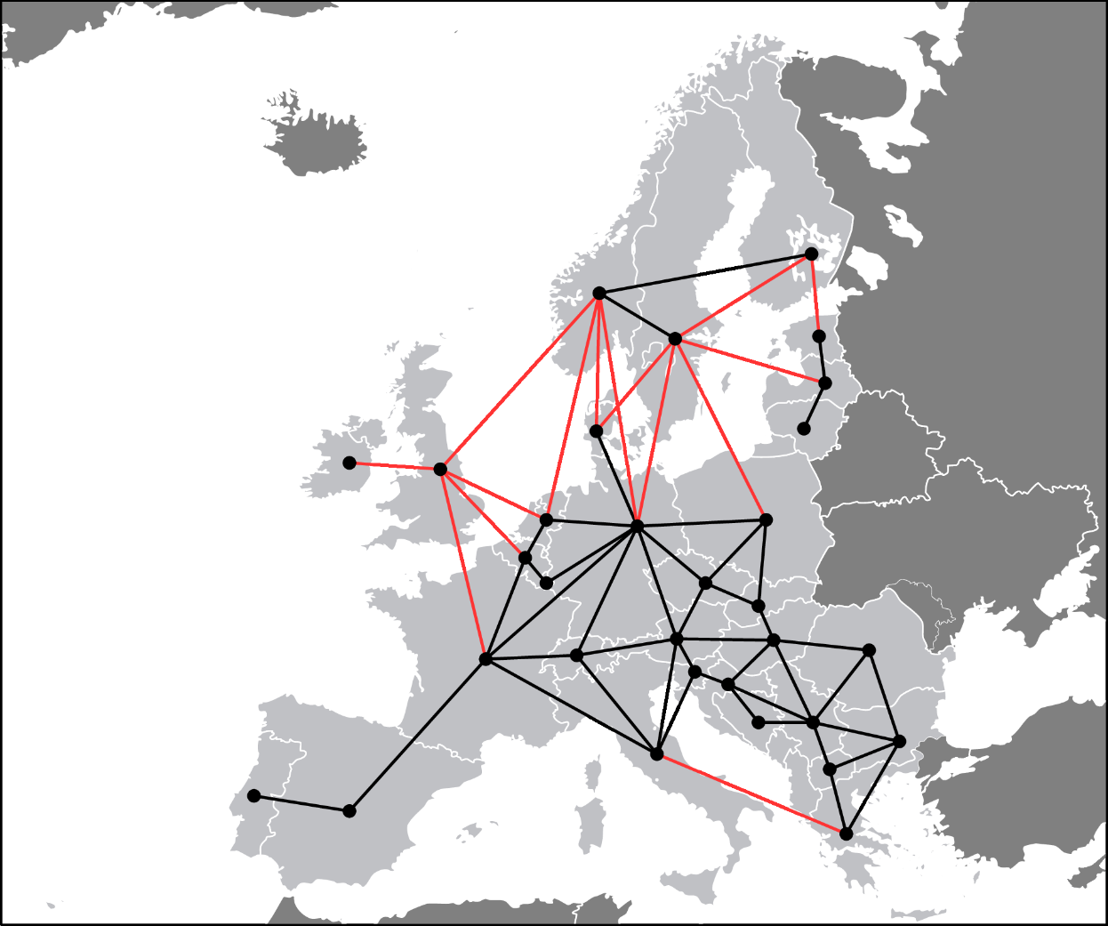
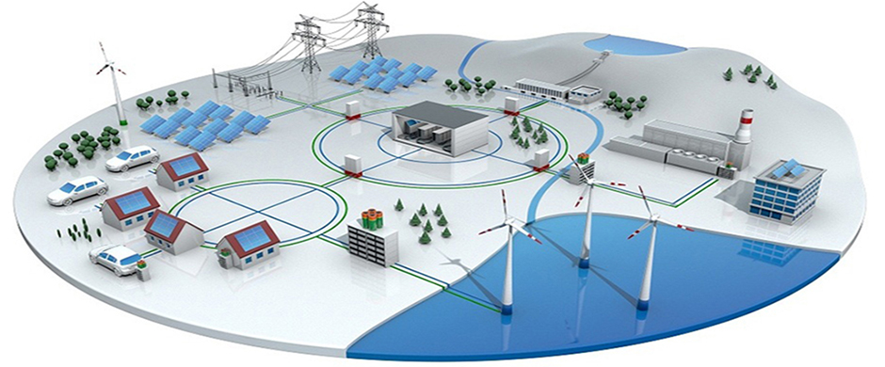
Next generation: Active consumers and distributed generation- local perspective
Demand Response module in EMPIRE : in testing now
Multiscale geographical representation
  Countries
  Regions
  Neigbourhoods
Kilde: 3M, Smart Grid: http://solutions.3m.com/wps/portal/3M/en_EU/SmartGrid/EU-Smart-Grid/
Notes:
Distributed generation
Generation (renewable) connected to the distribution system.
Rethinking system design: not just a question of moving electricity in bulk from large power plants to load centers
High shares of intermittent renewable generation.
Unpredictable generation
Needs to be balanced -> excess generation exported, deficit generation imported
Transmission and storage

Slide 17
References
EMPIRE
Skar, C., G. L. Doorman, G. A. PŽrez-ValdŽs, and A. Tomasgard. 2016. “A multi-horizon stochastic programming model for the European power system.” In review.
Skar, C., G. L. Doorman, G. Guidati, C. Soothill, and A. Tomasgard. 2016. “Modeling transitional measures to drive CCS deployment in the European power sector.”, In review.
Skar, C., Doorman, G. L. & Tomasgard, A. (2014, May). The future European power system under a climate policy regime. In EnergyCon 2014, IEEE International Energy Conference (pp. 337–344). Dubrovnik, Croatia. ISSN: 978-1-4799-2448-6.
Skar, C., Doorman, G. L. & Tomasgard, A. (2014, August). Large-scale power system planning using enhanced Benders decomposition. In Proceedings of the 18th Power Systems Computation Conference (PSCC). Krakow, Poland.

Slide 18
References
MULTI-HORIZON & SCENARIOS
Hellemo, L., Midthun, K., Tomasgard, A. and Werner, A., Multistage stochastic programming for natural gas infrastructure design with a production perspective, World Scientific Series in Finance, in Gassman, H.I. and Ziemba, W.T. (editors), Stochastic programming- Applications in finance, energy, planning and logistics, World Scientific Series in Finance, 2012.
Kaut, Michal; Midthun, Kjetil Trovik; Werner, Adrian; Tomasgard, Asgeir; Hellemo, Lars; Fodstad, Marte. (2014) Multi-horizon stochastic programming. Computational Management Science. volum 11 (1-2).
Werner, A.S., Pichler, A., Midthun, K.T., Hellemo, L., Tomasgard, A. , Risk measures in multi-horizon scenario trees, In Raimund Kovacevic, Georg Ch. Pflug, and Maria Th. Vespucci (editors) Handbook of Risk Management in Energy Production and Trading , Springer, 2013.
Seljom, Pernille Merethe; Tomasgard, Asgeir. (2015) Short-term uncertainty in long-term energy system models - A case study of wind power in Denmark. Energy Economics. vol. 49.

