Slide 1
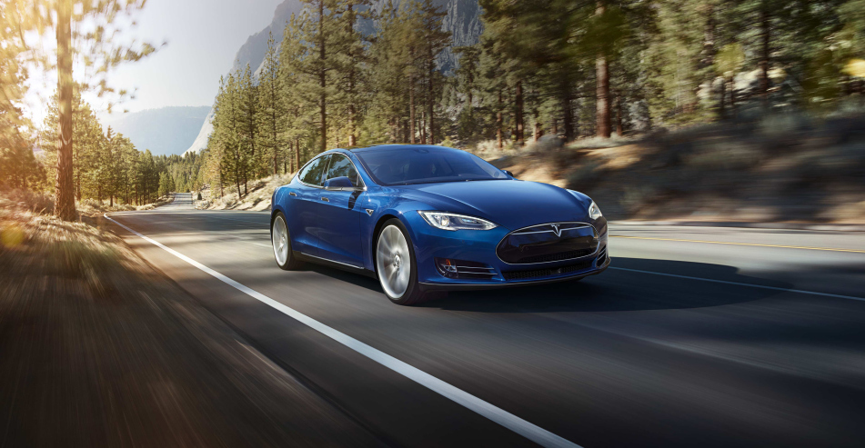
Life cycle assessment of passenger cars
Linda Ager-Wick Ellingsen
Anders Hammer Strømman

Slide 2
Good knowledge of environmental impacts of conventional vehicles

Slide 3
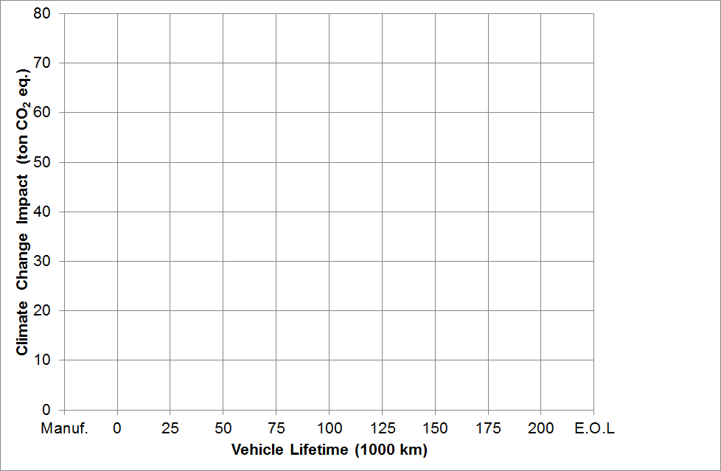
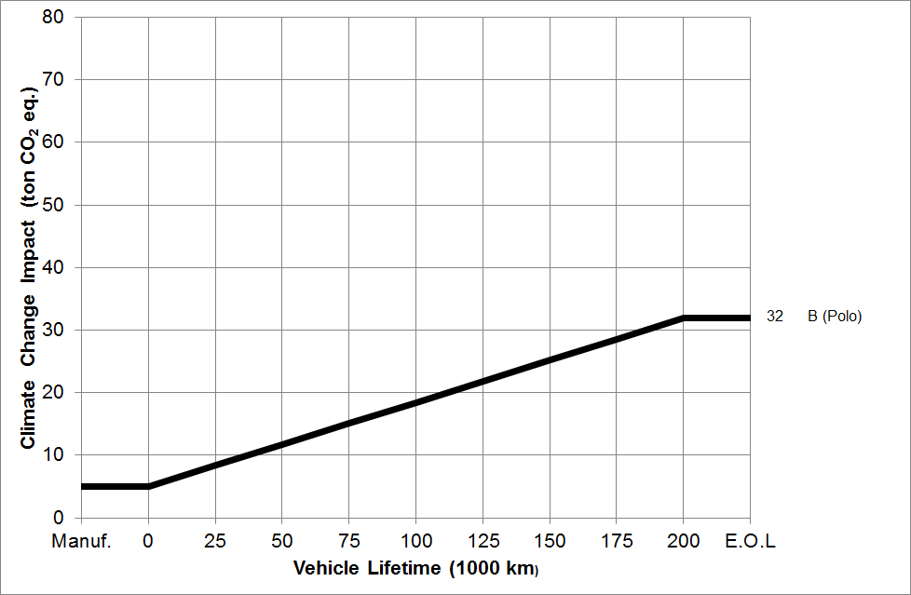
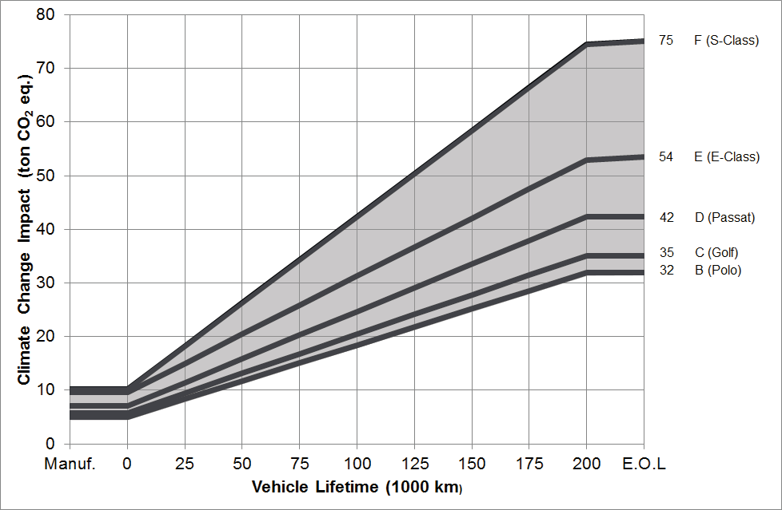
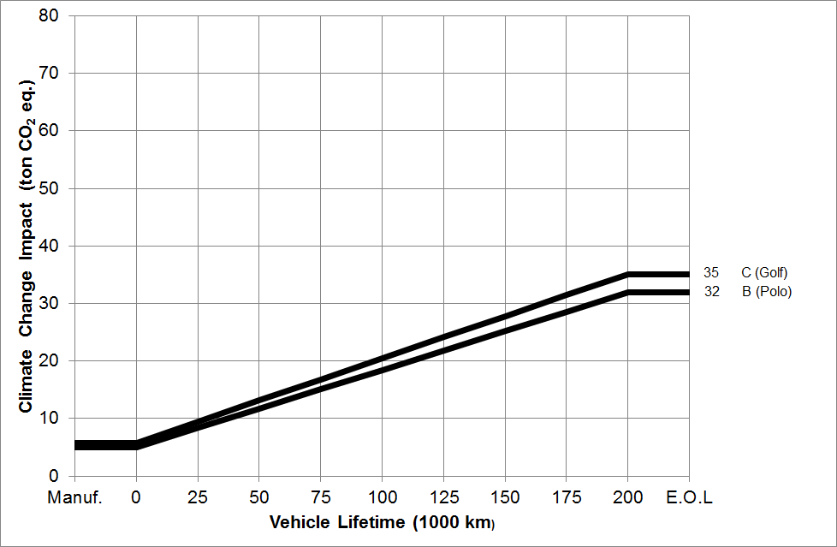
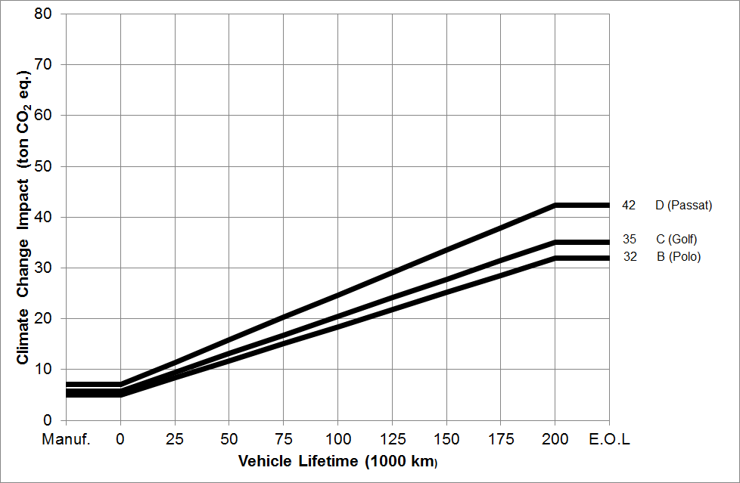
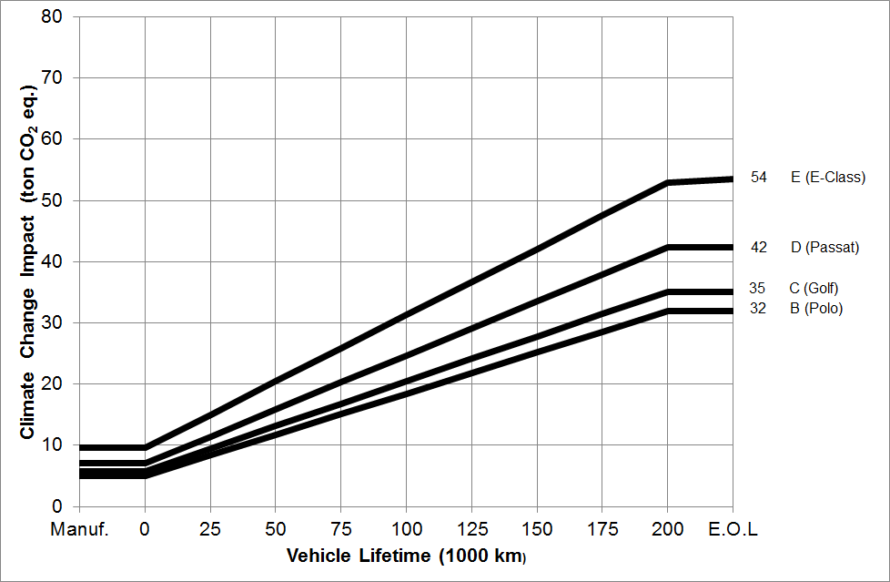
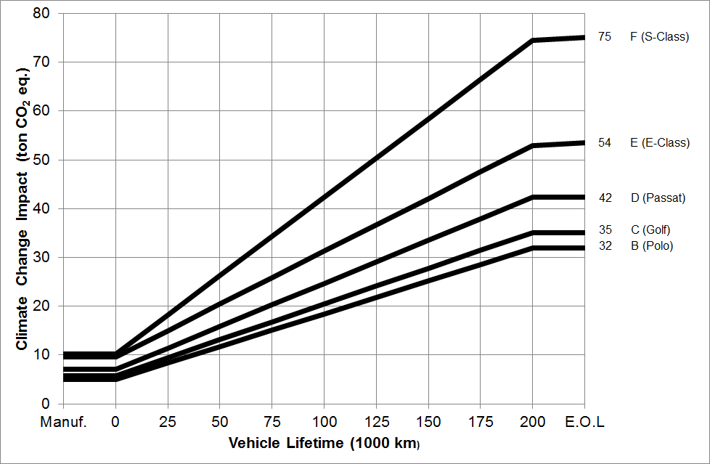
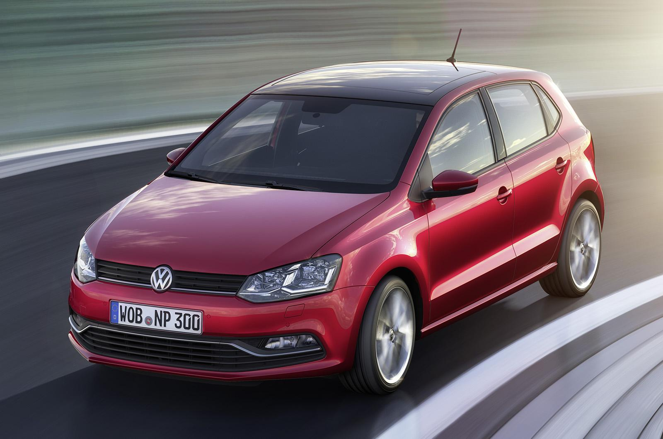
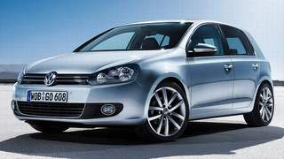
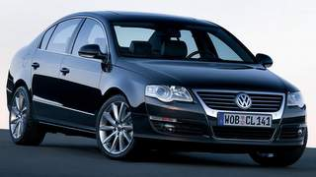
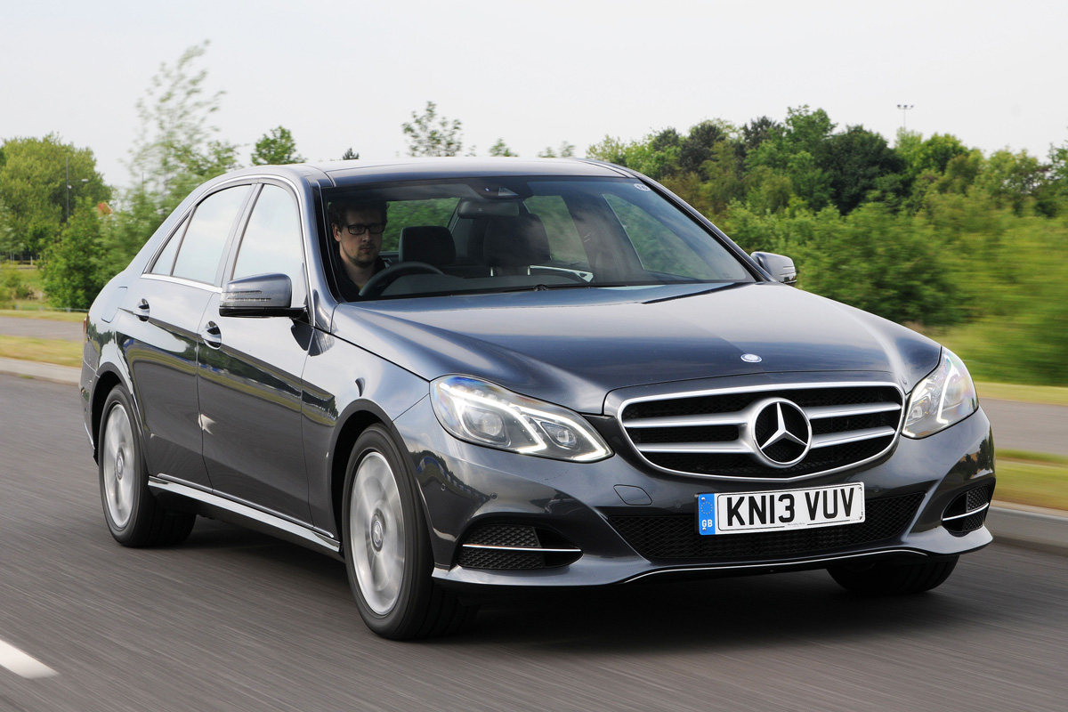
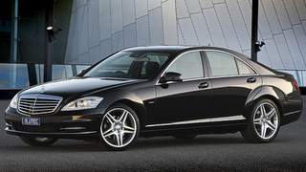
GHGs over the whole life cycle - high end of the range as of 2010
References: Daimler AG (2009, 2009, 2012), Volkswagen AG (2010, 2012)

Slide 4
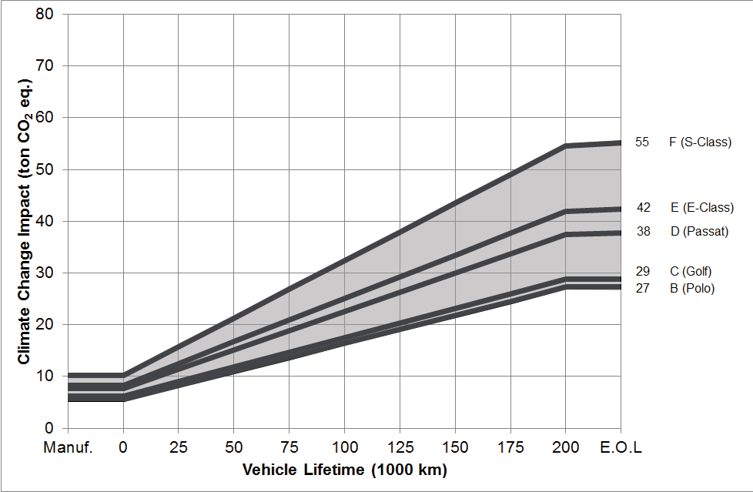
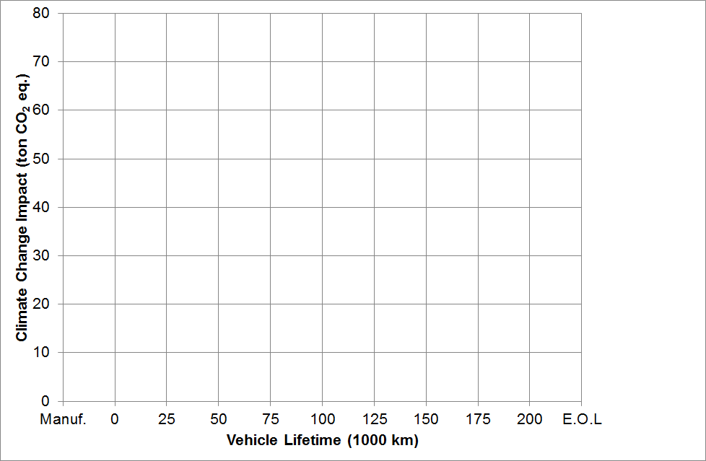
GHGs over the whole life cycle - low end of the range as of 2010
References: Daimler AG (2009, 2010, 2012,2013,2014), Volkswagen AG (2010, 2012,2013,2014)

Slide 5
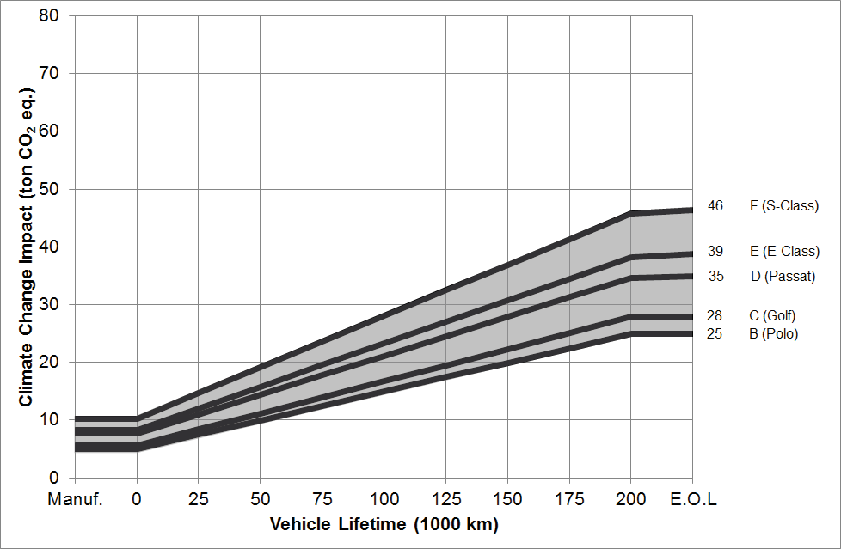
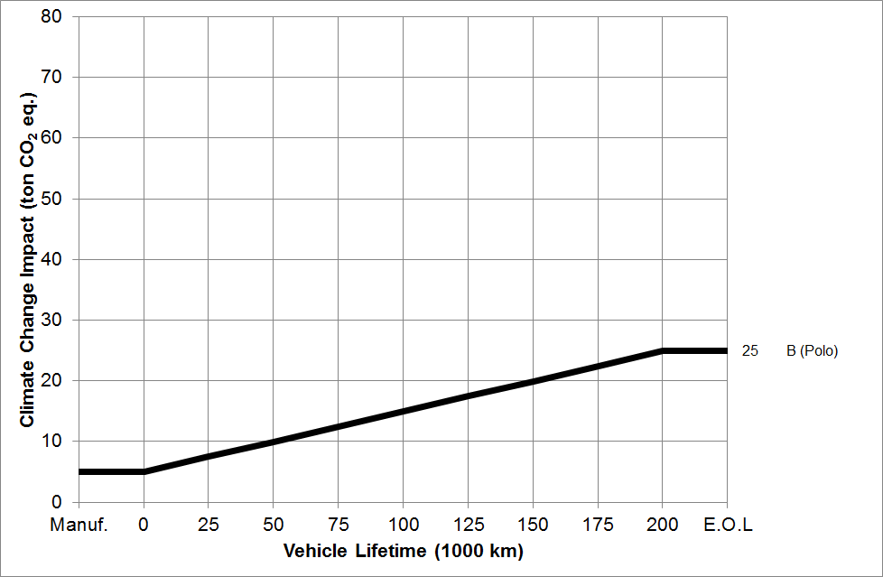
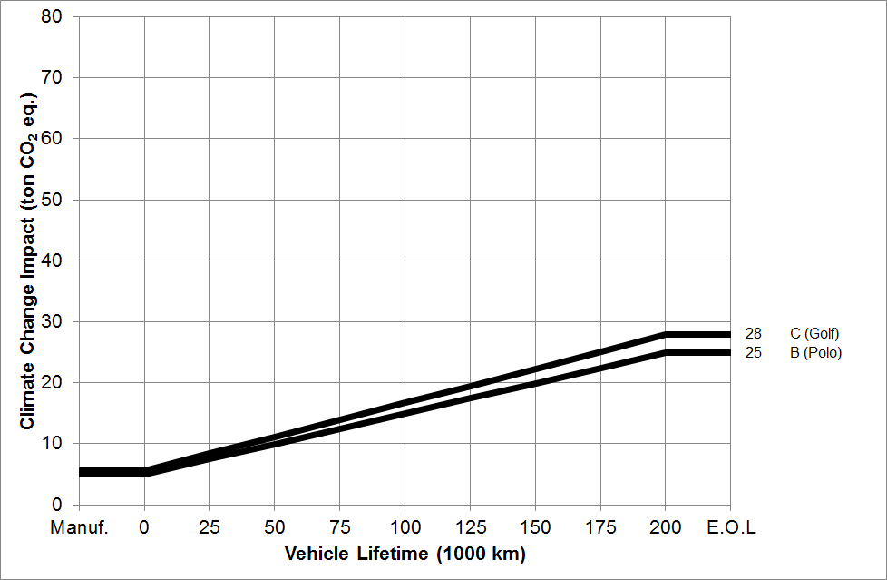
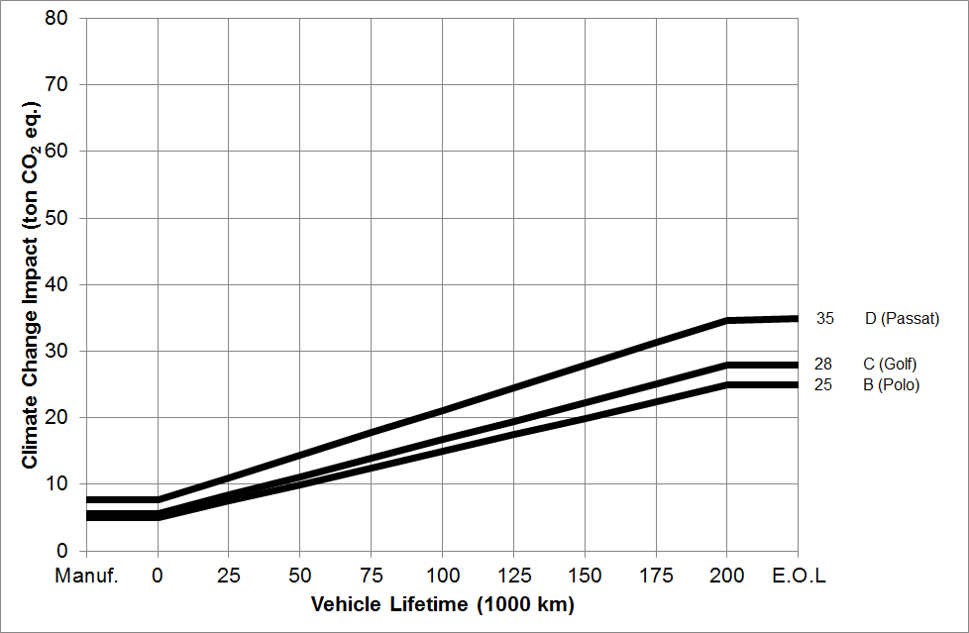
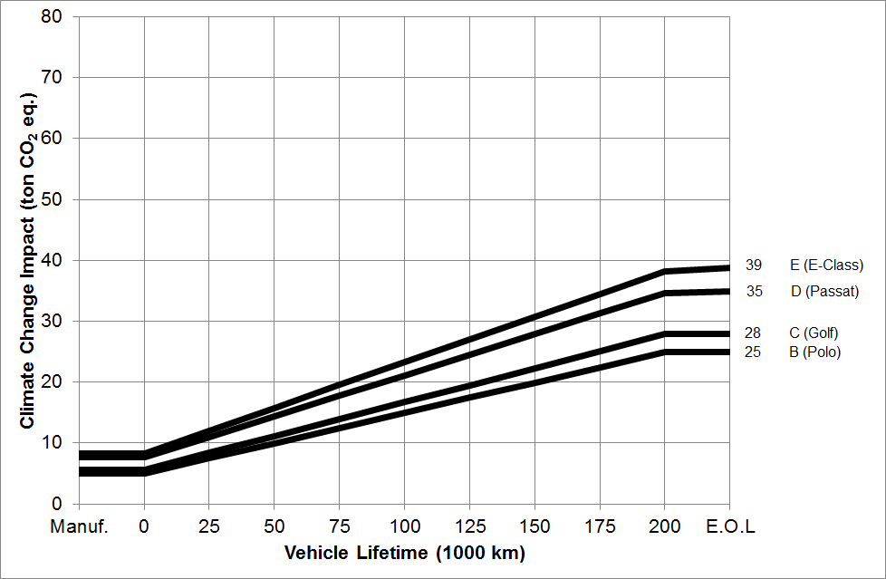
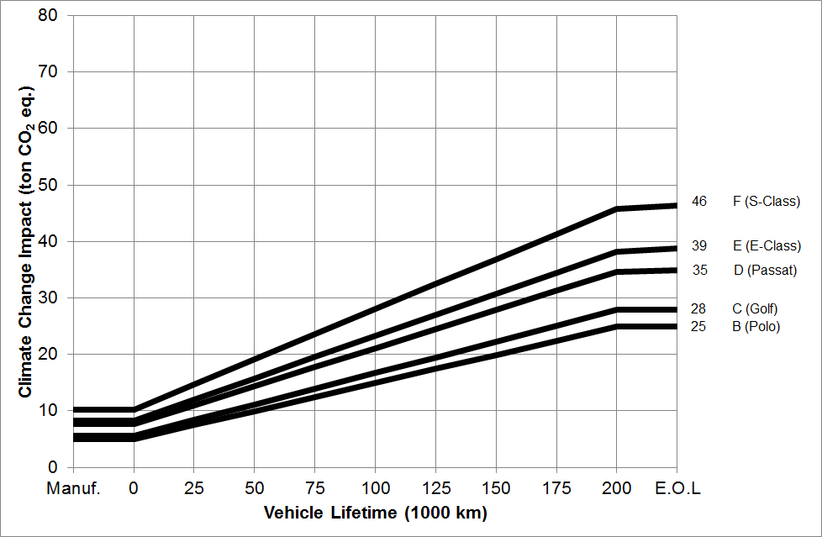
GHGs over the whole life cycle - low end of the range as of 2014
References: Daimler AG (2009, 2010, 2012,2013,2014), Volkswagen AG (2010, 2012,2013,2014)

Slide 6
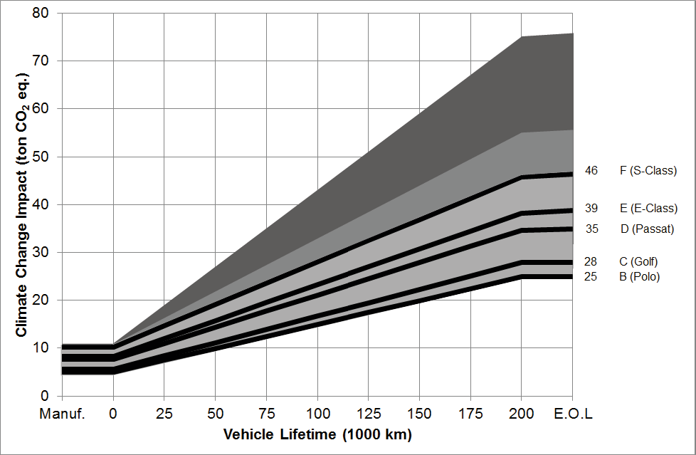
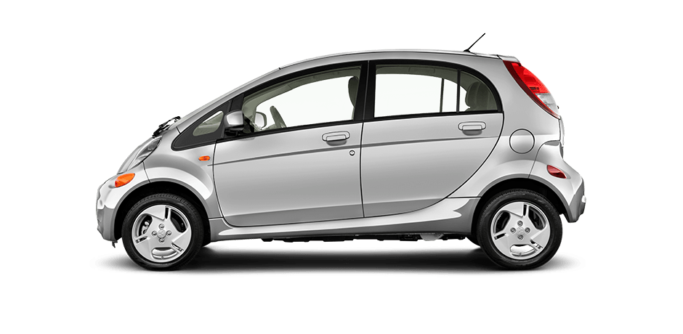
Car size, fuel type, and model year matter
References: Daimler AG (2009, 2010, 2012,2013,2014), Volkswagen AG (2010, 2012,2013,2014)

Slide 7
Electric vehicles
Segment | Curb weight (kg) | Battery size (kWh) | Driving range (km) | EV energy consumption (Wh/km)
A - mini car | 1100 | 17.7 | 133 | 146
C - medium car | 1500 | 24.4 | 171 | 170
D - large car | 1750 | 42.1 | 249 | 185
F - luxury car | 2100 | 59.9 | 317 | 207
Notes:
Picture is meant for illustrative purposes only

Slide 8
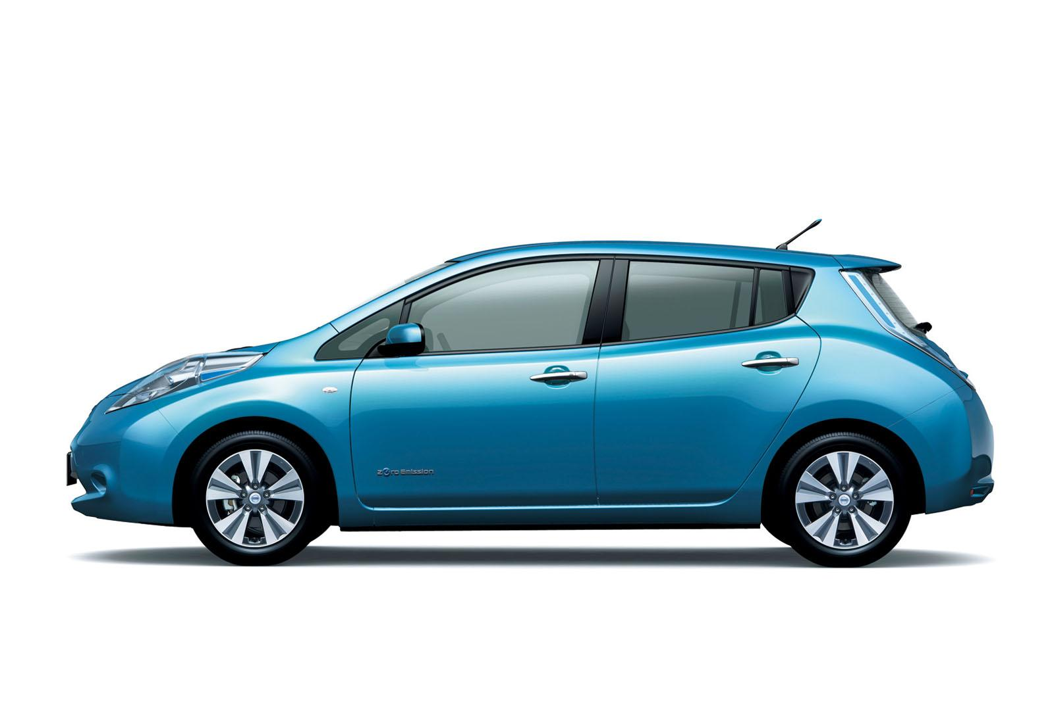
Electric vehicles
Segment | Curb weight (kg) | Battery size (kWh) | Driving range (km) | EV energy consumption (Wh/km)
A - mini car | 1100 | 17.7 | 133 | 146
C - medium car | 1500 | 26.6 | 171 | 170
D - large car | 1750 | 42.1 | 249 | 185
F - luxury car | 2100 | 59.9 | 317 | 207
Notes:
Picture is meant for illustrative purposes only

Slide 9
Electric vehicles
Segment | Curb weight (kg) | Battery size (kWh) | Driving range (km) | EV energy consumption (Wh/km)
A - mini car | 1100 | 17.7 | 133 | 146
C - medium car | 1500 | 26.6 | 171 | 170
D - large car | 1750 | 42.1 | 249 | 185
F - luxury car | 2100 | 59.9 | 317 | 207
Notes:
Picture is meant for illustrative purposes only

Slide 10
Electric vehicles
Segment | Curb weight (kg) | Battery size (kWh) | Driving range (km) | EV energy consumption (Wh/km)
A - mini car | 1100 | 17.7 | 133 | 146
C - medium car | 1500 | 26.6 | 171 | 170
D - large car | 1750 | 42.1 | 249 | 185
F - luxury car | 2100 | 59.9 | 317 | 207
Average European electricity mix (353 g CO₂/kWh at plug, 313 g CO₂/kWh at plant)
12 years and a yearly mileage of 15,000 km, resulting in a total mileage of 180,000 km
Notes:
Picture is meant for illustrative purposes only

Slide 12
Average conventional vehicles 2016

Slide 13
Notes:
Picture is meant for illustrative purposes only

Slide 14
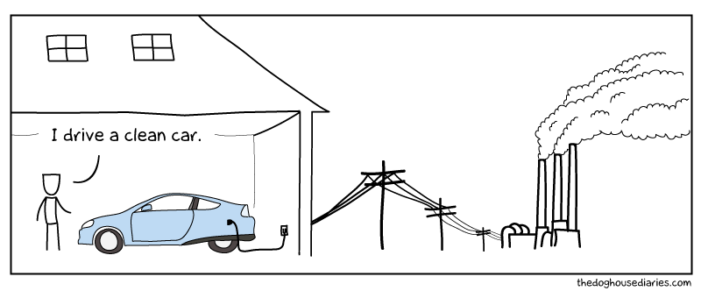
Sensitivity analysis

Slide 15
Sensitivity analysis – coal
World average coal (1029 g CO₂-eq/kWh)

Slide 16
Sensitivity analysis – natural gas
World average natural gas (595 g CO₂-eq/kWh)
Ellingsen et al. (2016)

Slide 17
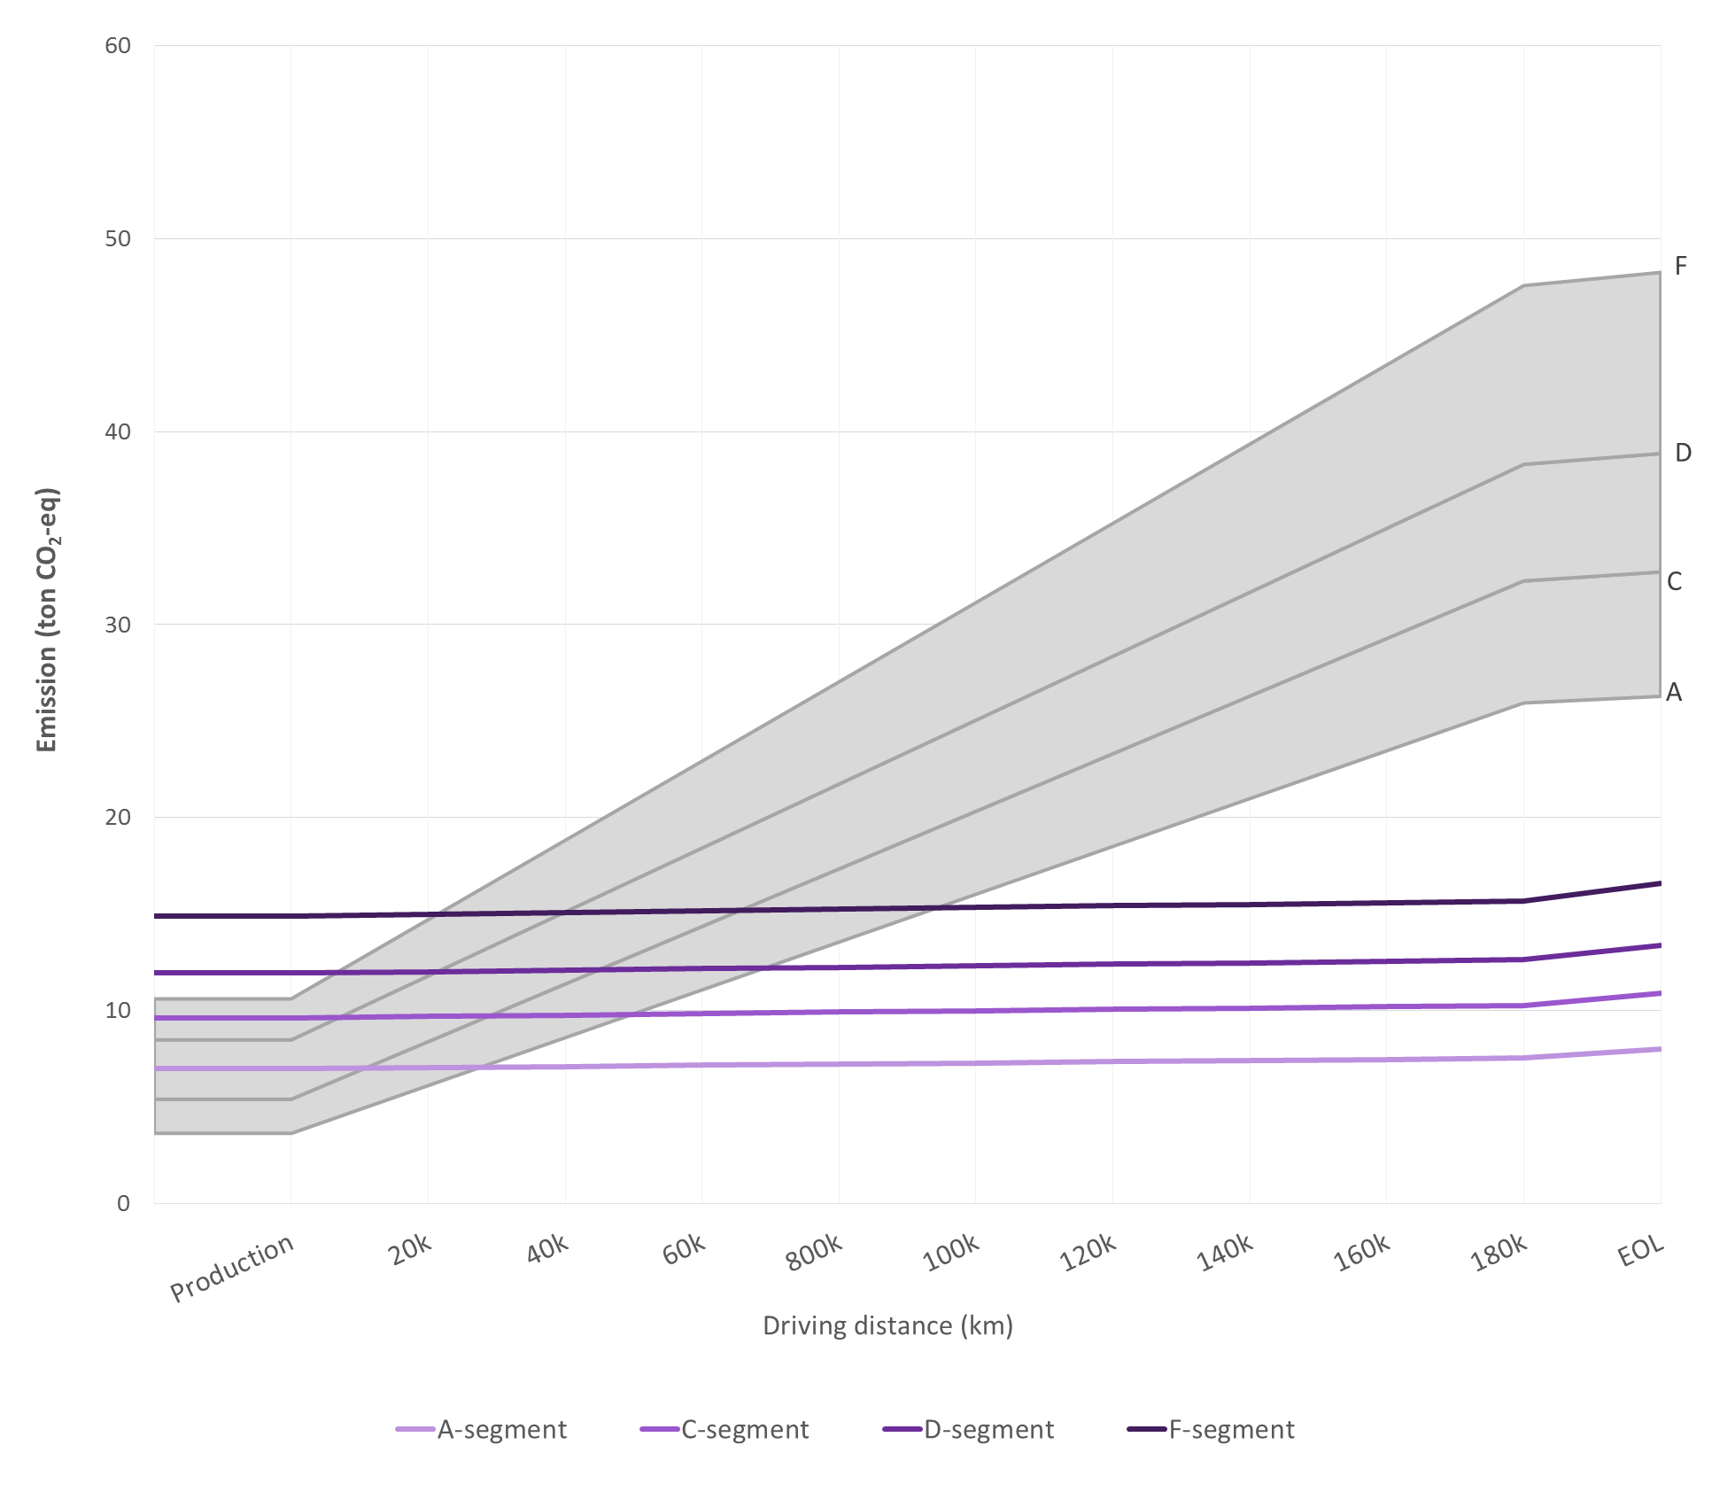
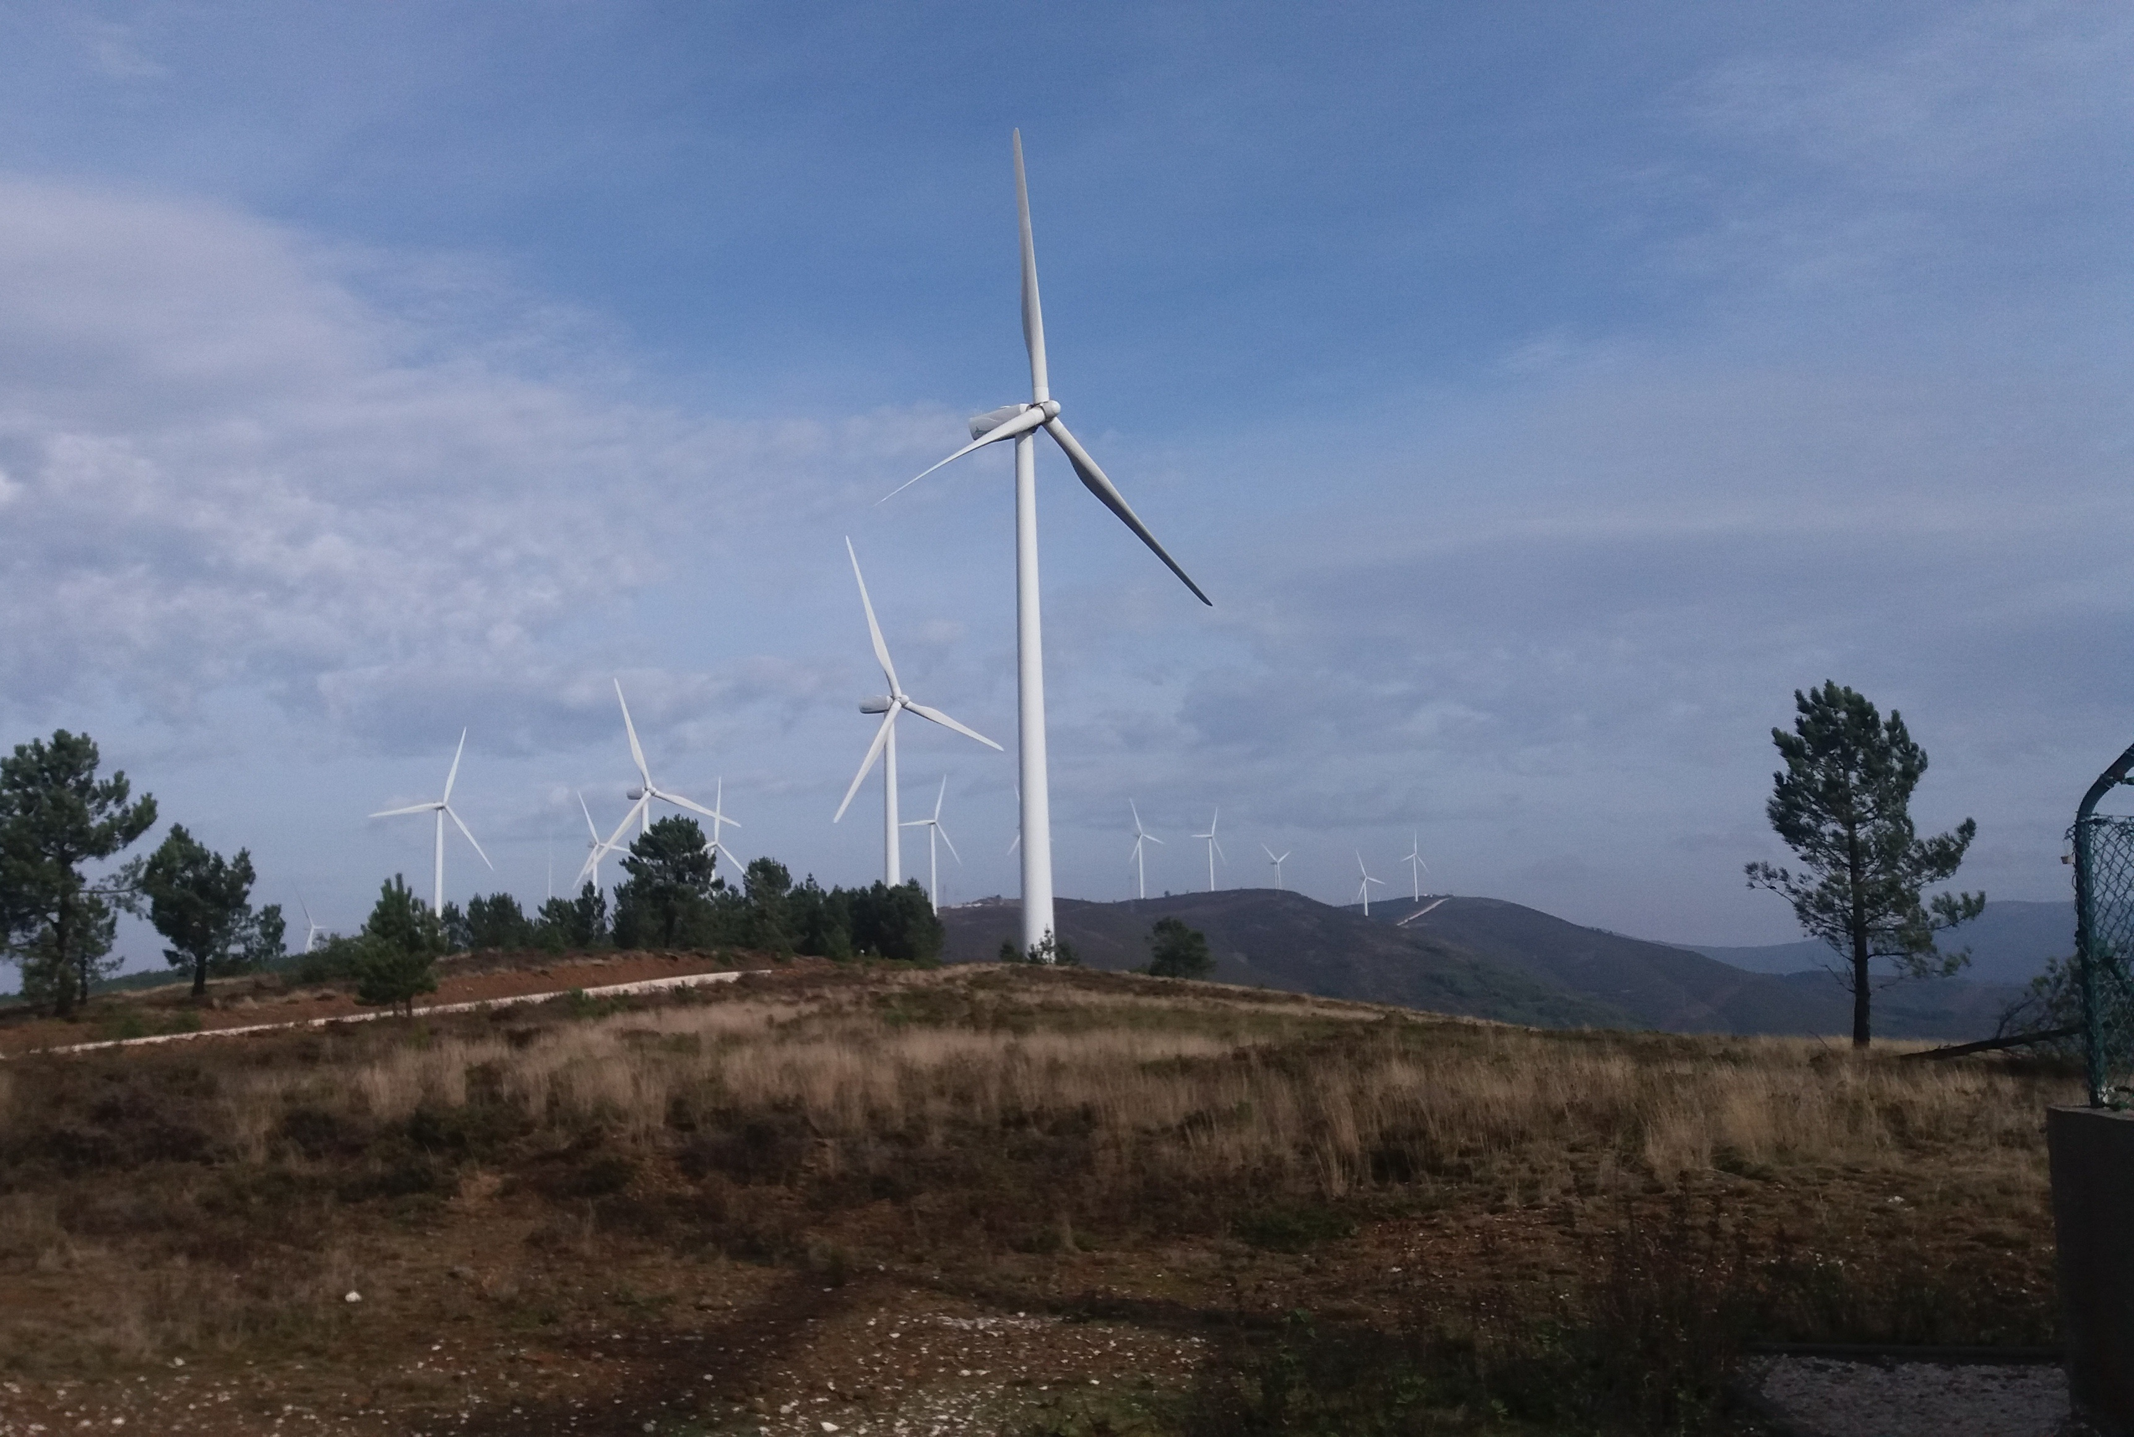
Sensitivity analysis – wind
Wind
(21 g CO₂-eq/kWh)
80k
Ellingsen et al. (2016)

Slide 18
Sensitivity analysis – all wind
Wind in all value chains (17 g CO₂-eq/kWh)
Ellingsen et al. (2016)

Slide 19
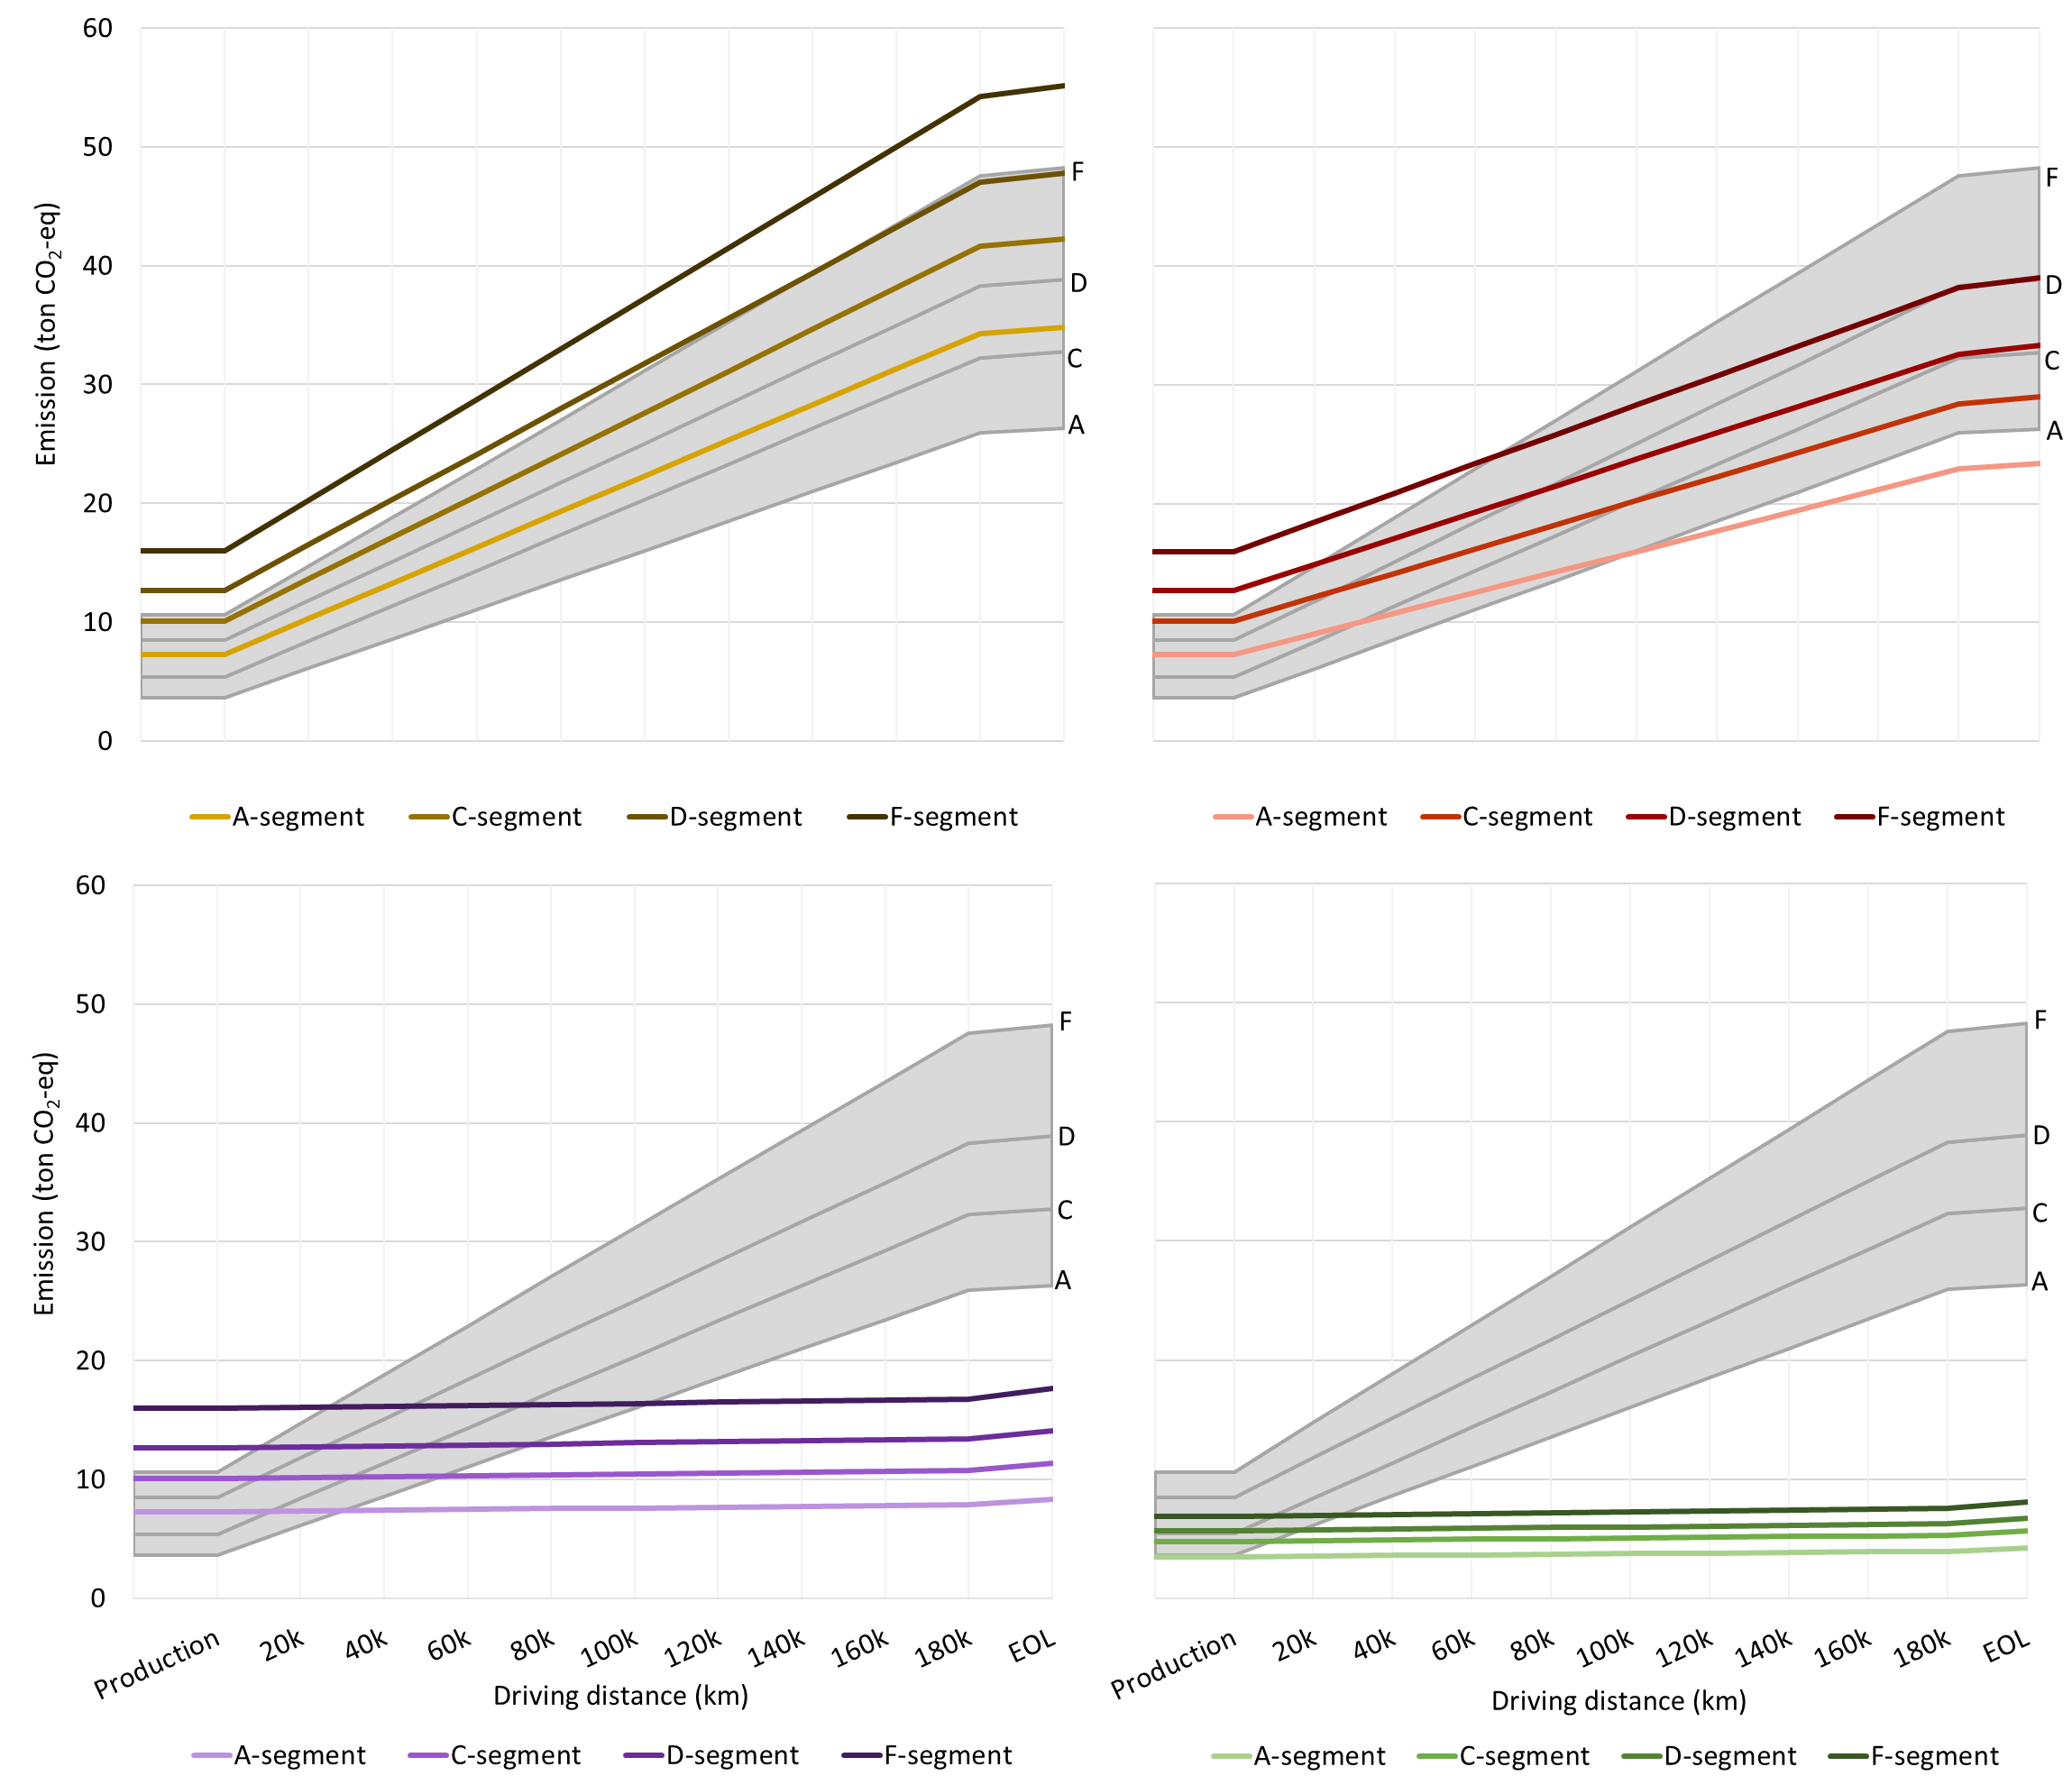
Difference in emission due to size decreases with lower carbon intensity

Slide 20
Conclusion
Regardless of powertrain technology, vehicle size is important
EVs can have lower lifecycle GHG emissions than ICEVs
A shift towards greener electricity is a positive development

Slide 21
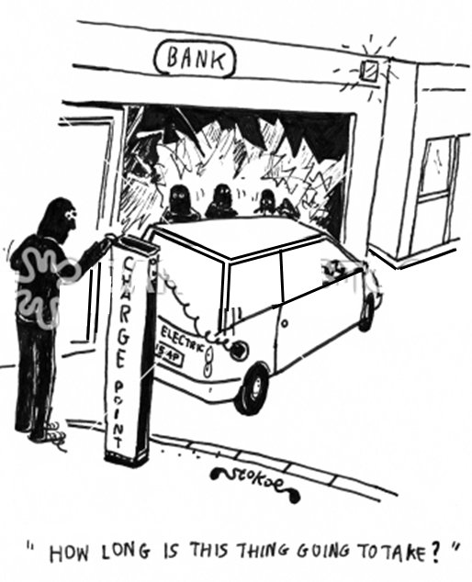
Questions?

Slide 22
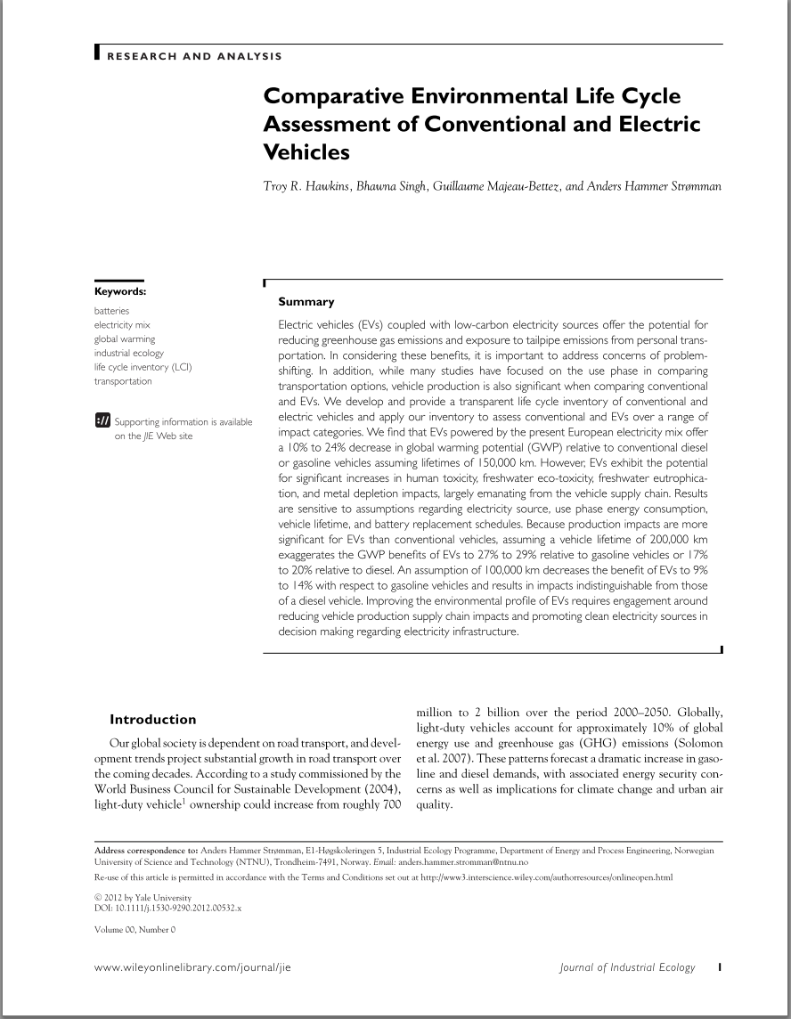
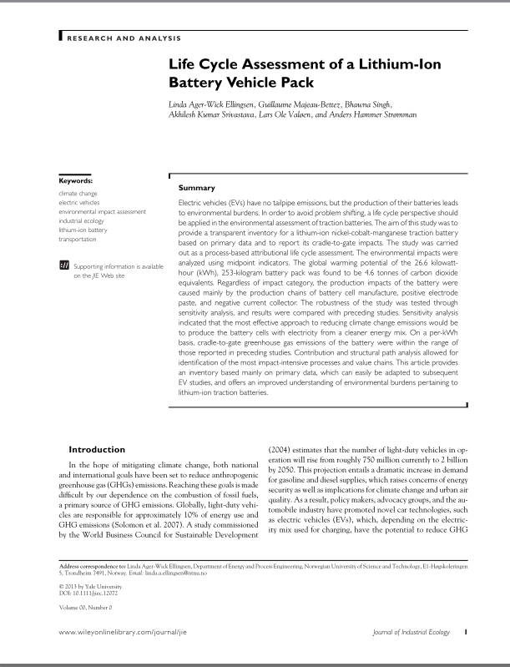
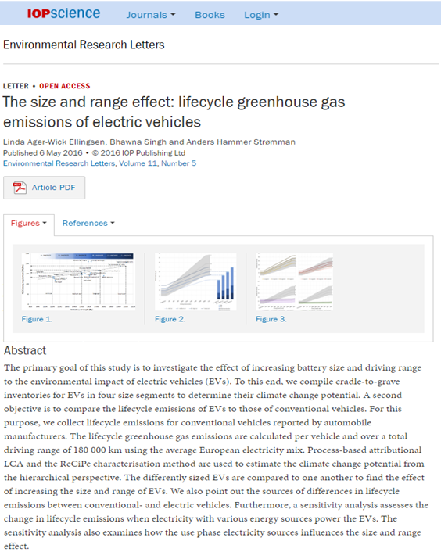
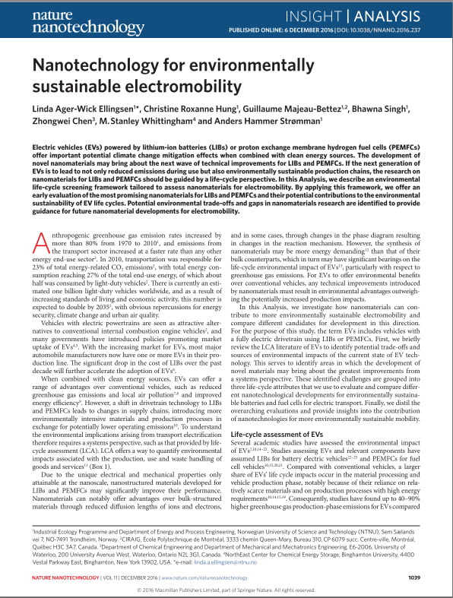
NTNU Publications on e-mobility
October 2012
November 2013
May 2016
December 2016
Ellingsen. L. A-W., Hung, R. H., & Strømman, A. H. Identifying key assumptions and differences in life cycle assessment studies of lithium-ion traction batteries with focus on greenhouse gas emissions (2017). Transportation Research Part D: Transport and Environment.
Ellingsen. L. A-W., Majeau-Bettez, M., & Strømman, A. H. (2015). Comment on “The significance of Li-ion batteries in electric vehicle life-cycle energy and emissions and recycling's role in its reduction” in Energy & Environmental Science. The International Journal of Life Cycle Assessment.
Singh, B., Ellingsen. L. A-W., & Strømman, A. H. (2015). Pathways for GHG emission reduction in Norwegian road transport sector: Perspective on consumption of passenger car transport and electricity mix. Transportation Research Part D: Transport and Environment.
Singh, B., Guest, G., Bright, R. M., & Strømman, A. H. (2014) Life Cycle Assessment of Electric and Fuel Cell Vehicle Transport Based on Forest Biomass. The International Journal of Life Cycle Assessment.
Singh, B., & Strømman, A. H. (2013). Environmental assessment of electrification of road transport in Norway: Scenarios and impacts. Transportation Research Part D: Transport and Environment.
Hawkins, T. R., Gausen, O. M., & Strømman, A. H. (2012). Environmental impacts of hybrid and electric vehicles—a review. The International Journal of Life Cycle Assessment.
Majeau-Bettez, M., Hawkings, T., & Strømman, A. H. (2011) Life Cycle Environmental Assessment of Lithium-ion and Nickel Metal Hydride Batteries for Plug-in Hybrid and Battery Electric Vehicles

Slide 23
Our understanding of GHG impacts from production of Li-ion batteries is converging
GHG emissons from production of a 26.6 kWh Li-ion battery

Slide 24
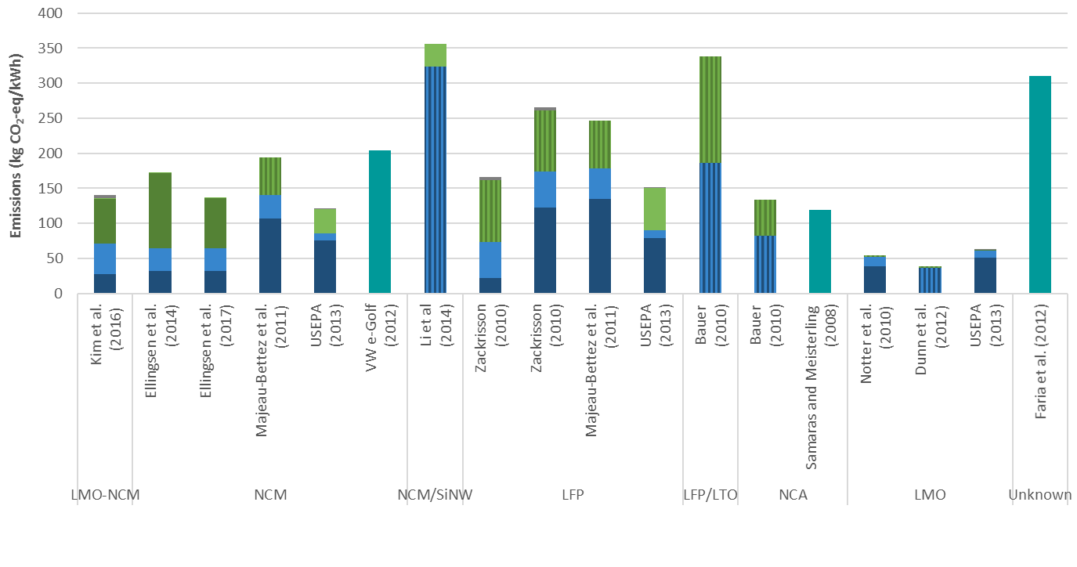
Cradle-to-gate studies of lithium-ion traction batteries

Slide 25
Life cycle assessment of vehicles
Complete life cycle
Vehicle life cycle
Vehicle production
Material extraction
Production of materials/components
Vehicle assembly
Energy life cycle
Vehicle operation
Energy extraction
Energy distribution
Energy conversion
Energy use
Maintenance
End-of-life vehicle
Battery recycling
Vehicle recycling

Slide 26
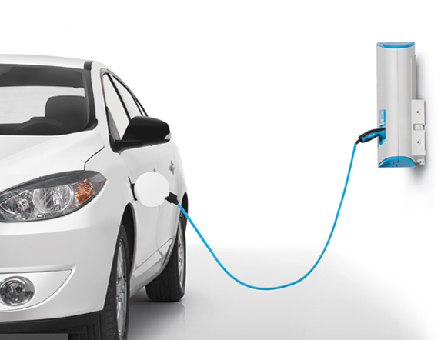
Use phase assumptions
Average European electricity mix (313 g CO₂/kWh at plug, 353 g CO₂/kWh at plant)
12 years and a yearly mileage of 15,000 km, resulting in a total mileage of 180,000 km

Slide 27
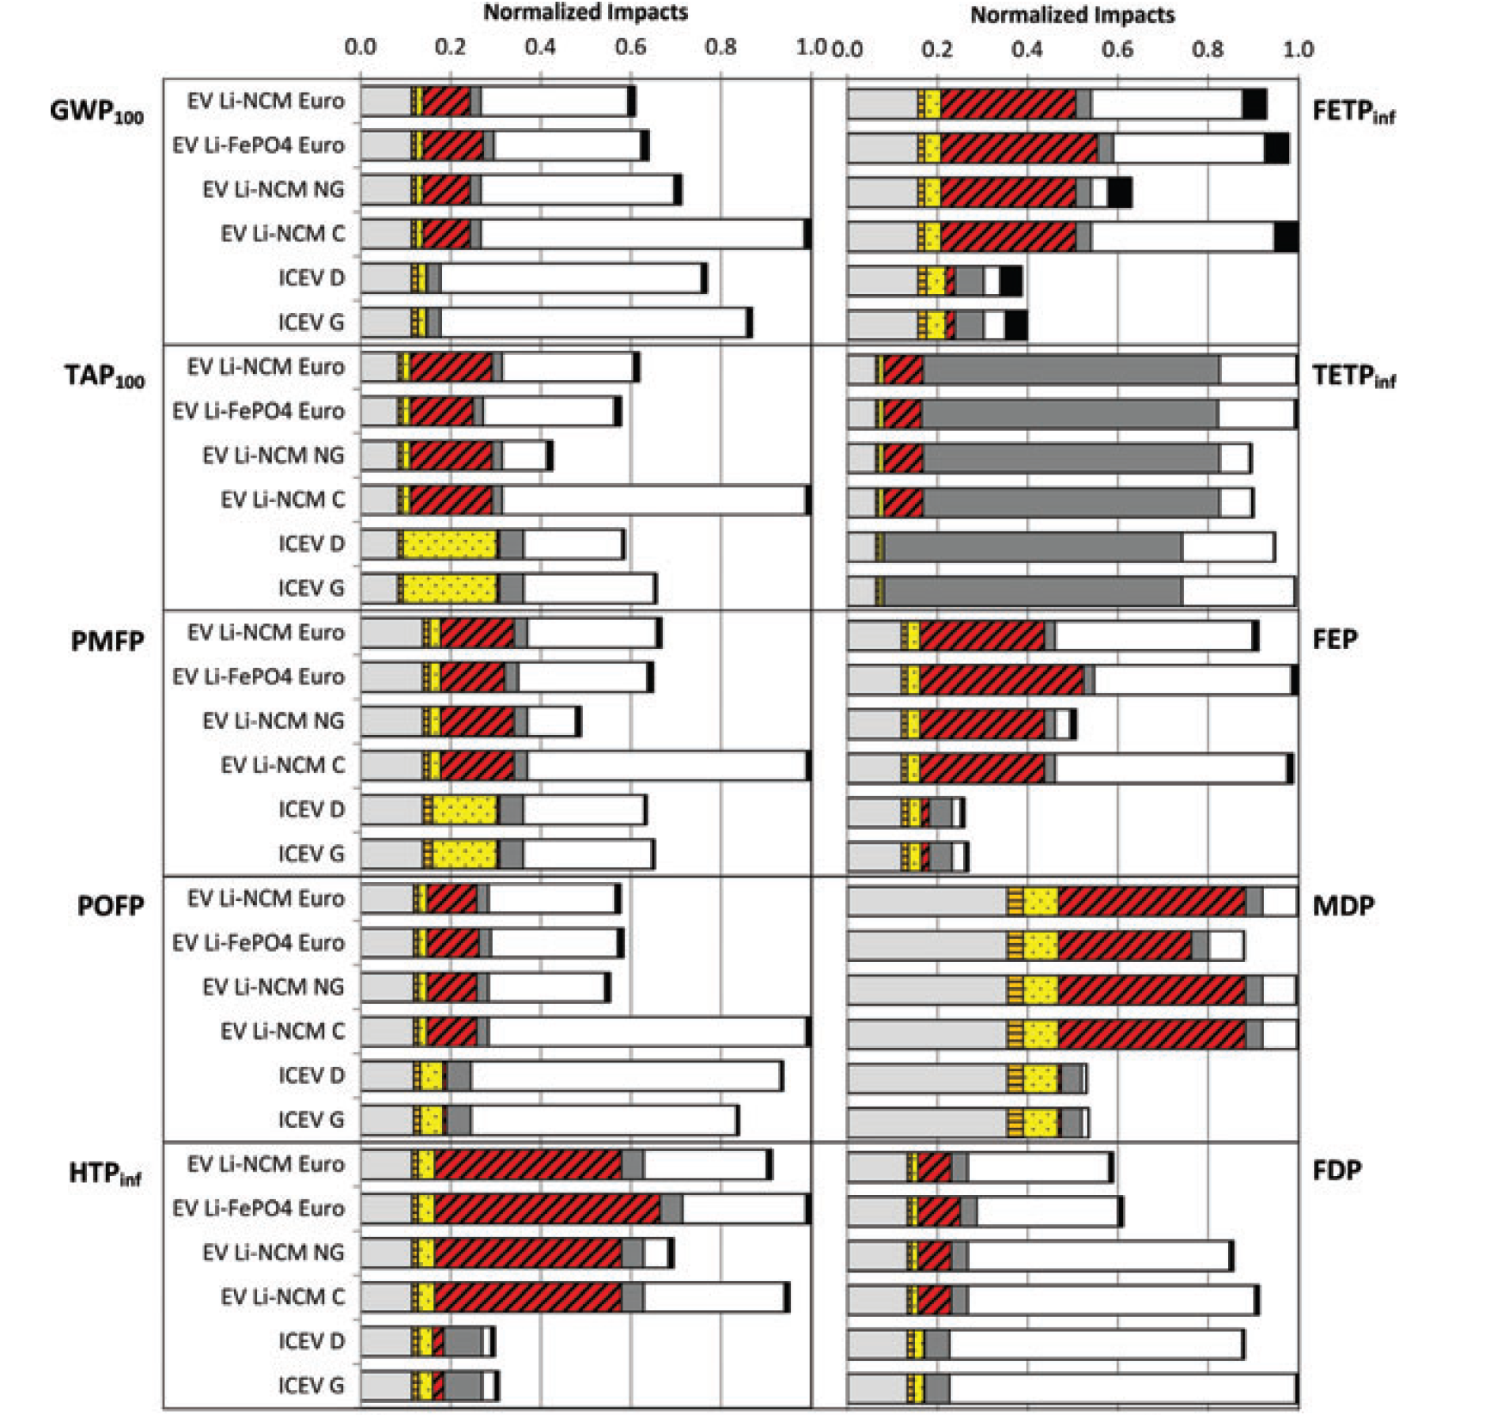
Reduction in some impact categories but increase in others
Acronyms:
1st column
global warming (GWP₁₀₀),
terrestrial acidification (TAP₁₀₀)
particulate matter formation (PMFP)
photochemical oxidation formation (POFP)
human toxicity (HTP_{inf})
2nd column
freshwater eco-toxicity (FETP_{inf})
terrestrial eco-toxicity (TETP_{inf})
freshwater eutrophication (FEP)
mineral resource depletion (MDP)
fossil resource depletion (FDP)
References: Hawkins et al. 2012
Notes:
Hawkins et al. 2012 “Comparative Environmental Life Cycle Assessment of Conventional and Electric Vehicles”

Slide 28
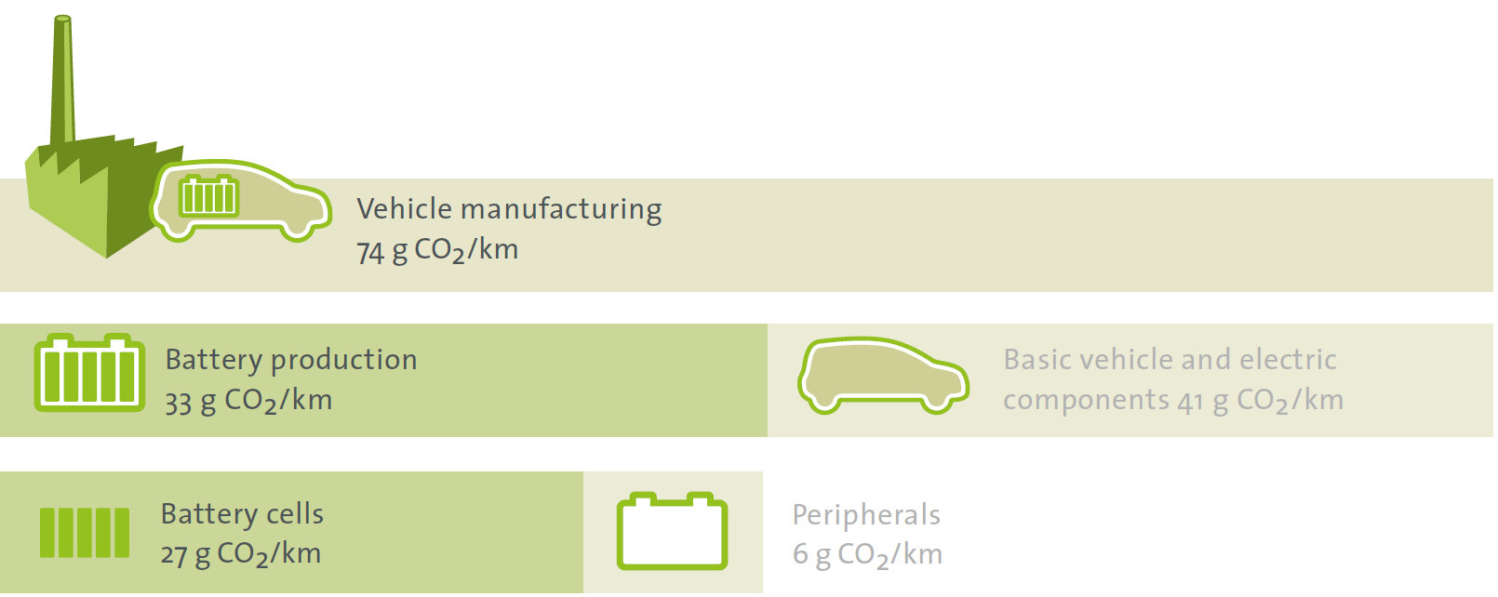
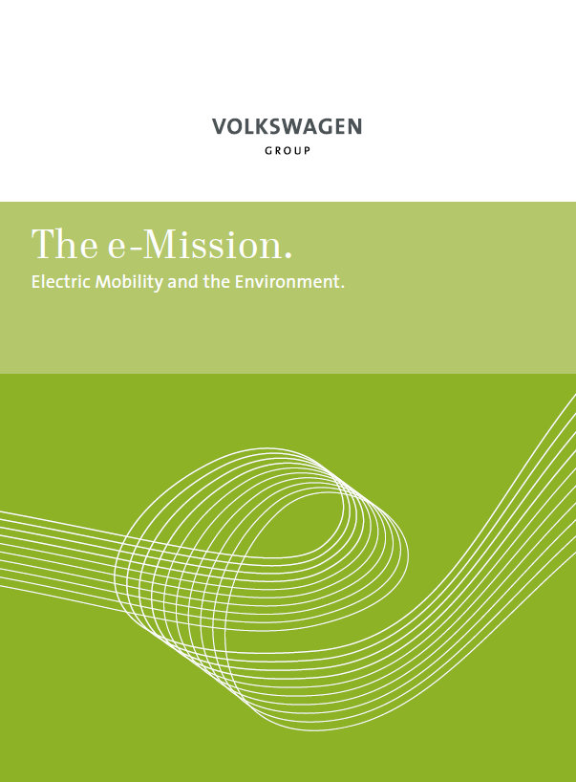
The battery constitute about half of the GHG emissions from vehicle manufacturing
ton CO₂-eq.
g CO₂-eq. / km

Slide 29
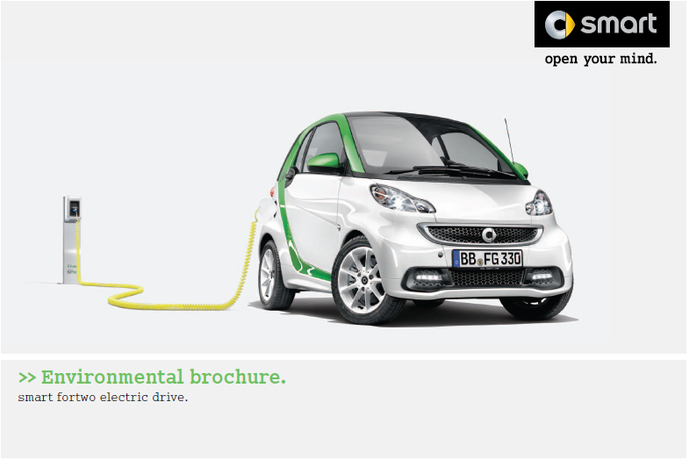
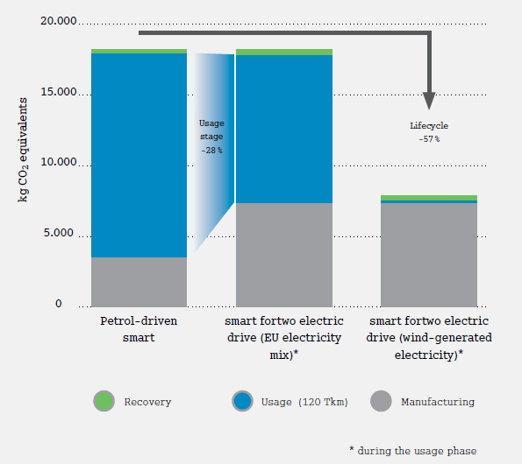
Smart fortwo EV LCA

Slide 30
Size selection
A - segment
B - segment
C - segment
D - segment
E - segment
F - segment

Slide 31
Why electric vehicles?

Slide 32
Notes:
Picture is meant for illustrative purposes only

Slide 33
Notes:
Picture is meant for illustrative purposes only

Slide 34
Notes:
Picture is meant for illustrative purposes only

Slide 35
Notes:
Picture is meant for illustrative purposes only

Slide 36
World energy use and the transport sector
Notes:
About half of the sector’s energy demand and CO2 emissions were due to the estimated one billion light duty vehicles currently in operation worldwide.

Slide 37
Cradle-to-gate studies of lithium-ion traction batteries

Slide 38
Electric vehicles
Mini car in A segment
Medium car in C segment
Large car in D segment
Luxury car in F segment
Notes:
Picture is meant for illustrative purposes only

