Slide 1

Green Production and Green Power

Slide 2
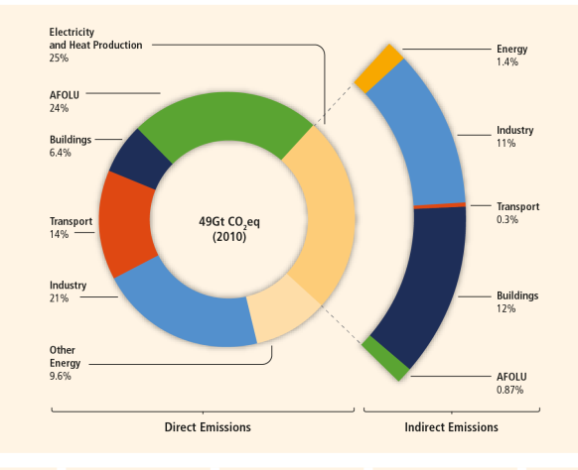
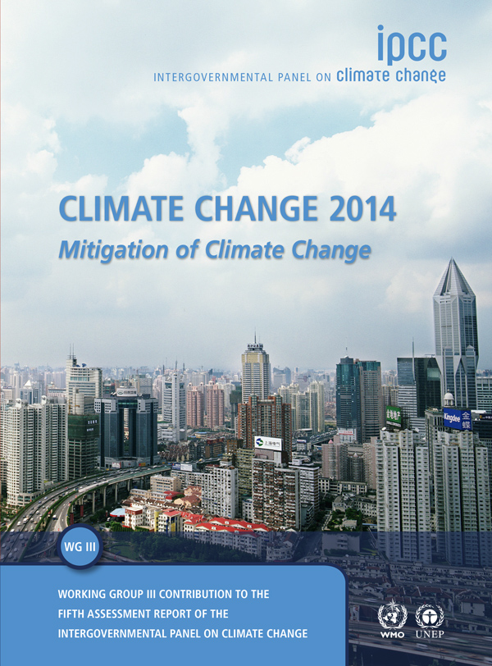

Slide 3
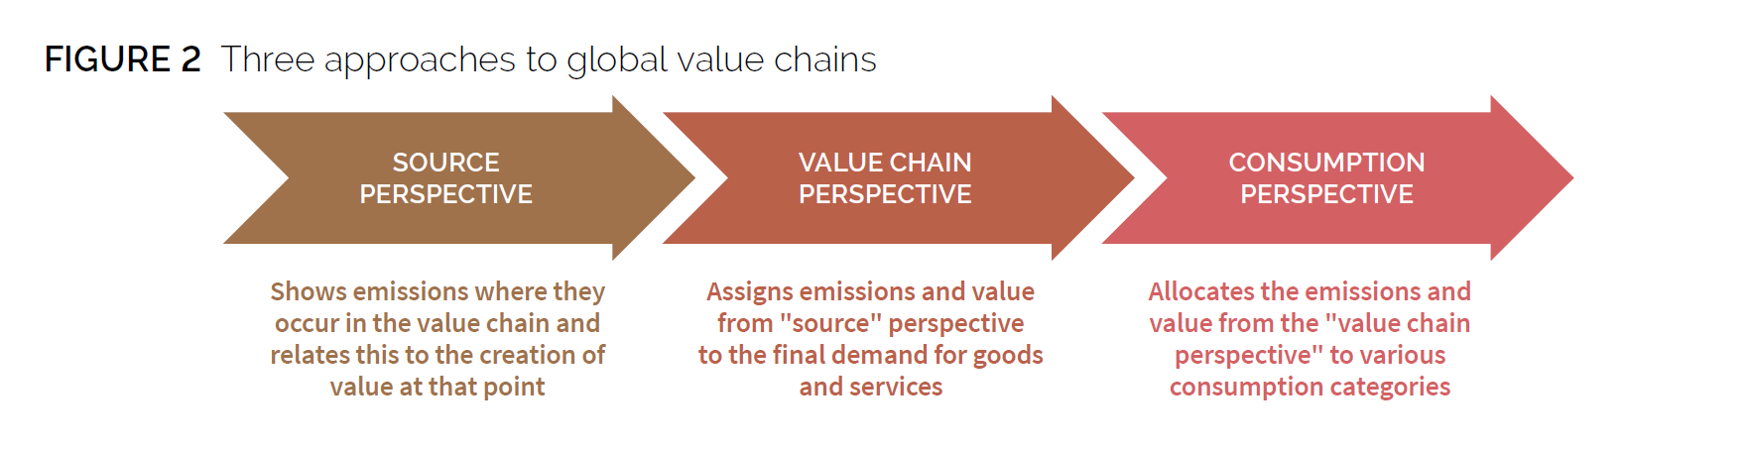

Slide 4
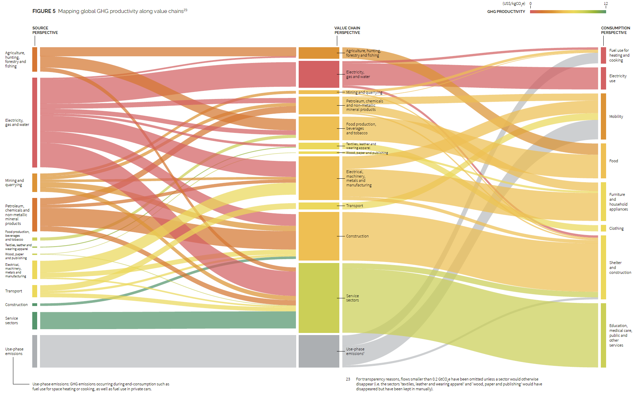

Slide 5
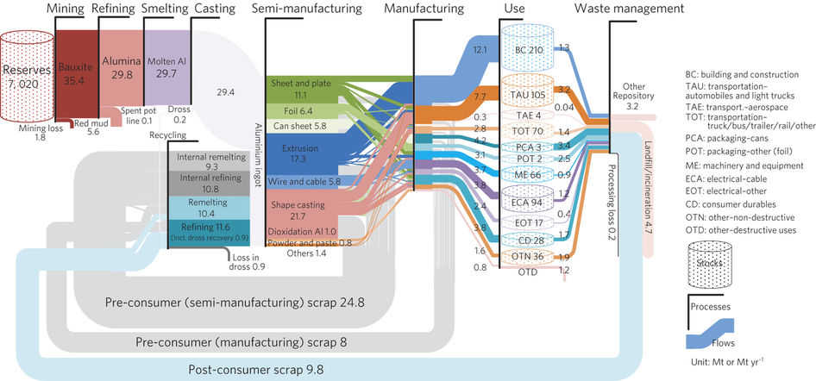

Slide 6
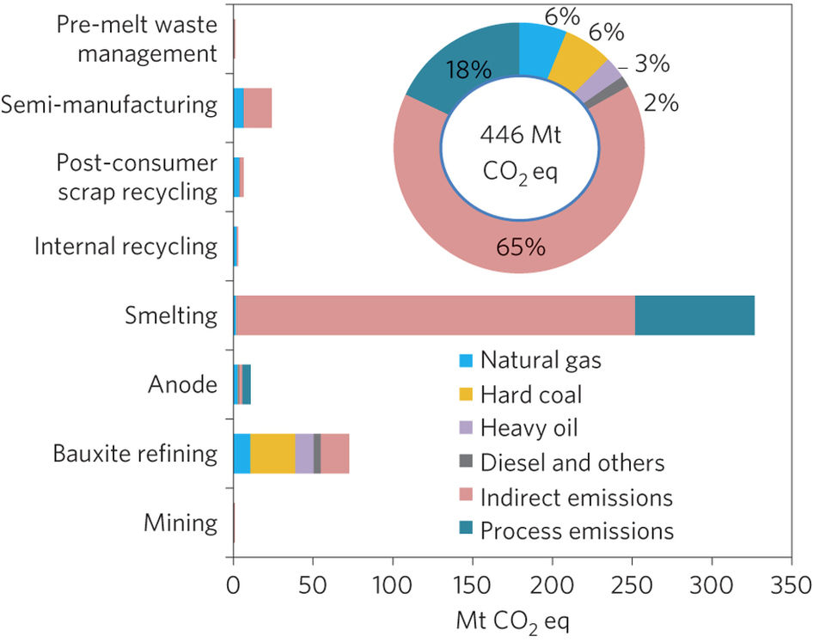

Slide 7
GHG Footprint from Li-ion battery manufacturing
Journal of Industrial Ecology - Ellingsen et al. (2013)

Slide 8
NTNU 2012

Slide 10

NTNU
Industrial Ecology

