Slide 1
Hydrogen value chains – scale and potential
David Berstad
SINTEF Energy Research
CenSES-samling
Hell, 24. august 2017

Slide 2
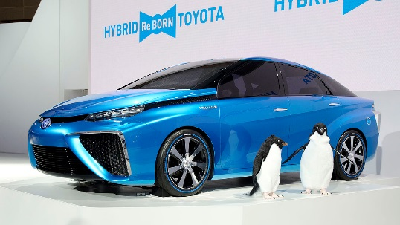
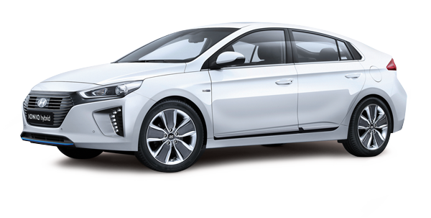
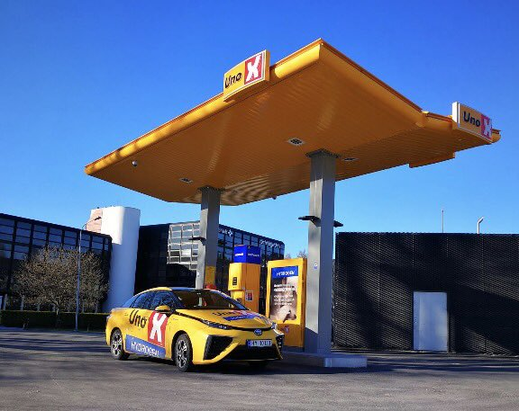
Examples on opportunities for domestic use and export of hydrogen
Hydrogen cars are already in production
H2 Mobility (Germany)
  400 hydrogen fuelling stations by 2023
Nel Hydrogen, Uno-X
  20 hydrogen fuelling stations in Norway by 2020
Greenstat, TiZir, Sunnhordaland kraftlag
  Project on planning of a 50 MW electrolysis plant in Tyssedal
  Replacing coal with hydrogen as reduction agent
Kawasaki Heavy Industries: Planning of a hydrogen pilot chain (2020) and commercial chain (long-term) between Australia and Japan (interest in Norway among others as energy origin)
"Town gas" (e.g. Leeds City Gate) and gas turbine power (e.g. Statoil et al.) in Continental Europe
Source: Wikipedia, hyundai.no
Source: Uno-X

Slide 3
Scale of a hydrogen value chain?

Slide 4
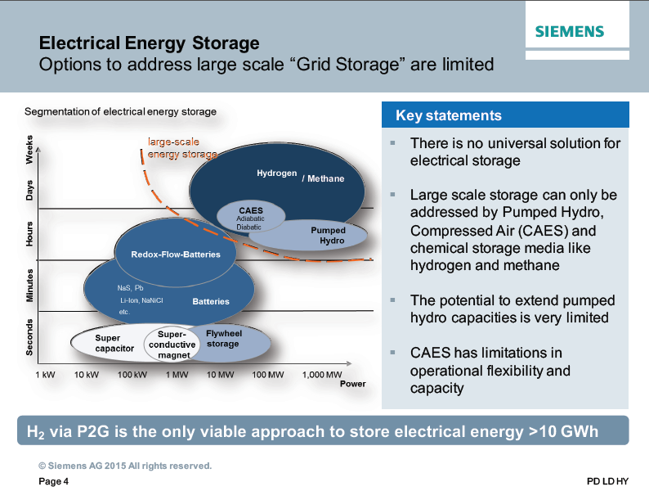
Electrical energy storage
Source:
M. Waidhas. Electrolyzer Technology – the Siemens view (2016)
http://www.scandinavianhydrogen.org/wp-content/uploads/2016/11/2_Manfred-Waidhas.pdf

Slide 5
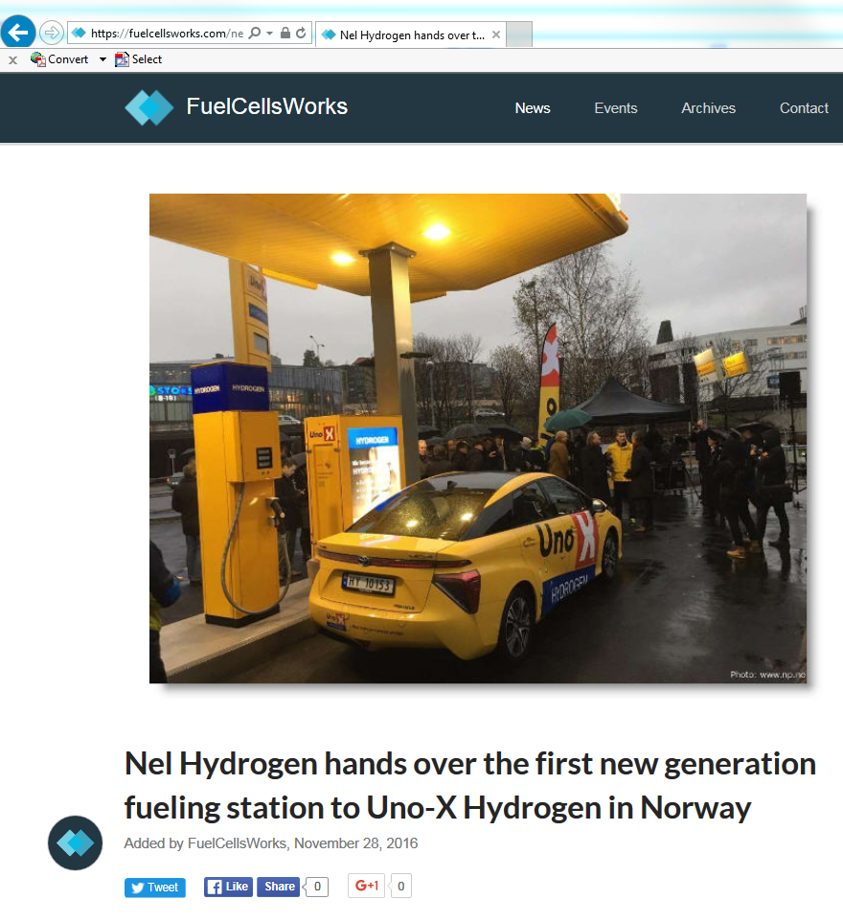
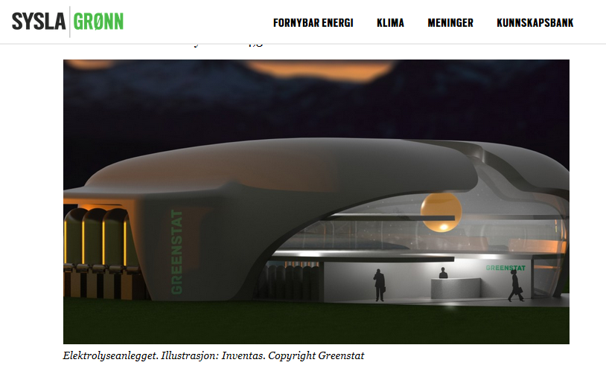
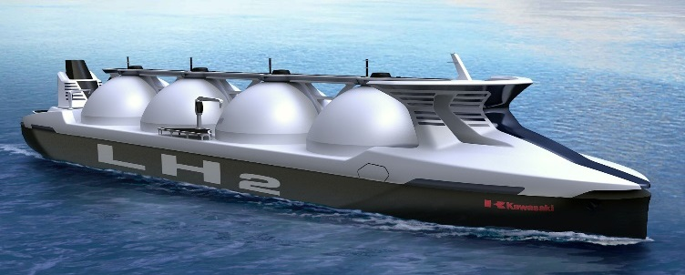
Examples of scale of production/consumption
Hydrogen fuelling station
Domestic use in industry (Tizir, Tyssedal)
Production, liquefaction of LH₂ for long-distance bulk transport
Source: Kawasaki Heavy Industries
x 10
–
x 100
x 15
–
x 25
0.2–1 ton/d
(≈ 0.4–2 MW)
30 ton/d
(≈ 50 MW)
500 ton/d
(> 1000 MW)
x 500–2500

Slide 6
Examples of scale of production/consumption
Scale of the Hyper project
Hydrogen fuelling station
Domestic use in industry (Tizir, Tyssedal)
Production, liquefaction of LH₂ for long-distance bulk transport
Source: Kawasaki Heavy Industries
x 10
–
x 100
x 15
–
x 25
0.2–1 ton/d
(≈ 0.4–2 MW)
30 ton/d
(≈ 50 MW)
500 ton/d
(> 1000 MW)
x 500–2500

Slide 7
Hydrogen production in a "Hyper scale"
How much is 500 ton (liquid) hydrogen per day?
Energy flux in the hydrogen product stream:
  5.8 kg/s * 142 MJ_{HHV}/kg ≈ 820 MW_{HHV}
Equivalent to full loading of a 160 000 m³ ship about every 3 weeks
Sufficient for roughly 2 million FC passenger cars (Japanese figures)
Corresponds to about 7 TWh per year of energy output
How much energy is needed, and how does it harmonise with available primary energy resources in Norway?
Source: Kawasaki Heavy Industries

Slide 8

Energy requirement (1/2)
If 500 tons per day of hydrogen is produced by water electrolysis
Water splitting (70–75 % conv. efficiency): ≈ 1 100–1 200 MW_{el}
Hydrogen compression, liquefaction, utilities: ≈ 200–300 MW_{el}
Total power requirement: ≈ 1 300–1 500 MW_{el}
Annual electrical energy requirement (95% availability):
  10.8–12.5 TWh_{el}/a

Slide 9
Energy requirement (2/2)
If 500 tons per day of hydrogen is produced by natural gas reforming
Natural gas requirement: ≈ 0.8 GSm³/a
Hydrogen liquefaction, CCS, utilities: ≈ 170–270 MW_{el}
Annual electrical energy requirement (95% availability):
  1.4–2.2 TWh_{el}/a

Slide 10
Primary energy sources in Norway
Oil, NGL, condensate
Natural gas
Hydropower
Wind power
Data source: Statistics Norway, Norsk Petroleum

Slide 11
Primary energy sources in Norway
Oil, NGL, condensate
Natural gas
Hydropower
Wind power
Data source: Statistics Norway, Norsk Petroleum

Slide 12
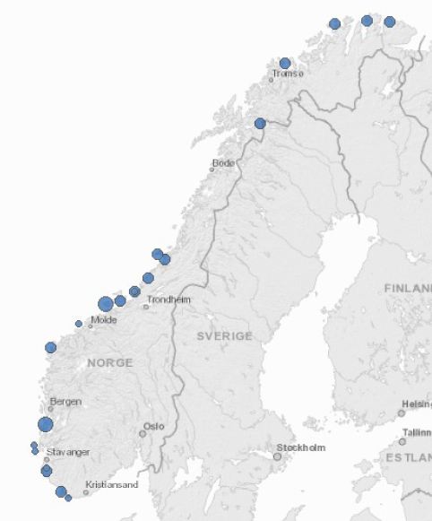
Motivation for potential hydrogen export from Norway
Vast energy resources, especially from natural gas, oil and hydro power
The potential for wind power generation is high, particularly in remote areas
Potential benefits from liquid hydrogen export:
  Potentially reducing the need for extensive
    power transmission capacity upgrades in remote areas
    gas transport pipelines in remote areas (Barents Sea)
  Decarbonisation of fossil energy resources with CCS
    Storage already demonstrated on the Norwegian shelf
    Potential for synergies and cost splitting with other CCS projects
  Strategic diversification of customer base for Norwegian energy resources

Slide 13
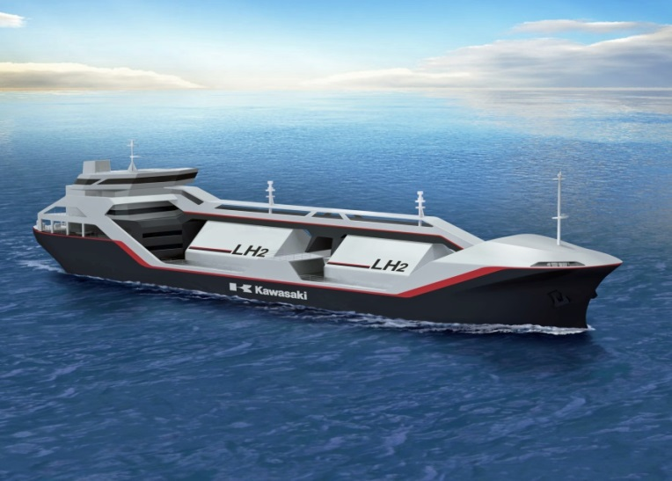
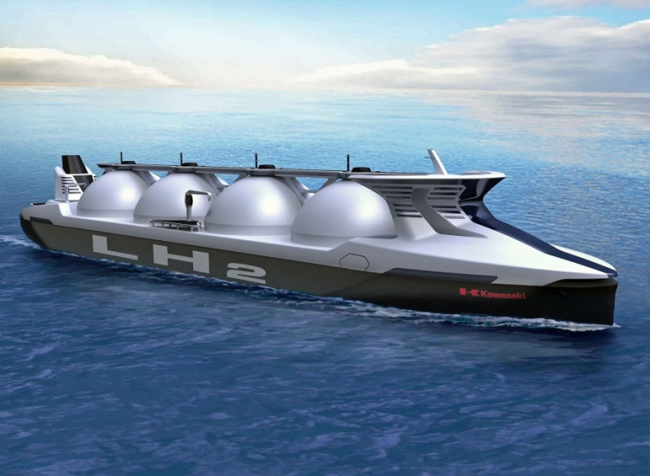
Japanese ambitions for LH₂ import
Pilot hydrogen chain (Target: 2020)
Hydrogen production and liquefaction rate:
  Possibly around 10 tons/day
Pilot ship with 2500 m³ cargo space
Full-scale hydrogen chain
Target hydrogen production and liquefaction rate:
  770 tons/day
Prospective carrier: 160 000 m³ cargo space
Source: Kawasaki Heavy Industries
Source: Kawasaki Heavy Industries

Slide 14










The Hyper project
Startup in May 2016. Duration: 2016–2019
Budget: 20 MNOK
Topic: Large-scale hydrogen production and liquefaction in Norway
  From natural gas with CO₂ capture
  From renewable energy sources (wind power and hydropower)
Networking and contact establishment in Japan and Europe

Slide 15
The Hyper concept

Slide 16
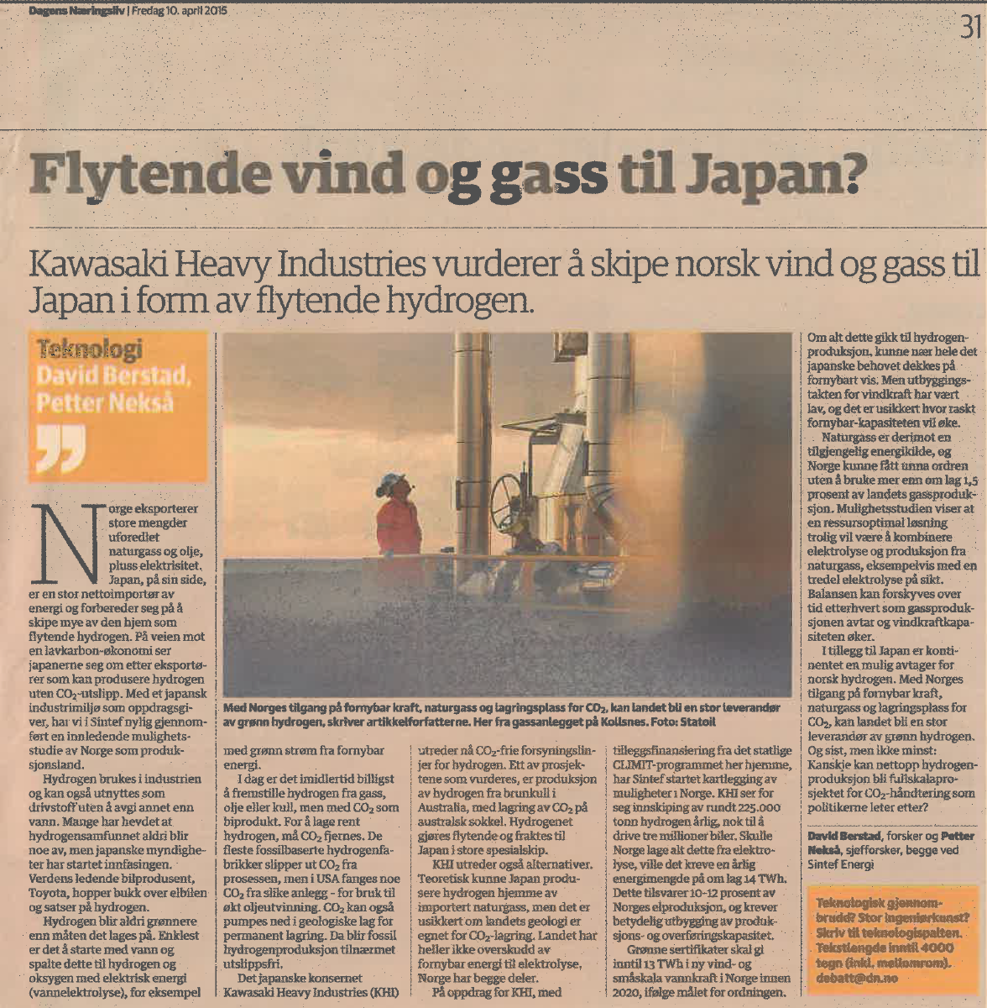
Hydrogen source.
Our view (2015)
"(…) to combine electrolysis and production from natural gas, e.g. with 1/3 from electrolysis in the long run. This balance can be changed over time (…)

Slide 17
Important clarifications to make
What is the scale of the hydrogen value chain?
  kW? MW? GW?
Location of production and consumption?
  1-1? 1-N N-1?
Hydrogen transport distances?
  10's, 100's, 1000's of kilometers?
Optimal transport/distribution mode?
  Pipeline
  Bulk
    Compressed
    Liquid

