Slide 1
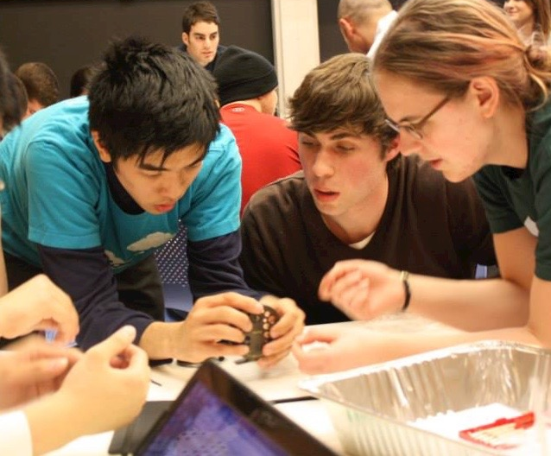
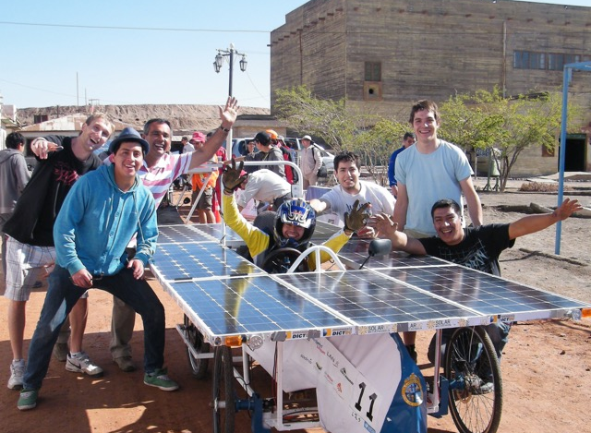
Rewarding and recognising teaching in academic careers
14th June 2021
Notes:
I am engaged with supporting change

Slide 2
Key messages of presentation:
Widespread perception of disparity between reward of teaching and reward of research in higher education
Engrained barriers to addressing the imbalance
Significant collaborative movement for changing academic career pathways and reward systems
Lessons learnt from universities that have implemented change

Slide 3
Key messages of presentation:
1
Widespread perception of disparity between reward of teaching and reward of research in higher education
Engrained barriers to addressing the imbalance
Significant collaborative movement for changing academic career pathways and reward systems
Lessons learnt from universities that have implemented change

Slide 4
Teaching Cultures Survey
Notes:
Self selecting group of unis
Anyone else lie to join?

Slide 5
15,659 participants
10 countries
21 universities
`
```````

Slide 6
Average institutional response rate
32%
`
```````

Slide 7
Definition of ‘university teaching’
‘University teaching’ refers to all activities relating to teaching and learning at universities.
Examples could include: teaching students; curriculum development; pedagogical research in higher education; student supervision and the development of university educational policy/strategy.
Notes:
Anyone else?
Survey was designed this year

Slide 8
Survey focus
Trust in the system: perceived institutional commitment to rewarding university teaching
The levers for change: the role of university teaching in key institutional processes
Promotion priorities: the role of university teaching in promotion to full professorship
Aspirations: expectations and desires for change to how university teaching is rewarded

Slide 9
Promotion criteria to full professorship
“How important would you like each of the following activities to be for promotion to full professor at your university (for a typical academic on a research/teaching contract)?”
university teaching
research
entrepreneurship, enterprise & external engagement
service to the university / administration

Slide 10
Promotion criteria to full professorship
“How important would you like each of the following activities to be for promotion to full professor at your university (for a typical academic on a research/teaching contract)?”
Not important
Somewhat important
Very important
It depends on the academic
Don’t know

Slide 11
Respondents who would like each activity to be very important ….
n = 15,502

Slide 12
… respondents who report each activity currently is very important
n = 15,502

Slide 14
Key messages of presentation:
Widespread perception of disparity between reward of teaching and reward of research in higher education
Engrained barriers to addressing the imbalance
Significant collaborative movement for changing academic career pathways and reward systems
Lessons learnt from universities that have implemented change

Slide 15
Key messages of presentation:
Widespread perception of disparity between reward of teaching and reward of research in higher education
Engrained barriers to addressing the imbalance
Significant collaborative movement for changing academic career pathways and reward systems
Lessons learnt from universities that have implemented change
2

Slide 16
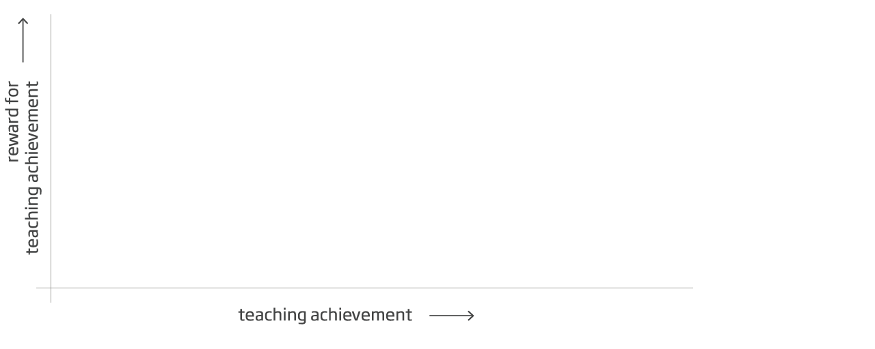

Slide 17
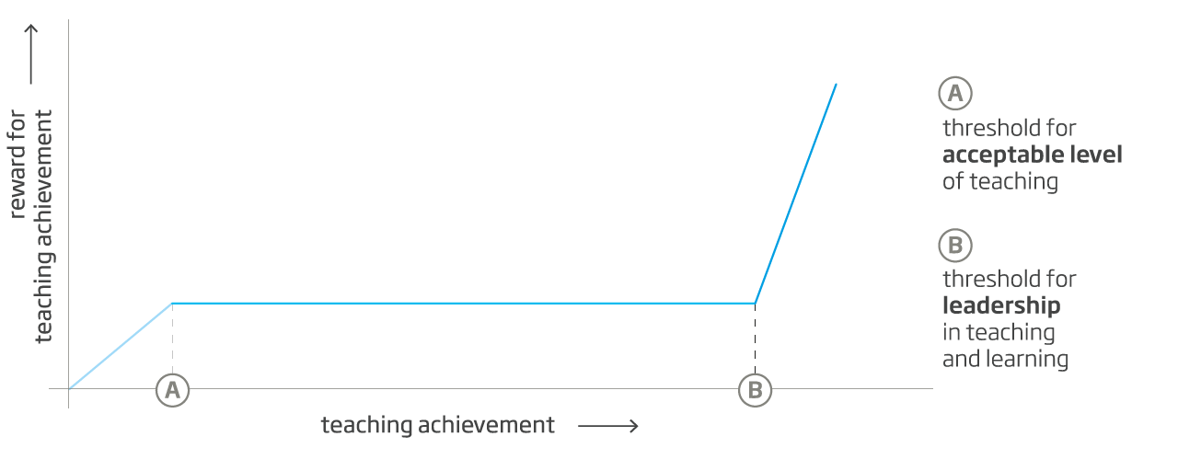
Notes:
Uni leaders acknowledging problem – educational innovation is contingent on rewad and recognistion

Slide 18
Challenges:
the absence of clear and accepted definitions of progressive ‘levels’ of teaching achievement that punctuate each stage of the career ladder

Slide 20
Challenges:
the absence of clear and accepted definitions of progressive ‘levels’ of teaching achievement that punctuate each stage of the career ladder
the inadequacy of the forms of evidence currently used to demonstrate and evaluate the teaching contribution of academics at each stage in their career progression

Slide 21
The Career Framework for University Teaching

Slide 22
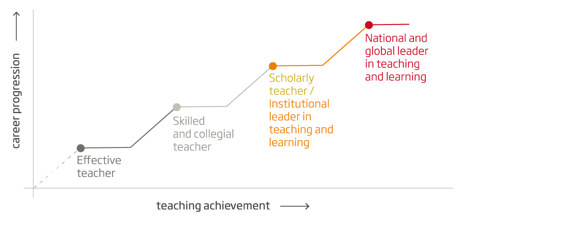
The Career Framework for University Teaching

Slide 23
Key messages of presentation:
Widespread perception of disparity between reward of teaching and reward of research in higher education
Engrained barriers to addressing the imbalance
Significant collaborative movement for changing academic career pathways and reward systems
Lessons learnt from universities that have implemented change

Slide 24
Key messages of presentation:
Widespread perception of disparity between reward of teaching and reward of research in higher education
Engrained barriers to addressing the imbalance
Significant collaborative movement for change academic career pathways and reward systems
Lessons learnt from universities that have implemented change
3

Slide 25
Institutional reform: UCL (UK)

Slide 26
Institutional reform: UCL (UK)
UCL Academic Careers Framework
In 2017, UCL launched its Academic Careers Framework for 2017/18 promotion round.
The Framework focuses on the candidate’s impact across four domains: teaching, research, institutional citizenship and enterprise/external engagement. Candidates must identify which of these four domains is: a threshold ability, a core ability and an extended/specialist ability.

Slide 27
National reform: Netherlands
Agreement across all 13 Dutch research universities
National agreement across all research universities to radically reform academic career pathways, with change in all domains, including research, leadership and teaching.
Supported by new national bursary scheme – Comenius Grant scheme – to support teaching, which is also structured around the Framework.

Slide 28
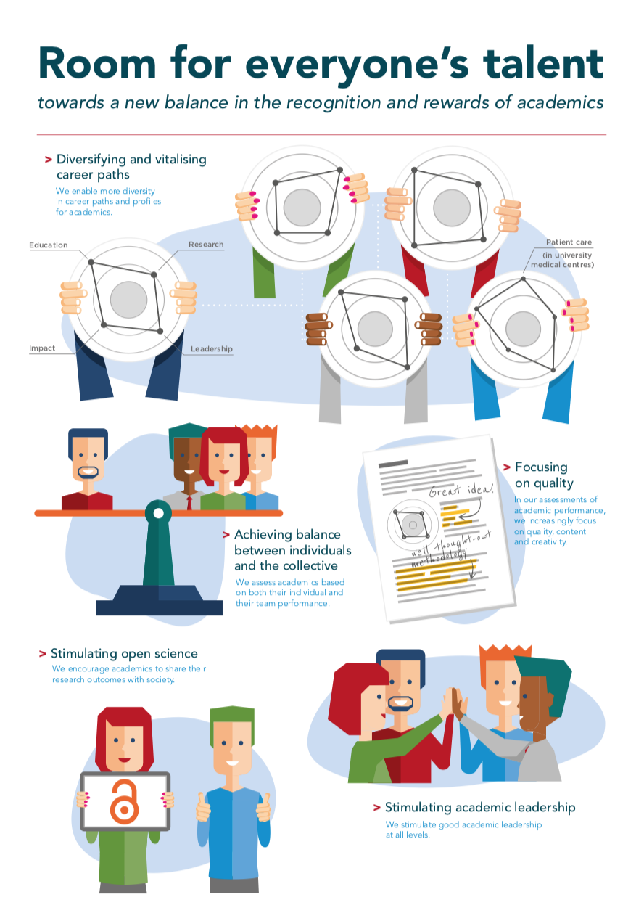
National reform: Netherlands
Notes:
Position paper

Slide 29
Key messages of presentation:
Widespread perception of disparity between reward of teaching and reward of research in higher education
Engrained barriers to addressing the imbalance
Significant collaborative movement for changing academic career pathways and reward systems
Lessons learnt from universities that have implemented change

Slide 30
Key messages of presentation:
Widespread perception of disparity between reward of teaching and reward of research in higher education
Engrained barriers to addressing the imbalance
Significant collaborative movement for change academic career pathways and reward systems
Lessons learnt from universities that have implemented change
4

Slide 31
Major (and sometimes catastrophic) challenges faced:
Misalignment of the policies and practices: same profile of candidate promoted, or candidates applying with insufficient evidence
Low participation in the new career opportunities: lack of trust in the new systems and opportunities for career advancement
Education-focused faculty become teaching ‘work horses’: with no opportunities to engage in activities to advance their career
Strongly voiced ‘push back’ from a core group of faculty: particularly from research-focused faculty

Slide 32
Common factors associated with successful change:
1. The academic community is convinced that:
the university is genuinely committed to rewarding teaching
a sound evidence-based base had been made for change
any changes would respect academic autonomy
2. Potential candidates for new opportunities are confident that:
genuine opportunities for professional development and career advancement will continue to be available
education-focused pathways will not become ‘second rate’
line managers, department heads and promotion board members will consistently recognize, endorse and reward teaching achievements

Slide 33
Teaching Cultures Survey focus
Trust in the system: perceived institutional commitment to rewarding university teaching
The levers for change: the role of university teaching in key institutional processes
Promotion priorities: the role of university teaching in promotion to full professorship
Aspirations: expectations and desires for change to how university teaching is rewarded

Slide 34
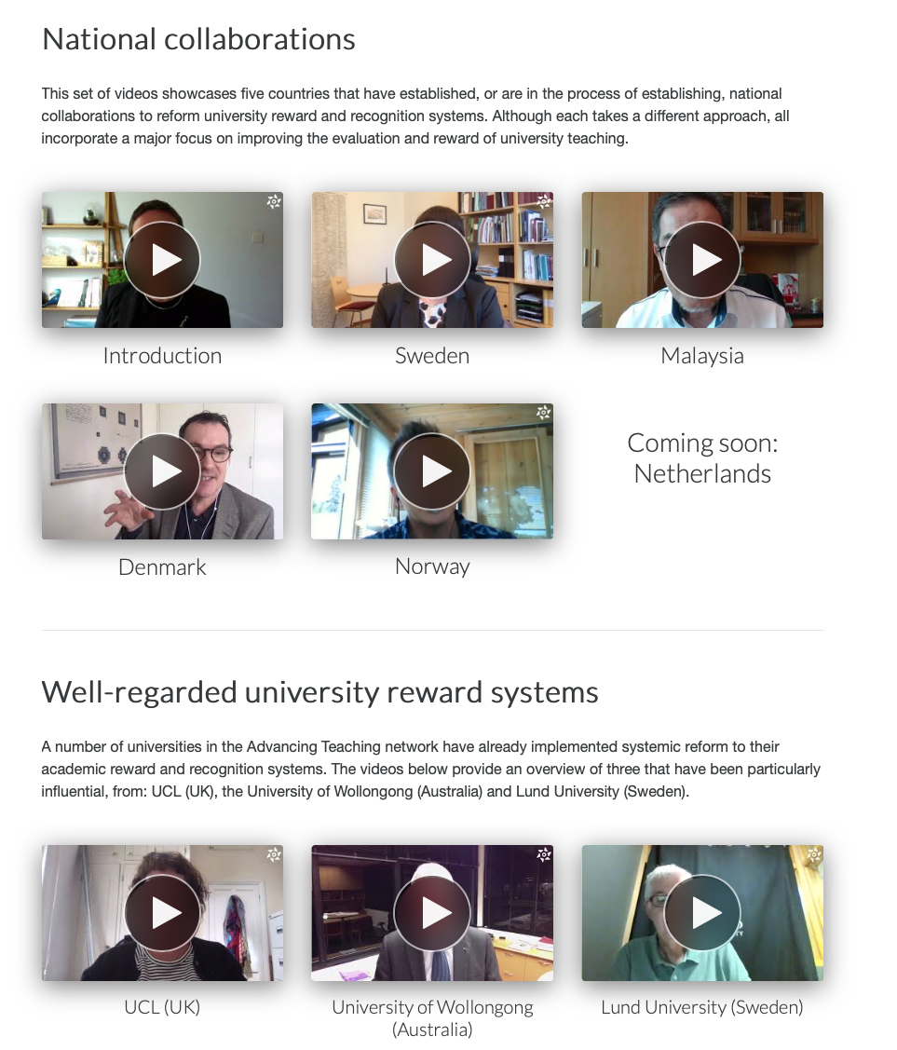
www.advancingteaching.com

Slide 35
Thank you

