Slide 1
Information about studying in Japan
Hiroshi Matsumoto
NTNU representative in Japan
Innovation Norway, Tokyo
hiroshi.matsumoto@innovationnorway.no

Slide 2
It is time for you to come to Japan for study!
In the past few years, major Japanese universities have been internationalized rapidly due to strong push / support by the Government.
  They started offering many courses, classes in English
  Double degree programs, Degree programs in English, One year / half year programs for exchange students
  They are very much improving support for foreign students
It is a asset to learn Japanese / Asian value standards, perspectives, ways of approaches to science, engineering, and societal challenges.
  to learn what is more global and local
  Re-define your own culture and value standards
  Japan is becoming a hub of Asian culture and economical activities attracting many Asian students, industry people

Slide 3
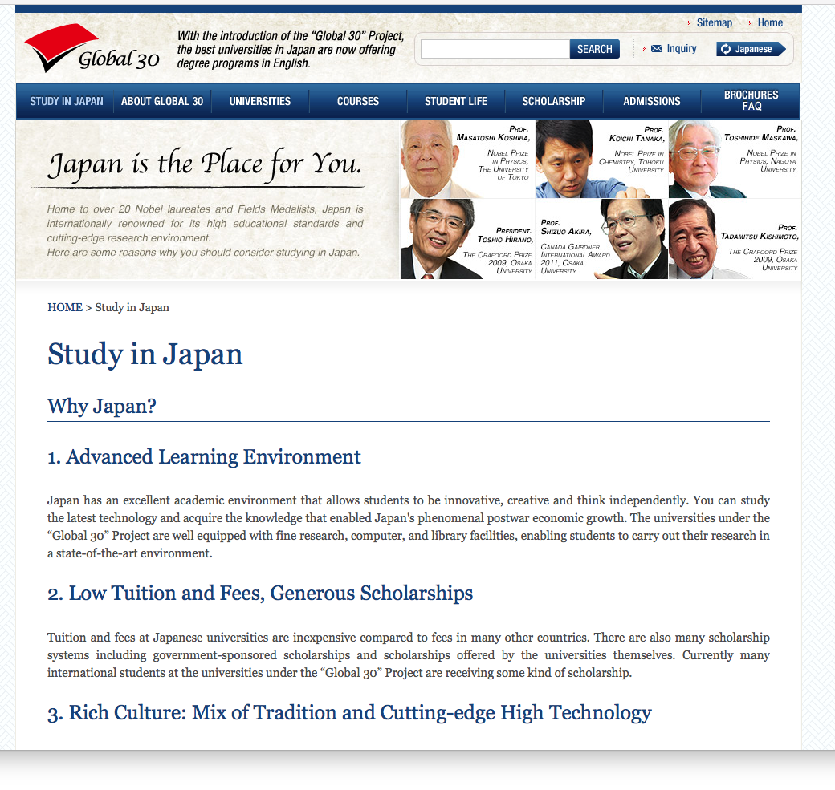
Portal site for Study in Japan: Japan: http://www.uni.international.mext.go.jp/study/

Slide 4

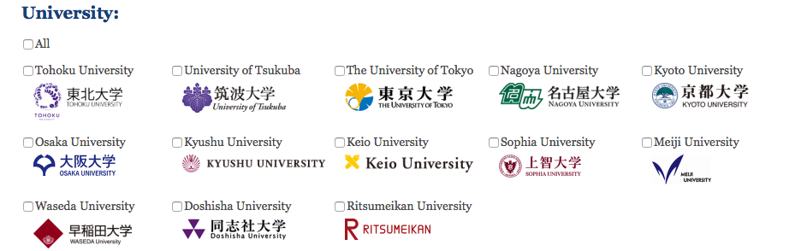

Slide 5
Japanese universities already concluded MoUs with NTNU for student exchanges
Name of university | Bachelor /Master /PhD | Program information | Durations | lectures given in English
The University of Tokyo, The School of Engineering | undergraduate / graduate | http://global.t.u-tokyo.ac.jp/t-cens_EAP/general-information/ | 6 months ~ 1 year | http://www.oice.t.u-tokyo.ac.jp/e_lectures/pdf/Lecture_May2015.pdf
Tokyo Institute of Technology | undergraduate / graduate | http://www.titech.ac.jp/english/graduate_school/international/exchange/acap.html | up to 1 year | http://www.titech.ac.jp/english/graduate_school/international/exchange/pdf/Class_List_U.pdf http://www.titech.ac.jp/english/enrolled/life/graduate_timetables.html
Waseda University | Bachelor | http://www.sci.waseda.ac.jp/eng/admissions_us/international/ | up to 1 year | http://www.sci.waseda.ac.jp/eng/admissions_us/schools/
Kyoto University | Undergraduate / graduate | http://www.kyoto-u.ac.jp/en/education-campus/international/students1/exchange.html | 6 monts or 1 year | http://www.z.k.kyoto-u.ac.jp/pdf_document/introduction/syllabus.pdf?1460678275 http://www.kyoto-u.ac.jp/en/education-campus/international/students1/program/guide/documents/Spring_2016_semester.pdf

Slide 6
Links between research, education, and innovation
You will be able to utilize research infrastructures which are not available in NTNU or Norway.
Researchers / Professors can send their Ph.D. students to Japan to acquire skills to utilize them.
Students having mastered these skills can bridge Norway and Japan for research collaborations.
There are many front-end element technologies / know-hows in Japan which are not fully utilized.
You might be able to come up with innovative ideas how to utilize/integrate these element technologies to find solutions to societal challenges / innovations.

Slide 7
An example of internship program in Japan
- Vulcanus in Japan: http://www.eu-japan.eu/events/vulcanus-japan
Vulcanus in Japan program consists of industrial placements for EU / COSME students. It starts in September and ends in August of the following year. The students follow:
  a one-week seminar on Japan,
  a four-month intensive Japanese language course,
  and then an eight-month traineeship in a Japanese company.
Objectives
  To study the range of advanced technologies employed by a leading Japanese host company.
  To learn Japanese and to understand and appreciate Japanese culture with a view to an enriching one year experience abroad.
  To be well placed in your future career to interact with Japanese businesses and people.
Example of industries / institutions regularly hosting
  Hitachi Central Laboratory, NTT Communications, NTT Data, NTT Basic Research Laboratories, Fujitsu Laboratories, Mitsubishi Chemical

Slide 8
Internship in Japan
Japanese industries are welcoming / looking for good foreign internship students from following reasons
  They are in short of good engineers /researchers and they are finding good inters are quite productive
  They want to build connections with abroad through internship and internationalize their activities
  They regard internship as a part of recruitment process
Innovation Norway in Tokyo is helping to start a pilot internship program in Japan.
  “Mayekawa”, one of the strongest company in industrial refrigeration has agreed to host NTNU students.
  Arrangement to fulfil academic requirements are now investigated. As an example, following arrangement with Waseda University in Tokyo is possible.
    4 weeks of intensive introductry Japanese course from mid June to mid July.
    One engineering class given in English on Saturdays in fall semester in parallel to internship in industry.

Slide 9
For more detailed/specific information, please come to ask during the network session!

