Slide 1
Exchange year at Tokyo University 15/16
Dara Goldar
Physics and mathematics
Graduate School of Science, Department of Physics
Content: - why Japan?
- application procedure
- daily life at school
- housing
- leisure time

Slide 2
Why Japan?
Support and guidance from university → ideal timing
Language
Culture
Resume

Slide 3
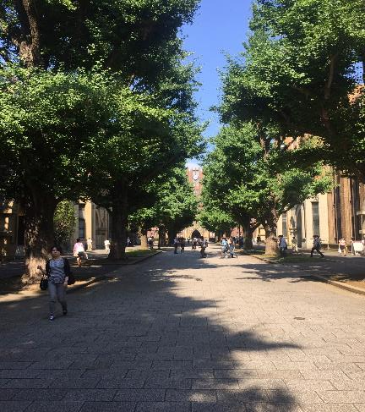
Application procedure: general agreement
Graduate School of Science
Housing
Tuition waiver
→ Flexible!

Slide 4
School
Language
Exam

Slide 5
Share House
+ Interesting environment (age, occupation, nationality)
+ Culture
+ Japanese
+ Share House activites
+ Central
- Expensive→ part-time job

Slide 6
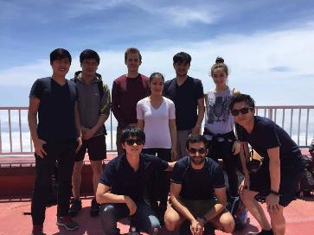
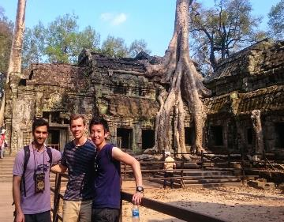
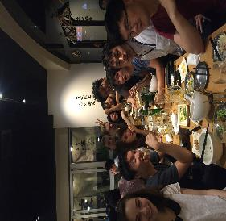
Leisure time
Yakiniku
Onsen
Taiko
Sørøst-Asia
Odaiba
Mt. Fuji
Sumo

