Slide 1
Outreach and communication
May 2013
Notes:
The fifth set of slides in a series of six about the Norwegian University of Science and Technology (NTNU):
Introduction
Education and learning environment
Research and artistic activities
Innovation and creativity
Outreach and communication
Internationalization

Slide 2
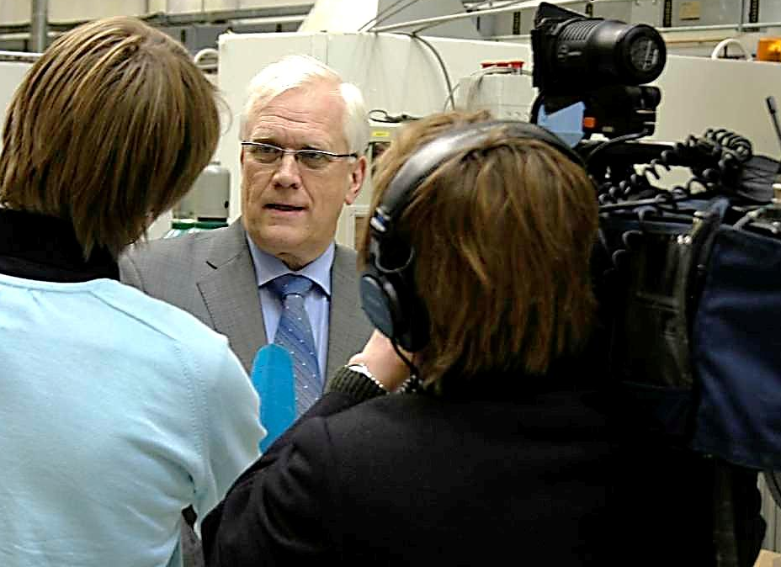
OUTREACH AND COMMUNICATION
Communication objectives
Active contributors to public debate.
Provide research-based expertise.
Generate interest in science and technology.
Make NTNU’s academic reputation visible.
May 2013
Notes:
From NTNU’s strategy ”Knowledge for a better world» approved by the NTNU Board March 30 2011. See www.ntnu.edu/strategy
Picture: NTNU’s rector (until august 2013) comments the newly released national budget for 2008. Photo: Tor H. Monsen/NTNU Info.

Slide 3
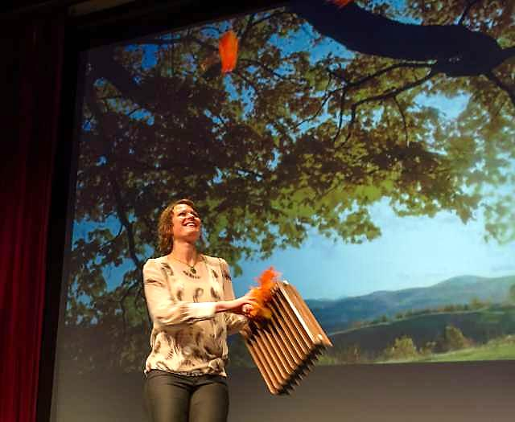
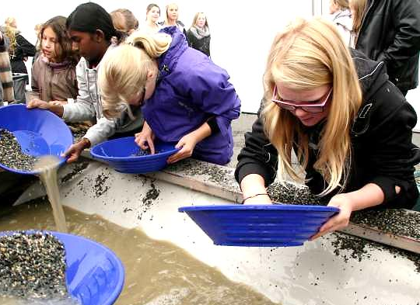
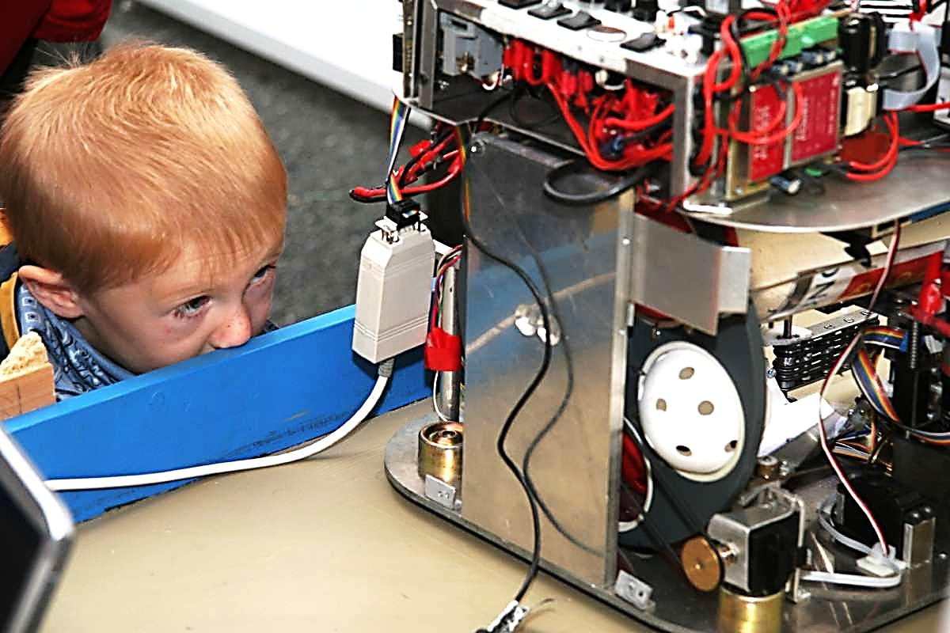
May 2013
Notes:
Pictures:
Top: «Researcher Grand Prix» for 2012 in the Student Society Grand hall. PhD-candidate Hanne Nøvik, Dept. of Hydraulic and Environmental Engineering. (Nøvik eventually won the competition). Photo: Thor Nielsen/NTNU Info.
Right: The Science Festival September 2012. Gold fever. Youth at the stand made by Geological Survey of Norway/Trondheim Science Centre, best stand 2012. Photo: Nina E. Tveter/NTNU Info.
Bottom left: The Annual Research Festival in Trondheim Sept. 2008. Boy watching «Eurobot 2008», a minirobot that recognizes indoor bandy balls and picks them up. Photo: Mentz Indergaard/NTNU Info.

Slide 4
OUTREACH AND COMMUNICATION
Science communication
Category | 2009 | 2010 | 2011 | 2012
Popular science articles | 282 | 212 | 220 | 227
Feature articles | 221 | 197 | 252 | 193
Popular science lectures | 897 | 790 | 790 | 861
Popular science books | 19 | 20 | 25 | 14
Media contributions | 3405 | 2488 | 3746 | 2635
Artist and museum presentations/exhibitions | 118 | 100 | 81 | 124
May 2013
Notes:
Data for 2012 from CRIStin February 2013: Logg inn → Rapporter → Institusjon → Kategorifordeling → (Enhet NTNU), Sett Startår og Sluttår → Vis rapport (wait 10-15 sec.) → Vis underkategorier.
Media contributions (Mediebidrag ) consists of the four subcategorie Documentary (Dokumentar), Program hosting (Programledelse), Program participation (Programdeltagelse) and Interview (Intervju). More than 90 % of the Media contributions come from the subcategory Interview. Artist and museum-related presentations (Kunstnerisk og museal presentasjon) consists of the five subcategories Museum exhibition (Museumsutstilling), Architecture exhibition (Arkitektutstilling), Art exhibition (Kunstutstilling), Web exhibition (Webutstilling) and Other (Annet). (Sources: All numbers from previous editions of NTNU’s Annual Report to the Ministry of Education and Research. Numbers for 2011 from the Cristin database as of 22 Feb 2012.) The highly fluctuating numbers for Media contributions for 2009 and 2011 are due to contributions from election experts in years of elections for municipalities (2011) and parliament (2009).

Slide 5
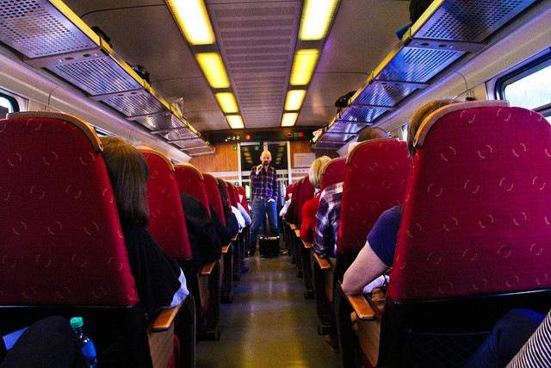
OUTREACH AND COMMUNICATION
Public events (2012)
Arranged 72 public events
13 000 visitors at the Science Fair and Researchers’ Night
21 000 mentions in Norwegian and international media
11 000 followers on NTNU’s Facebook account
6 500 followers on NTNU’s Twitter account
Publish popular science magazines Gemini and Spor
Net publication www.universitetsavisa.no and contributes to www.forskning.no
May 2013
Notes:
Number of public events: The sum of the Science Fair events (30 NTNU stands), Knowledge city (Kunnskapsbyen) (42), cf. NTNU’s Annual Report to the Ministry of Education and Research (Rapport og planer 2012–2013), p. 32ff.
Number of visitors: Rapport og planer 2011–2012, p. 32ff.
Number of media mentionings and followers: NTNU’s Annual Report to the Ministry of Education and Research (Rapport og planer 2011–2012), p. 32ff, based on searches in the media search provider Retriever as.
The magazine Gemini on web: www.gemini.no
The magazine Spor on web: www.ntnu.no/vitenskapsmuseet/spor
CRISTIN-report for NTNU in 2011 (Logg inn → Rapporter → Institusjon → Kategorifordeling → (Enhet NTNU), Set Startår and Sluttår → Run report (takes 20-30 sec.) → Vis underkategorier).
Picture: Reserachers’ Train to Røros 28 Sept. 2012. Professor in Sociology, Aksel Tjora, gives a lecture on situations and community on the train. Photo: Kari Støre Gullichsen/NTNU SVT.

Slide 6
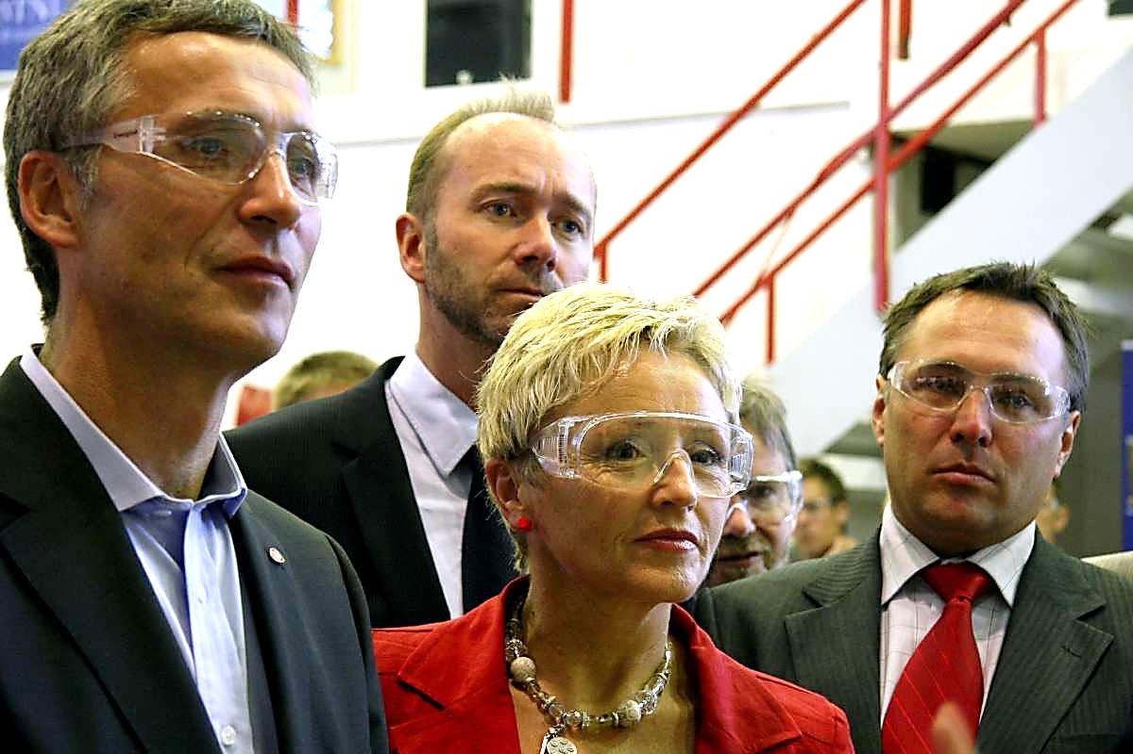
OUTREACH AND COMMUNICATION
Information for our user groups
Category | 2010 | 2011 | 2012
Scientific reviews | 101 | 93 | 103
Papers in trade journals | 58 | 52 | 66
Textbooks | 21 | 29 | 18
Technical books | 28 | 30 | 31
Reports | 146 | 174 | 174
Compendia | 13 | 16 | 12
May 2013
Notes:
Data for 2012 from CRISTIN-report as of February 2013 (Logg inn → Rapporter → Institusjon → Kategorifordeling → (Enhet NTNU), Sett Startår og Sluttår → Kjør rapport (20-30 sec.) → Vis underkategorier).
Previous data from NTNU’s Annual Report to the Ministry of Education and Research (Rapport og planer 20XX–20XX+1).
Picture: From left: Prime minister Mr. Jens Stoltenberg, Minister of Trade and Industry Mr. Trond Giske, Minister of Local Government and Regional Development Ms. Liv Signe Navarsete and County Mayor for Sør-Trøndelag County (with Trondheim where NTNU is situated) Mr. Tore O. Sandvik, in NTNU’s Thermal Engineering Laboratories 9 Sept. 2010. Photo: Nina E. Tveter/NTNU Info.

Slide 7
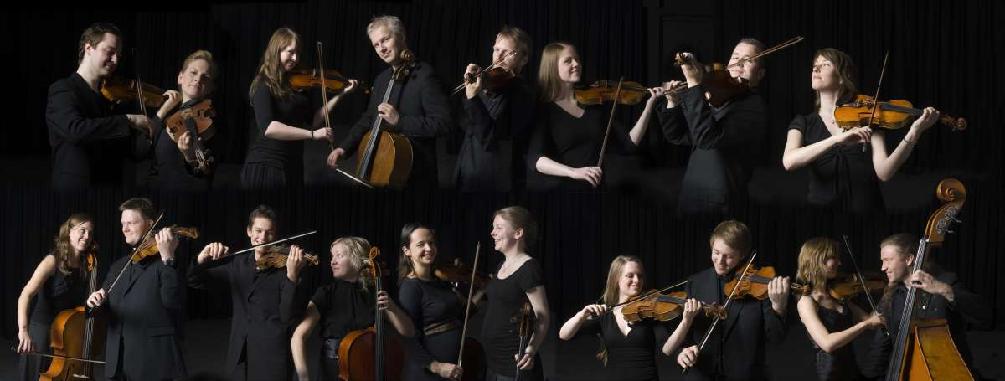
OUTREACH AND COMMUNICATION
Art and museum presentations
Category | 2008 | 2009 | 2010 | 2011 | 2012
Museum presentation | 23 | 31 | 24 | 15 | 27
Art exhibition | 13 | 37 | 22 | 25 | 39
Architecture exhibition | 0 | 2 | 1 | 8 | 10
Film production | 2 | 1 | 1 | 2 | 1
Theatre production | 12 | 8 | 10 | 12 | 9
Music recording | 6 | 3 | 6 | 2 | 5
May 2013
Notes:
Data for 2012 from CRISTIN-report as of February 2013 (Logg inn → Rapporter → Institusjon → Kategorifordeling → (Enhet NTNU), Sett Startår og Sluttår → Kjør rapport (20-30 sec.) → Vis underkategorier).
Previous data from NTNU’s Annual Report to the Ministry of Education and Research (Rapport og planer 2011–2012), NTNU-table 5 p. 30-31 (www.ntnu.no/strategier)
Picture: The Trondheim Soloists 2009-2010. From press material, www.trondheimsolistene.no/#media Photo: Jørn Adde, Trondheim/Trondheimsolistene.

Slide 8
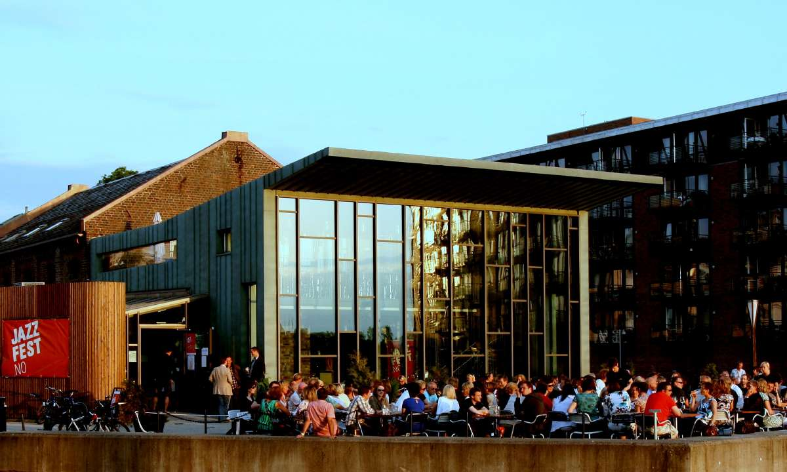
OUTREACH AND COMMUNICATION
Our cultural partners
The Trondheim Soloists
Trondheim Jazz Festival
Trondheim Chamber Music Festival
Team NTNU (cross country skiing team)
Dokkhuset Stage (rental agreement)
The Pstereo Festival
The Trøndelag Exhibition
Individual performers/CD releases
May 2013
Notes:
Regular collaborating partners (from ppt on Culture sponsing at NTNU).
NTNU is a central renter of the Dokkhuset Stage.
Picture: Dokkhuset Stage at Nedre Elvehavn/Solsiden, June 2008, Jazz Festival. Photo: Dokkhuset as/NTNU Info.

Slide 9
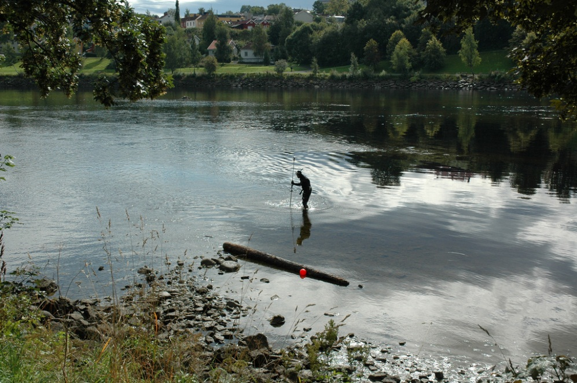
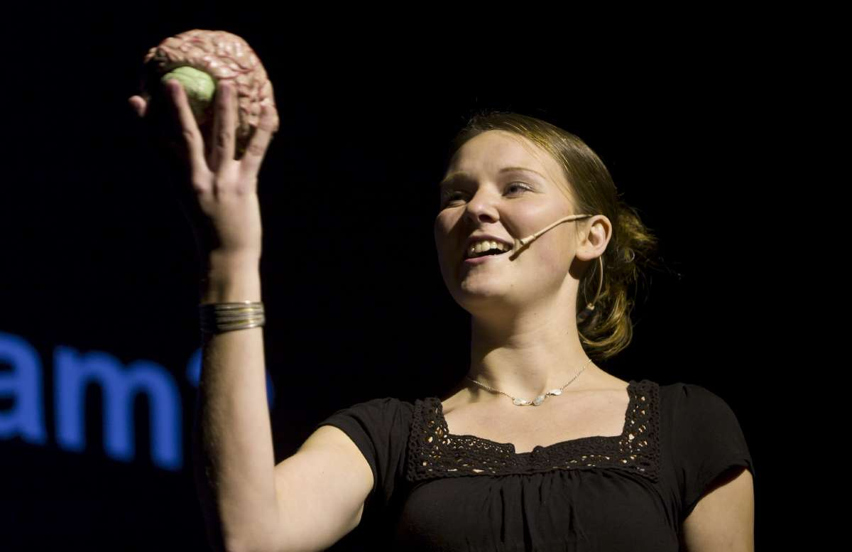
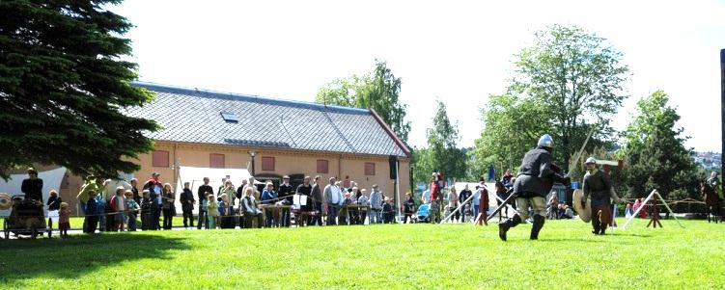
OUTREACH AND COMMUNICATION
“Trondheim – a city of knowledge”
May 2013
Notes:
“City of knowledge” is a cooperative project with organizations and institutions into regional knowledge-based communication. In 2011 there were 46 events as lectures, debates, city walks and excursions. The events have had an average of 70 participants, and seven of the lectures have been recorded in video for use by NTNU or the Norwegian Broadcasting Corporation’s program slot Kunnskapskanalen. They attracted an audience of 503 000. City of Knowledge cooperates with festivals and other events/arrangers in Trondheim’s culture life/arena to make science communication an integrated part of the city’s recreational acitivities.
Pictures: Top left: Researcher Grand Prix 2010 in the Student Society Building, presentation by PhD candidate Tora Bonnevie. Photo: Thor Nielsen/NTNU Info.
Bottom left: Medieval Days at NTNU’s Museum of Natural History and Archaeology, 6 June 2009. Photo: Navid Golmohammadi, NTNU Vitenskapsmuseet.
Top right: Surveying the middel ages bridge of Elgeseter. Photo: Øyvind Ødegård/NTNU Vitenskapsmuseet.
Bottom right: Stone ages activities at NTNU University Museum 15 Oct 2009. You can pretend to be an archaeologist in the sandbox. Photo: Tove Eivindsen/NTNU Vitenskapsmuseet.

Slide 10
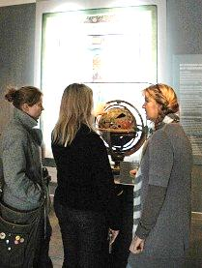
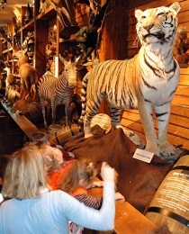
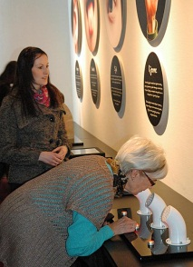
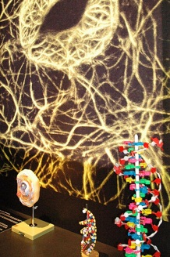
OUTREACH AND COMMUNICATION
NTNU University Museum – I
A leader in Norway on research, resource management and science communication in natural and cultural history
Scientific collections of national and international importance in natural and cultural history
The collections include
960 000 plants, animals and insects
8000 fossils, rocks and minerals
500 000 objects related to archaeology and cultural history
May 2013
Notes:
www.ntnu.no/vitenskapsmuseet/english
Museum of the year in Norway 2010.
Information from the Annual Report of NTNU University Museum, www.ntnu.no/vitenskapsmuseet/english
Pictures from top down:
1760; Noah’s Ark; Science and truth; Research and future.
All photos: Tove Eivindsen/NTNU Vitenskapsmuseet.

Slide 11
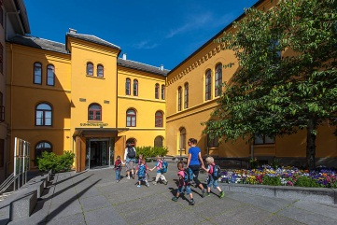
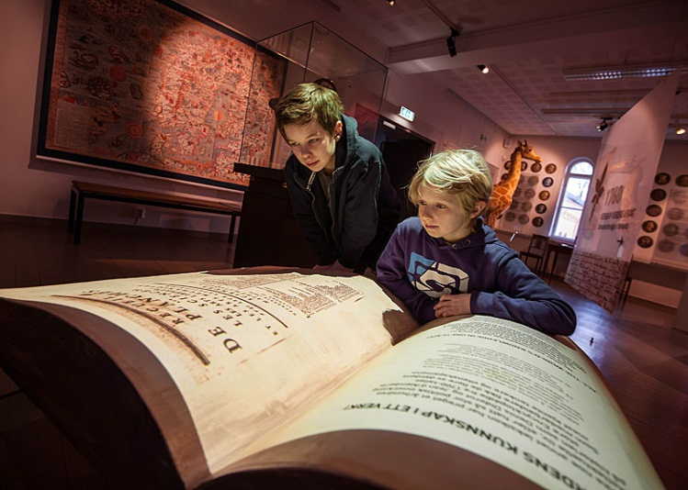
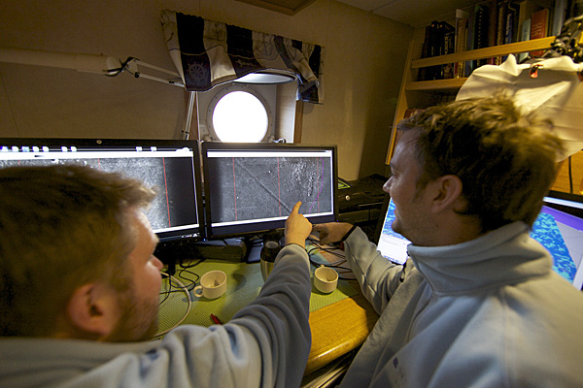
OUTREACH AND COMMUNICATION
NTNU University Museum – II
May 2013
Notes:
Pictures:
Top middle: The entrance to the museum in Gunnerushuset, July 2012. Photo: Åge Hojem/NTNU VM
Middle bottom: On bord R/V Gunnerus; on the screen pricture transmitted by Autonomous Underwater Robot. Photo: Geir Johnsen/NTNU NT, Trondhjem Biologiske Stasjon.
At left: Biologists/etymologists Chief Engineer Karstein Hårsaker and Assistant Professor Kaare H. Aagaard in the field. Photo: Åge Hojem/NTNU VM
To the right: Two boys looking at an old book in the museum. Photo: Åge Hojem/NTNU VM.

Slide 12
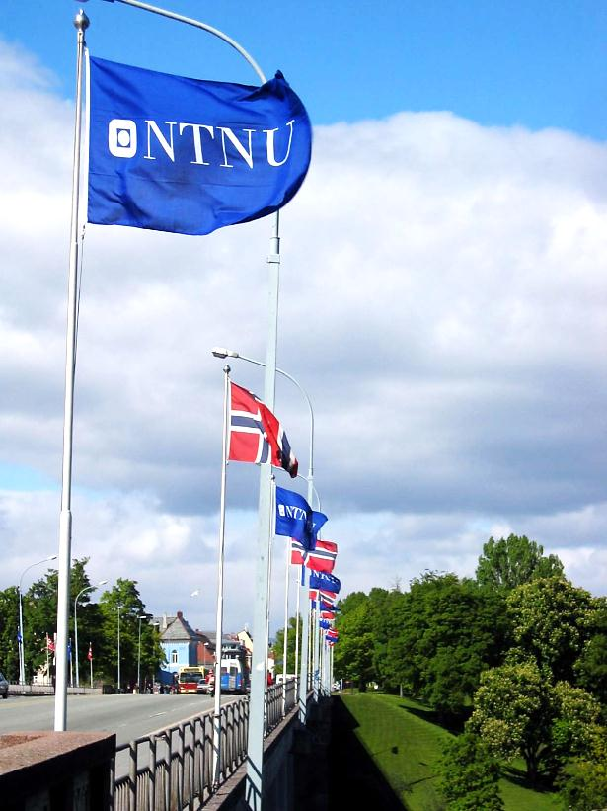
OUTREACH AND COMMUNICATION
NTNU’s national reputation
Reputation: Best reputation among universities among the Norwegian public. NTNU scores high on competence, professionality and societal responsibility.
Quality: 92 % of graduated master’s students are satsified or highly satisified with their studies at NTNU.
Well-being: Trondheim students are the most satisfied students at Norwegian universities.
Credibility: NTNU is regularly among the top universities listed by Norwegian journalists for credibility and overall rating.
Top leader alumni: Close to 20 % of the CEOs at Norway’s 500 leading companies are alumni of NTNU.
Adds value: NTNU develops sought-after competence, has a rich campus life, contributes to the national wealth creation and is a leader in R&D.
May 2013
Notes:
Sources: Reputation: Spørreundersøkelse om offentlige etater, Synovate, Oct. 2012.
Quality: Arnesen et al. 2012. NIFU-report 39/2012 Arbeidsmarkedssituasjon og tilfredshet med utdanningen blant ulike grupper av nyutdannede, Fig. 4.3. In addition: 41 % of Norwegian students think NTNU offers education of the highest quality. Second: University of Oslo at 20 %. (Sentio, May 2010).
Well-being: (TNS Gallup, January/February 2011). See www.sitel.no/Nyheter2/Studentenes-helse-og-trivselsundersoekelse-rapport-SHoT-2010 p.28
Credibility: Investigation among journalists. In 2012 NTNU was no. 1 (Aalund Business Research, Jan. 2013). NTNU has come first every year since 2007, except 2011 when Univ. of slo was first, NTNU second.
Top leaders: Only the Norwegian Business School BI and the Norwegian School of Economics have more leaders in Norwegian business and industry. (Topplederundersøkelsen 2012)
Adds value: Opinion among a majority in a national investigation, Norfakta 2007 and Sentio 2010. (Nasjonale spørreundersøkelser, Norfakta 2007 og Sentio 2010).
Picture: NTNU’s flags on the Elgeseter Bridge during the Doctoral Degree Awards Ceremony 28 May 2004. Photo: Mentz Indergaard/NTNU Info.

Slide 13
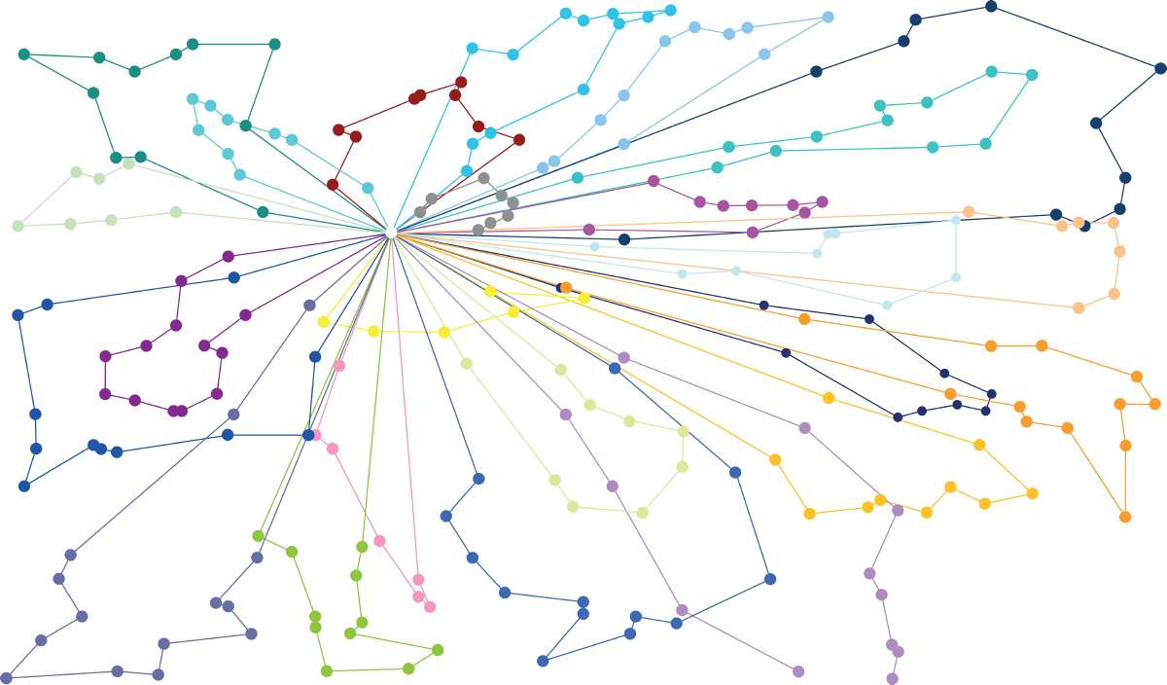
OUTREACH AND COMMUNICATION
Digital footprint (January 2013)
University | World ranking website visits | Facebook likes | Twitter followers | # screenings YouTubevideos
NTNU | 16 189 | 11 590 | 6 639 | 429 004
UiO | 10 954 | 5 446 | 7 453 | 34 759
UiB | 13 276 | 13 954 | 3 132 | 422 684
UiTø | 53 294 | 4 800 | 2 996 | 34 790
KTH | 15 171 | 5 501 | 2 435 | 54 989
Chalmers | 72 672 | 5 395 | 711 | 45 515
Delft | 32 964 | 11 729 | 10 424 | 766 143
ETH | 9 935 | 4 144 | 2 959 | 56 205
May 2013
Notes:
UiO = University of Oslo; UiB = University of Bergen; UiTø = University of Tromsø; KTH = Kungliga Tekniska Högskolan/Royal Institute of Technology, Stockholm; Chalmers = Chalmers tekniska högskola/Chalmers University of Technology, Gothenburg; Delft = Delft Univ. of Technology, The Netherlands; ETH = Eidgenössische Technische Hochschule/Swiss Federal Institute of Technology.
Visit at own websites: Data collected 28 january 2013. Numbers show how popular the websites are compared to all the world’s websites. Low number equals high ranking. The ranking is based on the web traffic ranking of www.alexa.com, backed by Amazon. The rank is based on aggregated traffic over three months from search engines and other sources. The rank enclose both the number of visitors and the number of pages visited at each domain. The rank also includes any parallell sites. NTNU is included with both www.ntnu.no (Norwegian) and www.ntnu.edu (English).
Facebook: Data gathered 28 Jan. 2013. Wikipedia is the world’s most visited website, next after Google, according to Alexa.com. The numbers show how many that like the most popular official FB-page from each university here listed. The numbers are for the following sites: NTNU: www.facebook.com/ntnu.no; UiO: www.facebook.com/UniOslo; UiB: www.facebook.com/universitetetibergen; UiTø: www.facebook.com/UniTromso; Chalmers: www.facebook.com/chalmersuniversityoftechnology; KTH: www.facebook.com/pages/Royal-Institute-of-Technology/105684872798314; Delft: www.facebook.com/TUDelft; ETH: www.facebook.com/pages/ETH-Zurich/307004006039
Twitter: Data gathered 28 Jan. 2013. Number of followers measured by the statistical tool in Twitter. Chalmers is the only university where we did not find an official Twitter-account, and instead used that of their library.
YouTube: Data gathered 28 Jan. 2013. YouTube is the world’s third most visited website, according to Alexa.com. We have tried to find the official channels from the universities listed, with the most published videos. The numbers show how many times the videos of these channels have been screened/downloaded. The numbers do not necessarily reflect how many videos the university have placed on the web, as publication on YouTube is not systematic. Many units, projects and individuals upload videos on their own initiative. The numbers displayed relate to the following channels:
NTNU: www.youtube.com/user/ntnuinfo; UiO: www.youtube.com/user/UiOinfo; UiB: www.youtube.com/UniBergen; UiTø: www.youtube.com/user/universitetetitromso; Chalmers: www.youtube.com/user/ChalmersUniversity; KTH: www.youtube.com/user/kth; Delft: www.youtube.com/user/tudelft; ETH: www.youtube.com/user/ethzurich
Picture underneath: Illustration of networks planning. Distribution Innovation. Ill.: Raymond Nilsson/NTNU Info.

Slide 14
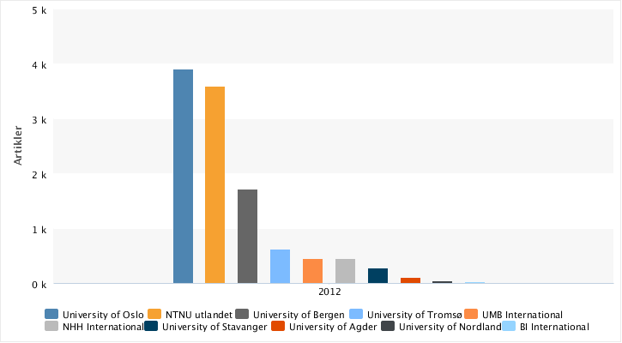
OUTREACH AND COMMUNICATION
Foreign media coverage
Web newspapers. (For Sweden newspapers in print are also included.)
Univ. of Oslo
NTNU
Univ. of Bergen
May 2013
Notes:
Except for Sweden, the numbers are for web news only, not newspapers in print.
University of Oslo in first place, as in 2011 . This year it is due to the trial of the terrorist from the 7/22 terror action at Utøya. A number of scientists at Univ. of Oslo were interviewed by foreign journalists.
Time line for the number regarding media mentionings for 2009 (1st number), 2010 , 2011 and 2012:
Univ. of Oslo: 2056 – 1739 – 2597 – 3896
NTNU: 1350 – 1850 – 1762 - 3589
Univ. of Bergen: 764 – 1004 – 839 - 1707
Univ. of Tromsø: 312 – 330 – 316 - 610
Univ. of Stavanger: 159 – 209 – 215 - 266
Univ. of Life Sciences at Ås: 77 – 163 – 186 - 452
Norwegian School of Economics : 180 – 438 (no observations pre 2012)
Norwegian Business School BI: 40 – 21 (no observations pre 2012)
Univ. of Agder: 6 – 13 – 16 - 94
Univ. of Nordland: 5 – 32 (no observations pre 2012)
Notice that the search co. Retriever outside of Norway surveys almost exclusively web media, with a few exceptions in the Nordic countries. With a good global coverage of printed newspapers we would surely see more mentioning of universities.

Slide 15
OUTREACH AND COMMUNICATION
GEMINI – multichannel
Gemini.no – daily science news in Norwegian
Accessible on smartphones and e-book readers
Two annual paper editions in English and Norwegian
Produced in a cooperation between SINTEF and NTNU
NTNU’s foremost science communication channel
May 2013
Notes:
www.gemini.no
Picture: Cover of Gemini no. 1/2012. Photo: Geir Mogen/NTNU Info.
Gemini offers free subscriptions for the paper edition
Gemini has the last years received national awards for magazine journalism; two 1st prizes, one 2nd prize and two 3rd prizes.
Cover picture: Photo: Geir Mogen/NTNU Info (Gemini no. 1/2012)

