Slide 1
Introduction
May 2013
Notes:
The first set of slides in a series of six about the Norwegian University of Science and Technology (NTNU):
Introduction
Education and learning environment
Research and artistic activities
Innovation and creativity
Outreach and communication
Internationalization

Slide 2
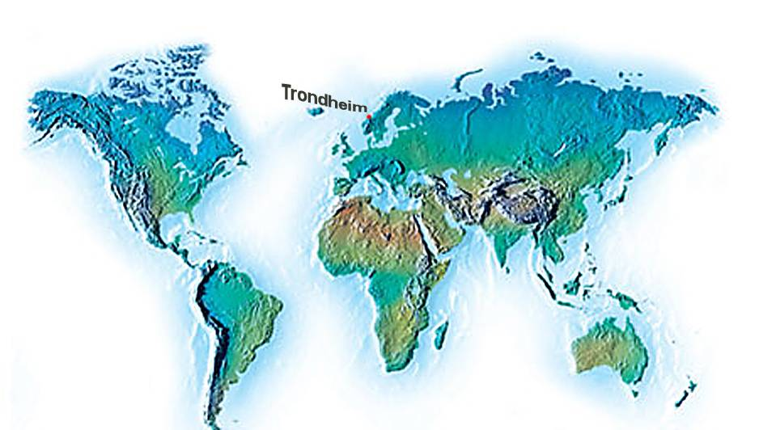
INTRO
May 2013
Notes:
Norway: Population 5.0 million. Trondheim, at 63º N 7º E. 176 348 inhabitants (01.01.2012; www.ssb.no/beftett/tab-2011-06-17-02. html)
The Norwegian University of Science and Technology (NTNU) is the second largest university in Norway, with 22 300 students and a staff providing 5000 person-years of work. Norway is part of the Scandinavian peninsula on the northern outskirts of Europe. About two-thirds of Norway is mountainous, just 4 per cent of its land area is arable, and its indented coastline of some 50 000 km is dotted with at least 50 000 islands.
Modern transport makes far away close at hand: Værnes, Trondheim’s airport, has dozens of flights to/from Oslo every day, as well as direct connections with all Norwegian cities, and international direct connections to several European cities on scheduled flights. There are frequent train connections with Oslo and the north. The coastal express liner service (“Hurtigruten”) has daily departures for Bergen to the south and Kirkenes at the Russian border in the far north.
Ocean currents moderate the climate: Trondheim has a milder climate in winter than its latitude might suggest, because it is at the receiving end of the North Atlantic Drift, the northern extension of the Gulf Stream. Visitors can expect two to three months of snow in winter, but few really cold spells. In the summer, expect temperate changeable conditions and a few periods of warm weather.

Slide 3
INTRO
An international university
Main focus: Europe, China, international mobility, international research training
About 350 MoUs related to international cooperation for research and education
10 % of NTNU’s students are foreign nationals
30 % of NTNU’s PhD candidates are international
25 % of NTNU’s academic staff is international
May 2013
Notes:
See separate slide series on Internationalization.
MoU = Memorandum of Understanding
The number of international PhD-candidates from FS: of the 2382 registered 850 have foreign citizenship [May 11 2012]
The number for international academic staff is from the NTNU personnel section (counted last in 2008).
Illustration: The emblem for the Globalisation Program at NTNU.

Slide 4
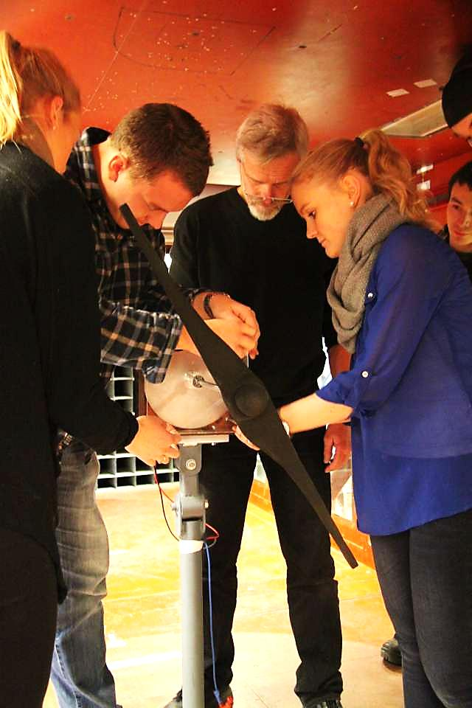
INTRO
University for technology and the arts
Norway’s primary institution for educating MSc-level engineers and scientists. Also comprehensive programmes in social sciences, teacher education, the arts and humanities, medicine, architecture and fine art.
Cross-disciplinary research delivers creative innovations with far-reaching social and economic impact.
NTNU has most courses in Norway in technology and art and aesthetic subjects.
May 2013
Notes:
From the cover of «Highlights of NTNU», at
www.ntnu.no/c/document_library/get_file?uuid=e9530ffd-3a21-49d4-8ad3-03764266732e&groupId=314472
Picture: Students testing propellers (and generators) in the wind tunnel, supervised by Prof. Lars Sætran (in the middle) at the Dept. of Energy and Process Engineering. Photo: Mentz Indergaard/NTNU Info.

Slide 5
INTRO
NTNU key figures (2012)
49 departments in 7 faculties
NTNU University Library
NTNU University Museum
11 865 student applications with NTNU as first choice
22 349 registered students, 7752 admitted in 2012
3 326 Bachelor and Master degrees awarded
374 doctoral degrees awarded (36 % women)
4 972 person-years
3 009 employed in education and research; 629 full professors
EUR 714 mill. budget
585 000 m² of owned and rented premises
May 2013
Notes:
The source for the number of primary applicants (applicants that have NTNU listed as their first choice) is from dbh.nsd.uib.no . The term “primary applicants” only applies to those applicants coordinated through UCAS, the Norwegian Universities and Colleges Admissions Service. The number does not include those applying directly to NTNU for a higher degree, for the cand.psychol. degree in psychology, applicants for the spring semester and applicants to The Trondheim Academy of Fine Art and performance studies in music (as a result of required entrance exams for admission).
The difference of approximately 3,000 between those accepted and the number of graduates is explained in this way: Those who graduate have completed a course of study here, for example in technology (MSc). Among those accepted, many will not complete a course of study for a lower/higher degree at NTNU. Some do not show up despite accepting a place at the university, some leave after a few weeks/months, some are accepted into studies of a shorter duration on the basis of main studies at another university, and some only follow individual courses as part of their continuing education.
The admissions process may be divided into five stages: 1) Submitted applications; 2) Qualified applicants; 3) Study offers; 4) Acceptance of the study offer; 5) Arriving at the university and paying the semester fee. (Numbers for categories 1) and 5) are found in the DBH, the Database for Higher Education (dbh.nsd.uib.no.)
The number of registered students is taken from ”Studentrapport/Registrerte studenter (Totalt/studenter)” for NTNU in the DBH – dbh.nsd.uib.no) for 2012.
The number of degrees awarded is from the relevant tables in dbh.nsd.uib.no, as is the number of PhDs awarded from NTNU.
The number of employees ”Tilsatterapporter/Tilsatte” in DBH – dbh.nsd.uib.no for 2012 (Institusjon-stillingsgruppe-stillingskategori-stillingskode = Undervisnings-, forsknings- og formidlingsstilling). The number of full professors, adjunct professors (“prof. II”) not included, is from the same table, code 1013.
The budget number is from “Sum driftsinntekter” in the Økonomi section of dbh.nsd.uib.no (Here 1 Euro is set at 7.5 NOK).
The space estimate is taken from the category “Arealer/Arealdata” for 2012 in dbh.nsd.uib.no.
Picture: Monodisperse beads (beads with exactly the same diameter), known as ”Ugelstad beads”. Photo: Dept. of Chemical Engineering, NTNU.

Slide 6
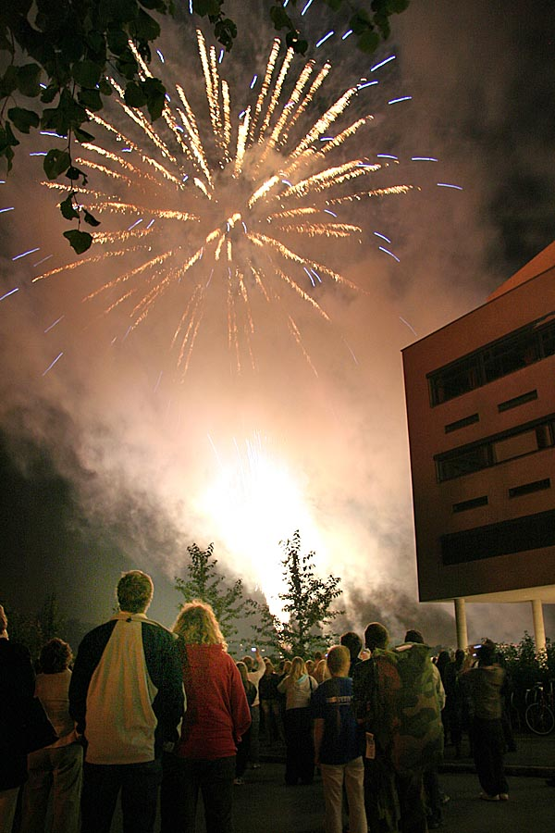
INTRO
NTNU’s vision: Knowledge for a better world
Set standards for knowledge development.
Create economic, cultural and social value.
Use NTNU’s main scientific profile in technology and the natural sciences, scientific breadth and interdisciplinary competence to help meet the challenges facing Norway and the world.
May 2013
Notes:
From NTNU’s strategy ”Knowledge for a better world” approved by the NTNU Board March 30 2011
See www.ntnu.edu/strategy
Fireworks and pyrotechnics in front of the Natural Science Building at the end of Researchers' Night Friday 22 September 2006.
Photo: Eirik Fyhn / NTNU IVT

Slide 7
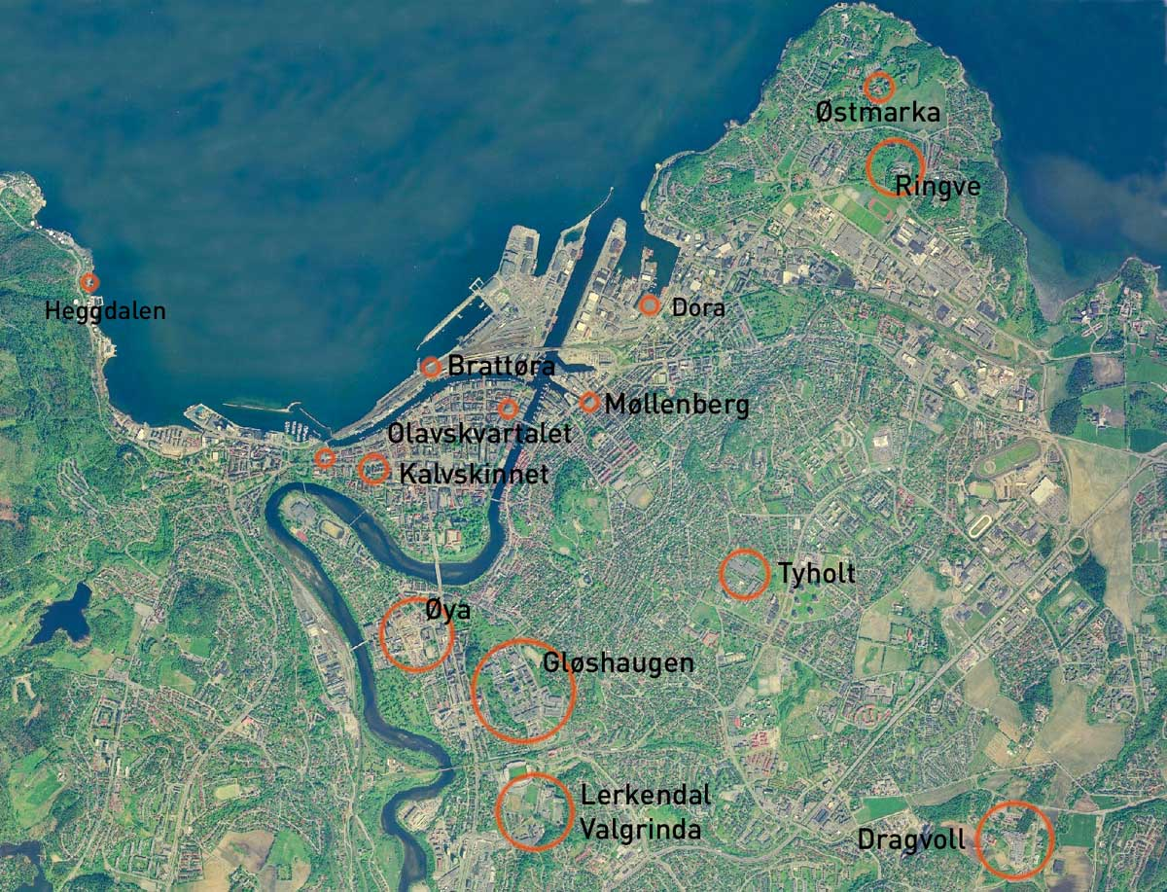
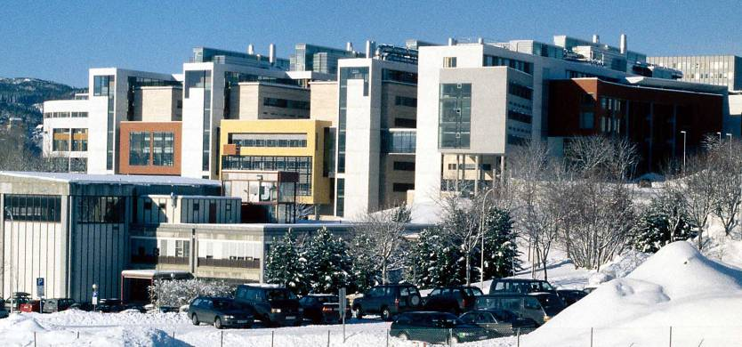
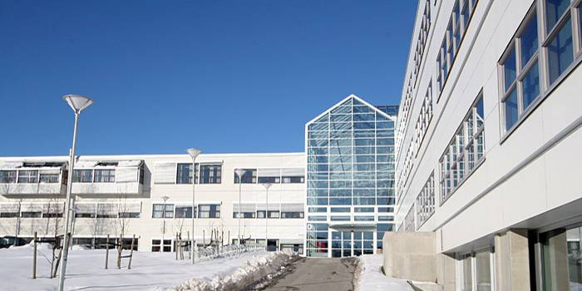
INTRO
NTNU in Trondheim
May 2013
Notes:
See a complete list at www.ntnu.edu/map/ A complete description of the campuses can be found at www.ntnu.edu/livingintrh/ntnu-campuses
Pictures:
Left: Natural Science Building, Campus Gløshaugen, February 2000. Photo: Mentz Indergaard/NTNU Info.
Right: The main entrance to the Dragvoll campus, facing southeast, March 2008. Photo: Mentz Indergaard/NTNU Info.

Slide 8
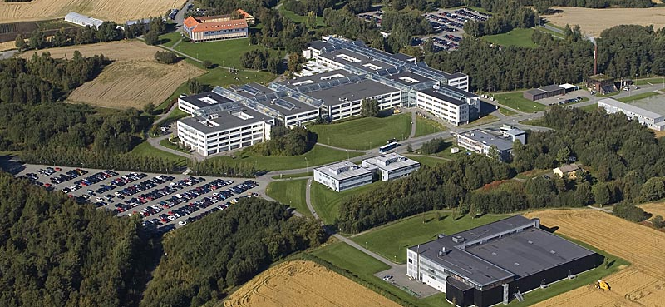
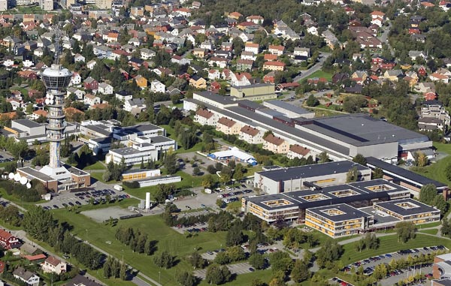
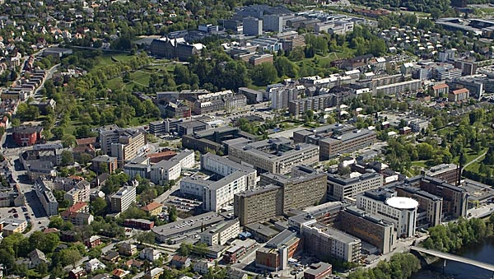
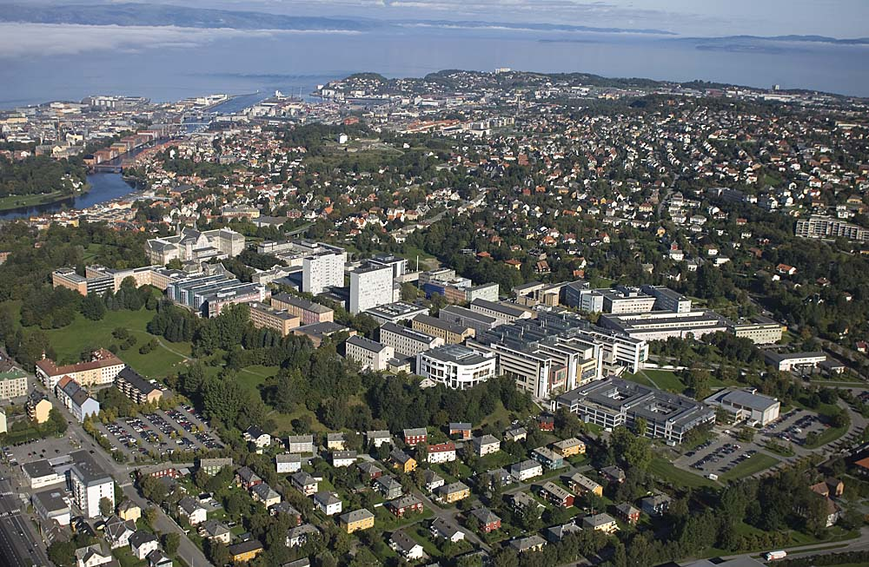
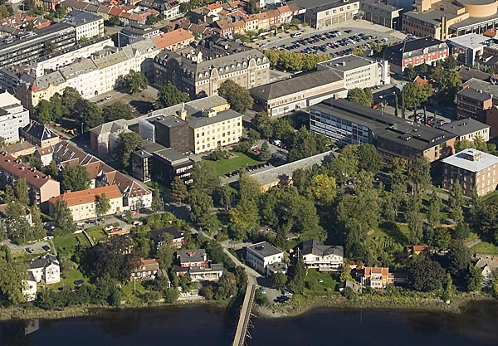
INTRO
Tyholt
Dragvoll
Øya
Kalvskinnet
Gløshaugen
May 2013
Notes:
Pictures:
Top left: Dragvoll campus. September 2009. Bottom left: Gløshaugen campus from southwest, Sept. 2009.
Top right: Centre for Marine Technology, including NTNU’s Dept. of Marine Technology, Sept. 2009.
Middle right: St. Olavs Hospital; university hospital with NTNU’s Faculty of Medicine. May 2009.
Bottom right: Kalvskinnet area with NTNU University Museum, with the Nidelva River in the foreground. Sept. 2009.
All photos: Erik Børseth, Synlig design og foto as/NTNU Info.
Distribution of students at each campus: (pr. 2012) Dragvoll – 43.4 %; Gløshaugen – 48.5 %; Tyholt – 2.7 %; Øya – 5.2 %. (Kalvskinnet – NTNU University Museum – has a minor number of graduate students in biology and archeology.)
The percentage distribution of campus space (per 2009): Gløshaugen with Lerkendal: 60 % (13 000 rooms; 60 buildings); Dragvoll: 14 %; Øya: 13 %; Kalvskinnet: 4 %; Tyholt: 4 %; Olavskvartal + Industribygget: 4 %. Rest: 1 %.

Slide 9
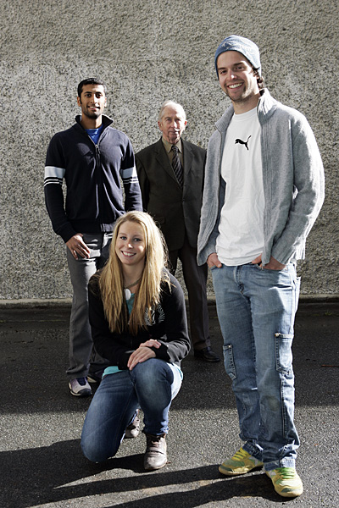
INTRO
NTNU Alumni
A professional network for NTNU
Arena for contact with the community at large, business and industry
Goal: Networking and knowledge-sharing
28 000 members (2013)
Worldwide networks
May 2013
Notes:
From NTNU Alumni, May 2013
Contact: alumni@ntnu.no
www.ntnu.no/alumni
Picture: NTNU Alumni members, Aug. 2007. Photo: Gorm Kallestad, Scanpix/NTNU Info

Slide 10
INTRO
NTNU’s values
Creative
Constructive
Critical
Respectful and caring
May 2013
Notes:
From NTNU’s strategy, ”Knowledge for a better world″, approved by the NTNU Board March 30 2011
See www.ntnu.edu/strategy
Illustration: NTNU Info

Slide 11
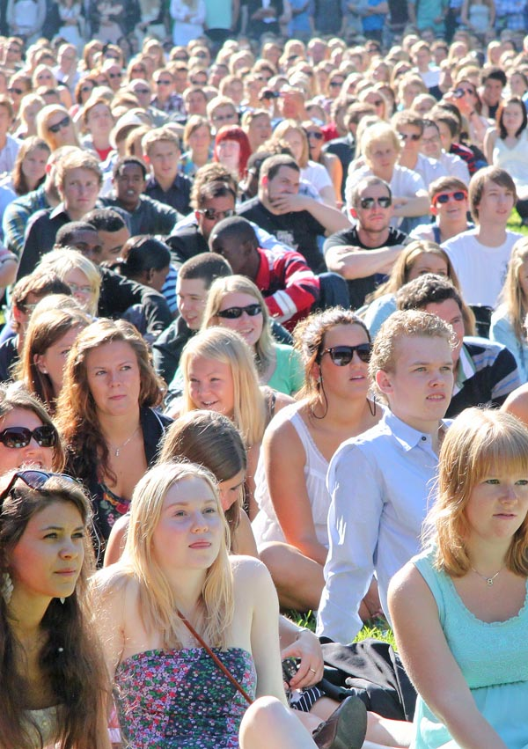
INTRO
NTNU’s mission in society
In general Research and development; education based on our research; disseminate knowledge; be a positive influence in society; stimulate to innovation.
In particular Develop science and technology to address global challenges.
For democracy and solidarity Participate in public debate; find solutions to global challenges; promote human rights and intercultural dialogue.
May 2013
Notes:
From NTNU’s strategy, ”Knowledge for a better world″, approved by the NTNU Board March 30 2011
See www.ntnu.edu/strategy
Picture: New students at matriculation day, August 2010. Photo: Mentz Indergaard/NTNU Info.

Slide 12
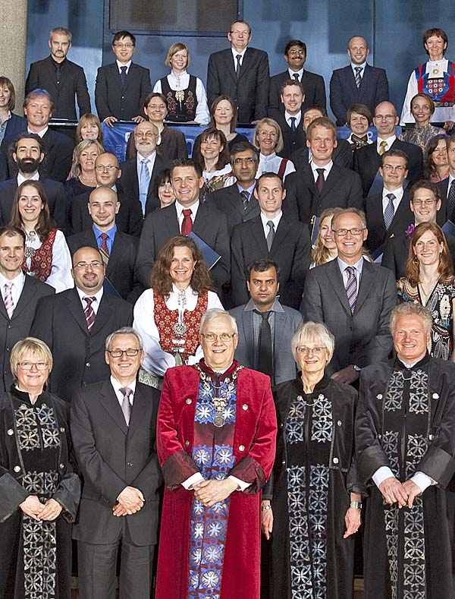
INTRO
Main objectives
International level cooperation with leading research groups.
First-class laboratories and infrastructure.
Attract top students and staff.
Students and staff who are proud of being part of NTNU.
May 2013
Notes:
From NTNU’s strategy, ”Knowledge for a better world″, approved by the NTNU Board March 30 2011
See www.ntnu.edu/strategy
Picture: From the 2010 Doctoral Degree Awards Ceremony, with NTNU’s rector in the centre. Foto: Thor Nielsen/NTNU Info.

Slide 13
Sources of revenue (EUR million)
INTRO
May 2013
Notes:
Numbers are generated from Note 1 to the NTNU accounts, an appendix in the university’s Annual Report (2011-2012) to the Ministry of Education and Research, and (for 2012) Økonomi at http://dbh.nsd.uib.no/
(Blue column) Ministry of Education & Research and other ministries.
(Red column) The Research Council of Norway.
(Yellow column) Business.
(Green column) State/municipal: Sum of “State institutions” + “Counties/Municipalities”.
(Light blue column) European Union (EU).
(Grey column) Other: “Organizations” + “Foundations” + “Other + “Sale of real estate, equipment, etc.” + “Sum other income”.
The year-by-year total for NTNU is in mill. Euro (here 1 Euro = 7.5 NOK): 385 (2002); 419 (2003); 467 (2004); 481.6 (2005); 501.6 (2006); 561 (2007); 589 (2008); 636.4 (2009); 679.7 (2010); 698.8 (2011); 714.1 (2012)

Slide 14
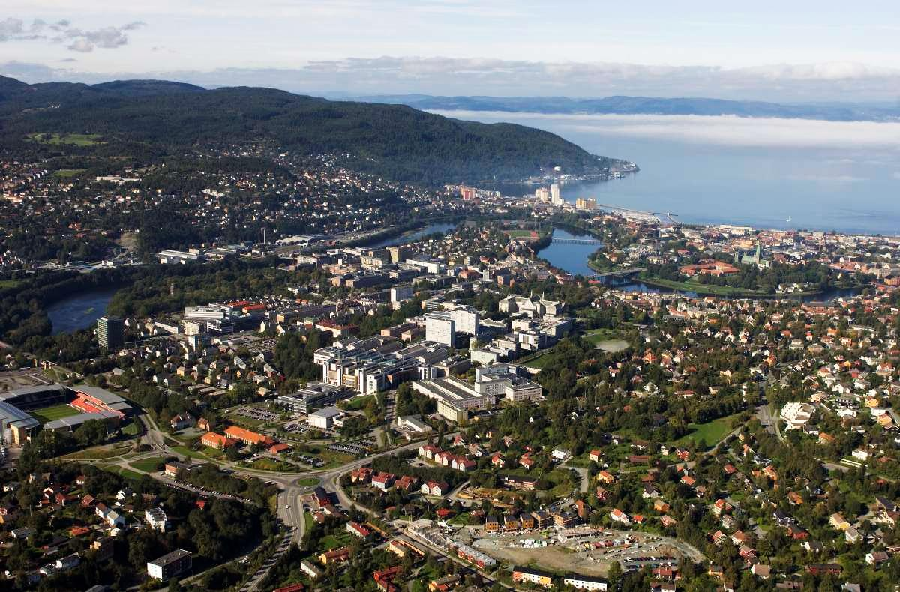
INTRO
May 2013
Notes:
Aerial photo of NTNU (Gløshaugen campus in foreground) and Trondheim from southeast, 15 September 2009.
Foto: Erik Børseth, Synlig design og foto as/NTNU Info.

Slide 15
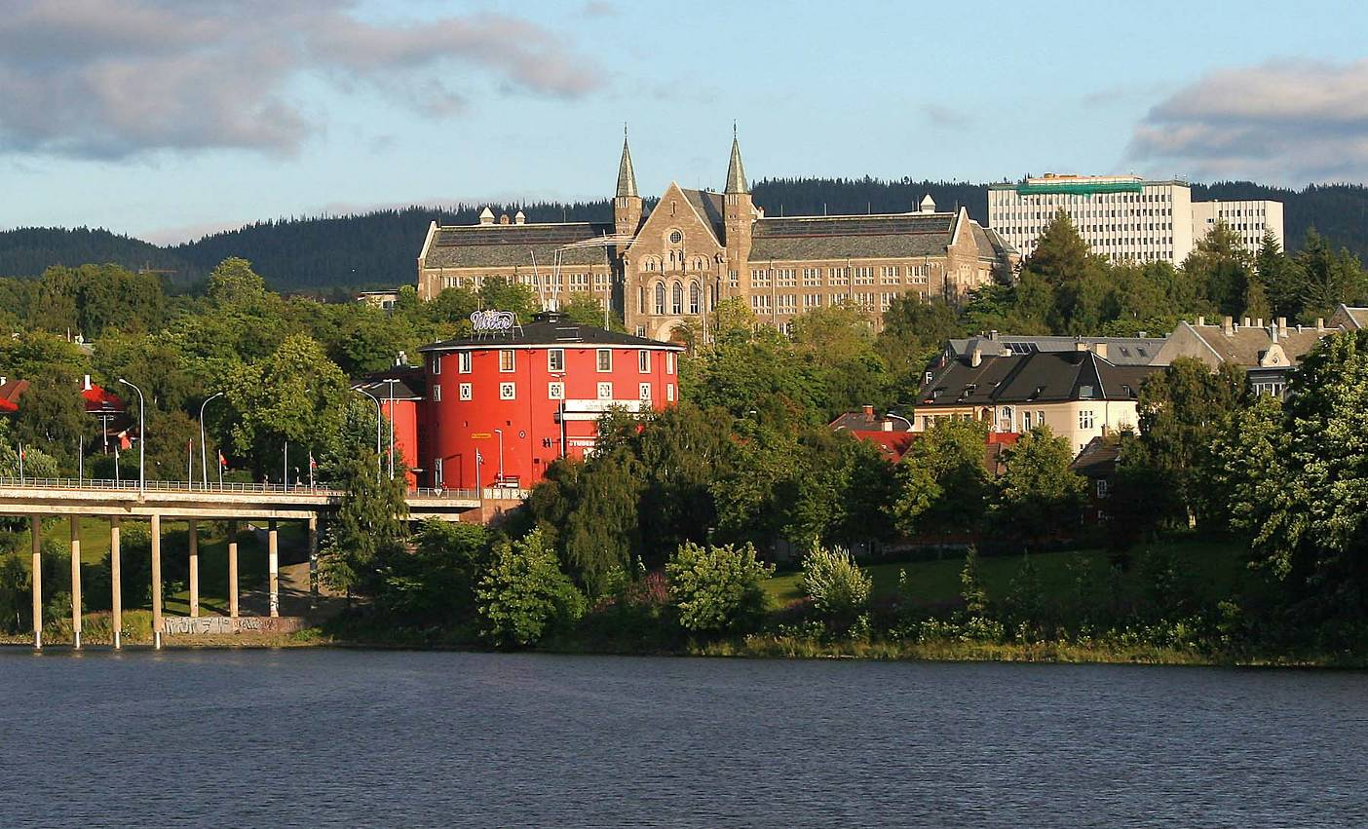
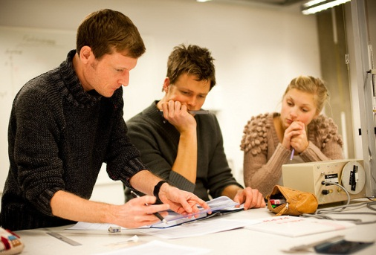
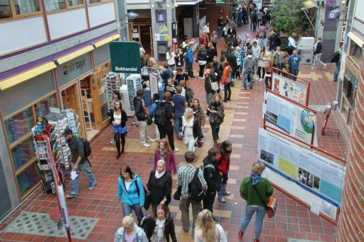
INTRO
May 2013
Notes:
Pictures:
Top: Student Society Building in front of the Main Administrative Building at NTNU (Gløshaugen campus), summer 2005. Photo: Mentz Indergaard/NTNU Info.
At left: First-year technology students studying for their mathematics course in the cafeteria of the Natural Sciences Building, 17 Sept. 2009, Gløshaugen campus, NTNU. Photo: Johan Røed. IVT, NTNU.
In the middle student assistants help with a physics laboratory exercise (course TFY4102), Mechanical oscillating systems. C4, the Natural Sciences Building, Gløshaugen Campus, NTNU. Feb 22 2010. Photo: Johan Røed, IVT, NTNU.
At right: “Open house” at Dragvoll campus 1 Sept. 2010 in connection with NTNU’s centennial celebration. Photo: Mentz Indergaard/NTNU Info.

Slide 16
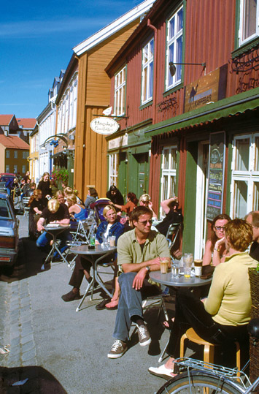
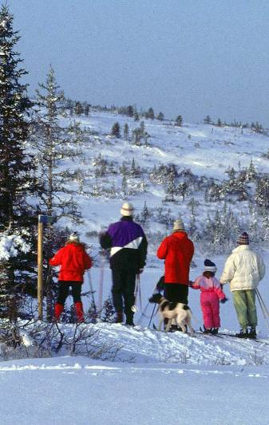
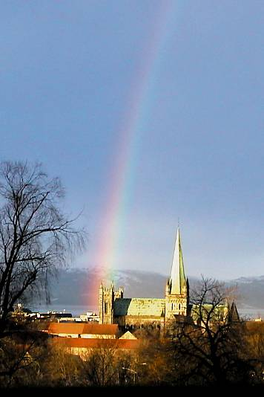
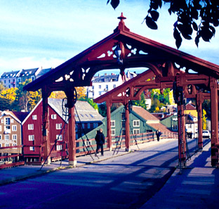
INTRO
May 2013
Notes:
Life in Trondheim:
Left: Coffee bar in Bakklandet. Photo: Norsk Bildebyrå/NTNU Info.
Winter photo: Skiing in Bymarka (across Vintervannet lake). Photo: Norsk Bildebyrå/NTNU Info.
Rainbow over Nidaros Cathedral, autumn 1999. Photo: Kenneth Aar/NTNU Info.
Bottom: Gamle Bybro bridge, Bakklandet, October 2001. Photo: Mentz Indergaard/NTNU Info.

Slide 17
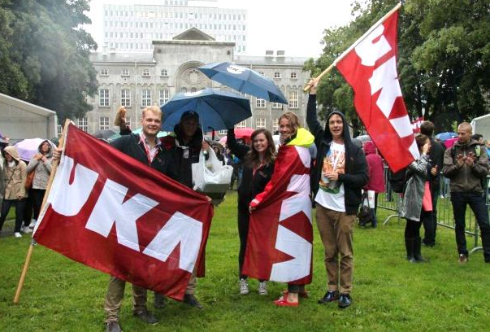
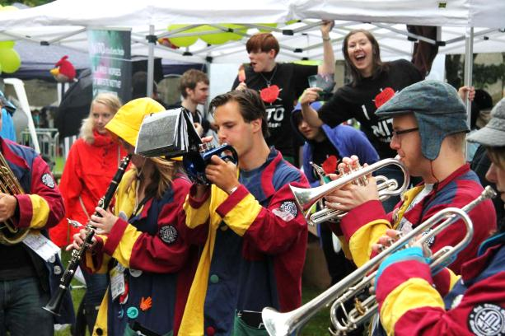
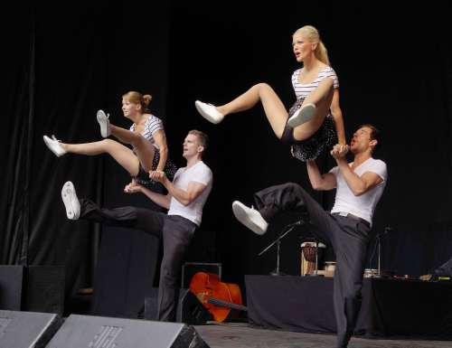
INTRO
The best student town in Norway
One in five inhabitants in Trondheim is a student
The Student Union (Studentersamfundet) has 8 000 members and its own building
UKA, the student week, is Norway’s largest cultural festival
ISFiT, the biannual International Student Festival in Trondheim
NTNUI is Norway’s largest sports association with 12 000 members
May 2013
Notes:
In 2012 the total number of students in Trondheim studying at NTNU, Sør-Trøndelag University College and other local institutions of higher learning was: NTNU 22349, Høgskolen i Sør-Trøndelag (HiST) 8159, Høgskolen Dronning Mauds Minne 1155, Luftkrigsskolen ca. 100, Folkeuniversitetet ca. 400 and Trondheim BI 1485. Total ca. 33 700. (Sourvces: DBH, hogskolene.forsvaret.no/luftkrigsskolen/omlksk/Sider/default.aspx and www.folkeuniversitetet.no/digiport/software/CuteEditorV66/aspedit/uploads/jussbrosjyre_trondheim.pdfTrTrondheim’s population as of 01.01.2012 was 176 340; www.ssb.no/beftett/tab-2011-06-17-02.html, with approximately 70,000 households. In addition to residents, about 23,000 students live in the city, but formally reside in their respective home counties. To estimate the actual population for Trondheim, we must also subtract about 2,000 students whose registered address is Trondheim, but who live and study elsewhere. The actual resident population is thus probably higher than 180,000. See www.trondheim.kommune.no -> om kommunen/fakta og tall/befolkningsstatistikk and www.trondheim.com ->om Trondheim/Trondheim i dag.
NTNUI = The Student Sports Association at NTNU - www.ntnui.no/main/Page/43.xhtml?lang=en
Pictures from left:
1) Enrolment Day at NTNU Tuesday 16 Aug 2011. Volunteers from the Student festival “UKA-11”. Photo: Mentz Indergaard/NTNU Info.
2) Enrolment Day at NTNU Tuesday 16 Aug 2011. The Student Orchestra "Dei taktlause" of the union of electronics students. Photo: Mentz Indergaard/NTNU Info
3) Enrolment Day at NTNU 2012. NTNUI Dance group. Photo: Mentz Indergaard/NTNU Info

Slide 18
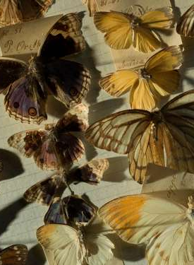
Research
INTRO
Six strategic research areas
Four Centres of Excellence
Four Centres of Research-Based Innovation
Two Centres for Environment- friendly Energy Research
More than 100 laboratories
Several other large research programmes (NanoLab, HUNT)
May 2013
Notes:
See more on research in the series on Research and artistic activities.
Picture: From the butterfly collection at NTNU University Museum. Photo: Åge Hojem/NTNU VM.

Slide 19
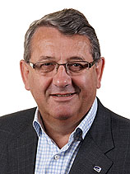
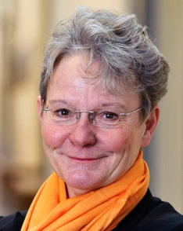
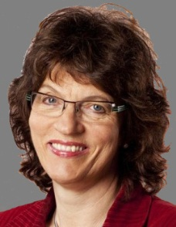
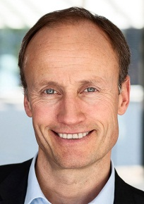
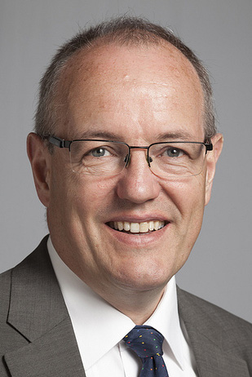
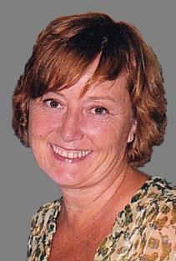
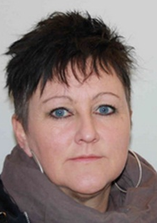
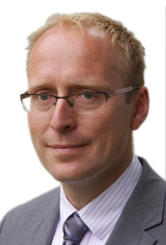
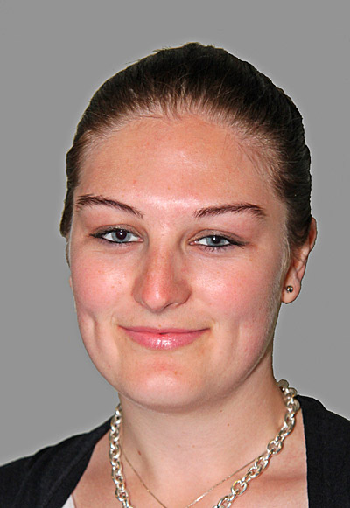
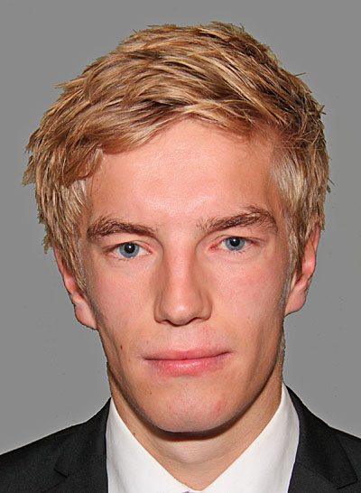
INTRO
The Board – NTNU’s governing body
Per Kristian Foss (Chair)
Karin Röding (external)
Randi Wenche Haugen (external)
Nils Kristian Nakstad (external)
Bjarne Foss (academic staff)
Kristin Melum Eide (academic staff)
Helge Holden (academic staff)
Marit Grønning-Moe (techn. adm. staff)
Gunnar Bovim (Rector and Secretary to the Board)
Magnus Steigedal (acad. staff w/o tenure)
Merete Falck (student)
Haakon Utby (student)
May 2013
Notes:
The Board is the highest governing body at NTNU.
The Board makes decisions on issues of principal importance. The Board is responsible for activities at the university and for ensuring that the university operates within the framework and guidelines stipulated by the Ministry of Education and Research, and the Storting. The Board decides the strategies, objectives and the expected results from NTNU. It also presents the accounts, financial statements and budget proposals. The Board appoints the Rector. [Rector = Vice-Chancellor (UK) = President (USA)]
The Rector is the Secretary to the Board and the head of academic and administrative affairs at NTNU.
The Rector reports to the Board and represents NTNU on a day-to-day basis. The Rector is responsible for communications between the Board and the outside world regarding decisions passed by the Board.
There are 11 members of the Board. Three are from the academic staff at NTNU, one represents academic or research staff without tenure, one represents the technical and administrative staff. There are also two student members of the Board and four external representatives (all from outside the university). All members are elected for a four-year term, except for the two student representatives and the representative for academic or research staff without tenure who are elected for one year.
Members of the Board as of 1 August 2013 are:
External repr.: Per Kristian Foss (Chair, member of Norwegian Parliament), Karin Röding (rector at Mälardalens College, Eskilstuna, Sweden), Randi Wenche Haugen (CEO, Olavsfestdagene), Nils Kristian Nakstad (CEO, Enova).
Academic staff: Professor Bjarne Foss, Dept. of Engineering Cybernetics; professor Kristin Melum Eide, Dept. of Language and Literature; professor Helge Holden, Dept. of Mathematical Sciences.
Non-tenured faculty: Magnus Steigedal, Faculty of Medicine.
Technical/administrative staff: Marit Grønning-Moe, Technical Division.
Students: Merete Falck and Haakon Utby (1 Aug. 2012– 31 July 2013). (see www.ntnu.edu/board)
Photos:
Foss: Stortinget.no - http://www.stortinget.no/no/Stortinget-og-demokratiet/Galleri/Stortingsrepresentantene/?acrid=F
Røding: Jerker Berglin, http://www.mdh.se/hogskolan/pressinfo/pressbilder-1.1534
Haugen: Olavsfestdagene; http://www.olavsfestdagene.no/om-oss/
Nakstad: Enova - http://www.enova.no/presse/pressesenter/pressebilder/266/0/
Bovim: Thor Nielsen, Trondheim/NTNU Komm.avd.
Foss: Rune Petter Ness, Trondheim/NTNU Komm.avd.
Melum Eide: https://twitter.com/KristinMEide
Grønning-Moe: Universitetsavisa, http://www.universitetsavisa.no/politikk/article16866.ece
Steigedal, Holden, Falck, Utby: Mentz Indergaard/NTNU Komm.avd.

Slide 20
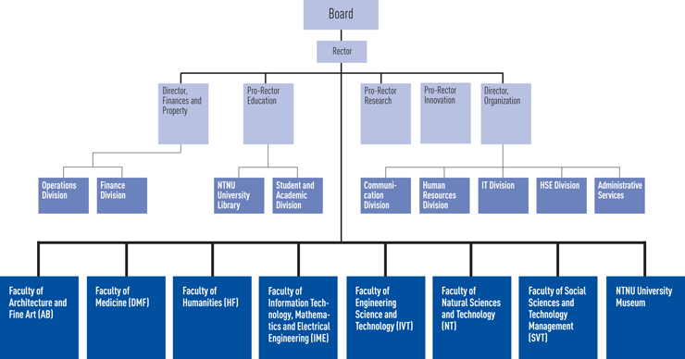
INTRO
NTNU’s organization
May 2013
Notes:
Source: http://www.ntnu.edu/orgmap
[Rector = Vice-Chancellor (UK) = President (USA)].
The faculties and their departments, see http://www.ntnu.edu/faculties

Slide 21
INTRO
Trondheim’s academic history
1217 Schola Cathedralis Nidarosiensis
1760 Royal Norwegian Society of Sciences and Letters
1910 Norwegian Institute of Technology (NTH)
1922 Norwegian Teacher Training College
1950 SINTEF (The Foundation for Scientific and Industrial Research at the
Norwegian Institute of Technology)
1955 The Norwegian Academy of Technological Sciences (NTVA) (Trondheim)
1968 University of Trondheim
1973 Trondheim Conservatory of Music
1974 Section for Medicine (From 1984: Faculty of Medicine)
1979 Trondheim Academy of Fine Art
1984 College of Arts and Science
1996 Norwegian University of Science and Technology (NTNU)
2010 Celebration of Trondheim’s 250 years as academic city
May 2013
Notes:
The Norwegian University of Science and Technology was established on 1 January 1996, as a result of the reorganization of the University of Trondheim. The university has its foundation in three institutions: the Norwegian Institute of Technology (NTH), the College of Arts and Science (previously Norw. Teacher Training College establ. 1922), and the Museum of Natural History and Archaeology (1760). The Faculty of Medicine, the Trondheim Conservatory of Music and the Trondheim Academy of Fine Art were also included as a part of NTNU in the 1996 reorganization.
See: www.ntnu.no/2010 and www.ntnu.edu/2010/history ; www.sintef.no/Home/About-us/History/ ; www.ntva.no/index.php?option=com_content&view=article&id=93
Sources:
Brandt, T. og O. Nordal. 2010. Turbulens og tankekraft. Historien om NTNU. Oslo: Pax. Stubhaug, Arild. 2009. DKNVS – Norges første vitenskapsselskap 250 år. Trondheim: Tapir Akademisk. (populærutgave)
Stubhaug, Arild. 2010. Den lange linjen: historien om Videnskabsselskabet i Trondheim. Trondheim: Tapir akademisk Devik, Olaf. 1960. N.T.H. Femti år. Oslo: Teknisk Ukeblad. Kirkhusmo, Anders. 1983. Akademi og seminar. NLHT 1922–1982. Trondheim: UNIT – NLH/Tapir. Hanisch, T.J. og E. Lange. 1985. Vitenskap for industrien. NTH – En høyskole i utvikling gjennom 75 år. Oslo/Trondheim: Universitetsforlaget. Midbøe, Hans. 1960. Det Kongelige Norske Videnskabers Selskabs historie 1760–1960. Bd. I-II. Trondheim: DKNVS.
Wale, Astrid. 1997. Universitet og høgskole : Den allmennvitenskapelige høgskolen 1984-1996. Trondheim : Strindheim trykkeris forlag. With Andersen, H. et al. 2009. Aemula Lauri : the Royal Norwegian Society of Sciences and Letters, 1760-2010. Sagamore Beach, Mass.: Science History Publications. Øverås, A., A. E. Erichsen og Johan Due. 1952. Trondheim katedralskoles historie 1152–1952. Trondheim: Brun bokhandels forlag.

Slide 22
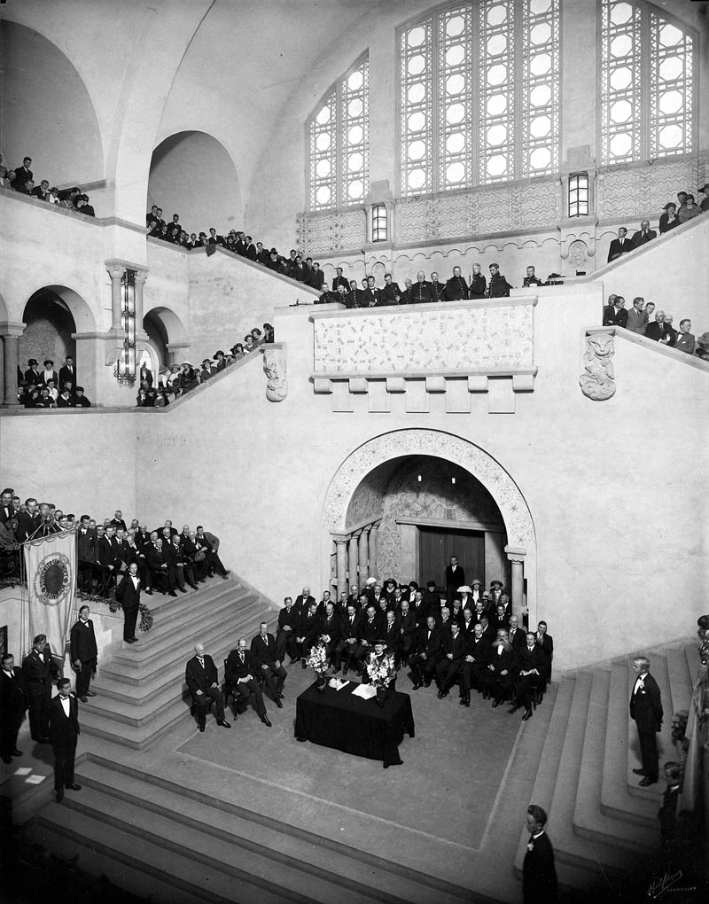
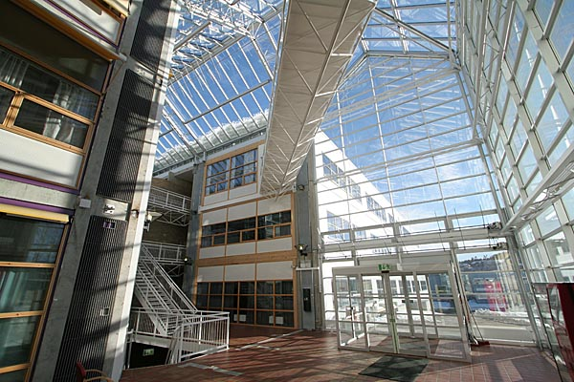
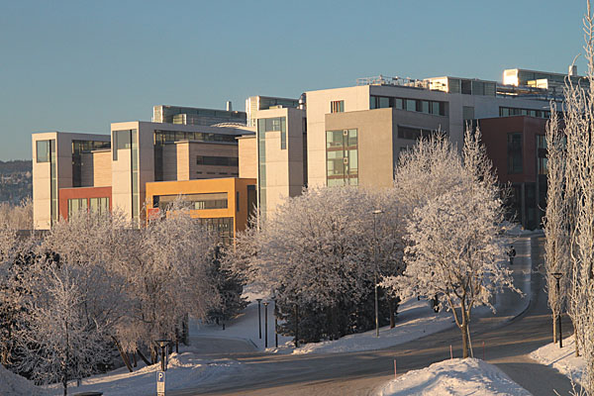
INTRO
May 2013
Notes:
At left: The Assembly Hall of the Main Administration Building, Gløshaugen campus. Enrolment Day 1 Sept. 1923 for the Norwegian Institute of Technology (opened 1910, now a part of NTNU). Photo: Hilfling-Rasmussen, Trondhjem. (Hilfing-arkivet, Spesialsamlingen, UBiT, NTNU.)
Top right: Inside the main entrance of the Dragvoll campus, facing east. March 2008. Photo: Mentz Indergaard/NTNU Info.
Middle right: Natural Sciences Building, Gløshaugen campus, January 2010. Photo: Mentz Indergaard/NTNU Info.
Bottom right: NTNU’s Museum of Natural History and Archeology (established 1760) with the artwork/pavilion ”REFLEXIONS” by Mats Olofgörs and Torbjörn Johansson on the far left. March 2010. Foto: Mentz Indergaard/NTNU Info.

